Slide 1
Spectrum of Magnetic Resonance Imaging in Complicated Choledochal Cysts
Shahad Al Bayati, Martin A. Dufwenberg, Bobby Kalb, Dheeraj Gopireddy, Neeraj Lalwani , Chandana Lall, Hina Arif
Department of Radiology
University of Arizona, Tucson AZ

Slide 2
Disclosure
The authors have no conflicts of interest to disclose

Slide 3
Learning objectives
Illustrate characteristic MR imaging approach for Todani classification of bile duct cysts.
Identify the different complications of choledochal cysts.

Slide 4
Outline
Background
Incidence and Clinical Presentation
Imaging characteristics according to Modified Todani Classification System
Choledochal Cyst Complications:
Cholangitis
Pancreatitis
Stones
Malignancy
Summary
References

Slide 5
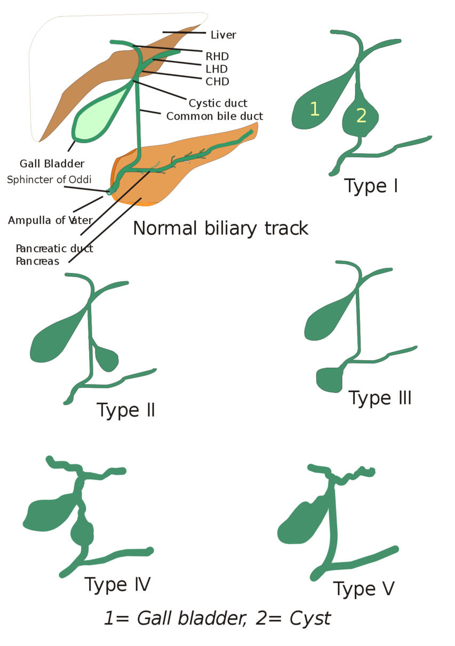
Background
Choledochal cysts are congenital anomalies of intrahepatic, extrahepatic bile ducts or both
Modified Todani Classification is the standard practice to subdivide choledochal cysts into five groups based on anatomical locations and morphological characteristics
*Graphic on right: I, Drriad, CC BY-SA 3.0, https://commons.wikimedia.org/w/index.php?curid=2309266

Slide 6
Choledochal cyst type | Incidence | Defining features
Type IA | 50%-80% | Cystic dilation of entire extrahepatic biliary tree with sparing of intrahepatic ducts
Type IB |  | Focal, segmental dilation of extrahepatic biliary tree
Type IC |  | Fusiform dilation of entire extrahepatic biliary tree extending into intrahepatic duct
Type II | 2% | Saccular diverticulum of CBD
Type III: "choledococele" | 1.4%–4.5% | Cystic dilation of intramural portion of distal CBD with bulge into the duodenum
Type IVA | 15%-35% | Intrahepatic and extrahepatic dilation of biliary ducts
Type IVB |  | Multiple dilation of extrahepatic biliary tree only
Type V: "Caroli's disease" | 20% | Multiple dilation of intrahepatic biliary ducts
* Compiled from Bhavsar et al 2012

Slide 7
Background (cont.)
Choledochal cysts are mostly present in children in the first year of life
Increasingly diagnosed in older children and adults that present with cyst complications
Biliary duct malformations are rare entities - exact etiology is unclear and remains debatable
Abnormal connection between common bile duct and pancreatic duct
Association with other developmental anomalies

Slide 8
Incidence of choledochal cysts
Western populations – 1:100,000 to 1:150,000
Higher incidence in Asian countries - up to 1:13000 in Japan
Four times more common in females than males
In the past, majority of cases were reported in children, although more recent series report equal numbers in adults and children.

Slide 9
Clinical presentation of choledochal cysts
80% of patients present before age 10
Classic triad: abdominal pain, jaundice, and a palpable mass
Most patients only have 1-2 elements of triad.
Other symptoms include nausea, vomiting, fever, pruritus, and weight loss.
Infants: obstructive jaundice and abdominal masses
Children: abdominal pain and nausea/vomiting
Adults: pain, fever, nausea/vomiting, and jaundice

Slide 10
Diagnosis of choledochal cysts
Endoscopic retrograde cholangiopancreatography (ERCP) is the most sensitive diagnostic modality
Sensitivity decreases in case of recurrent inflammation and scarring
Magnetic resonance cholangiopancreatography (MRCP) is "gold standard" for diagnosis
Sensitivity 90–100%
Non-invasive
No ionizing radiation compared to ERCP.
MRCP with magnetic resonance imaging (MRI) can image surrounding structures, stones, and malignancy

Slide 11
Complications of choledochal cysts
Cholangitis
Pancreatitis
Choledocholithiasis
Malignant transformation
Cyst rupture
Biliary obstruction
Bleeding
Gastric outlet obstruction
Gallbladder volvulus
Intussusception

Slide 12
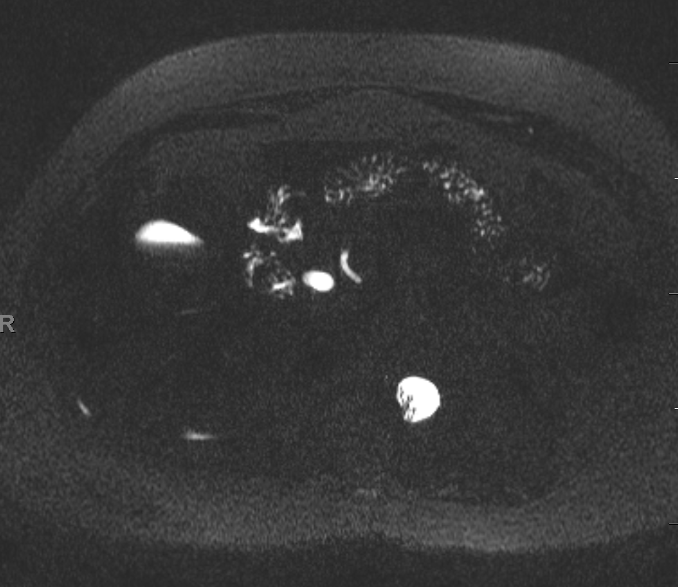
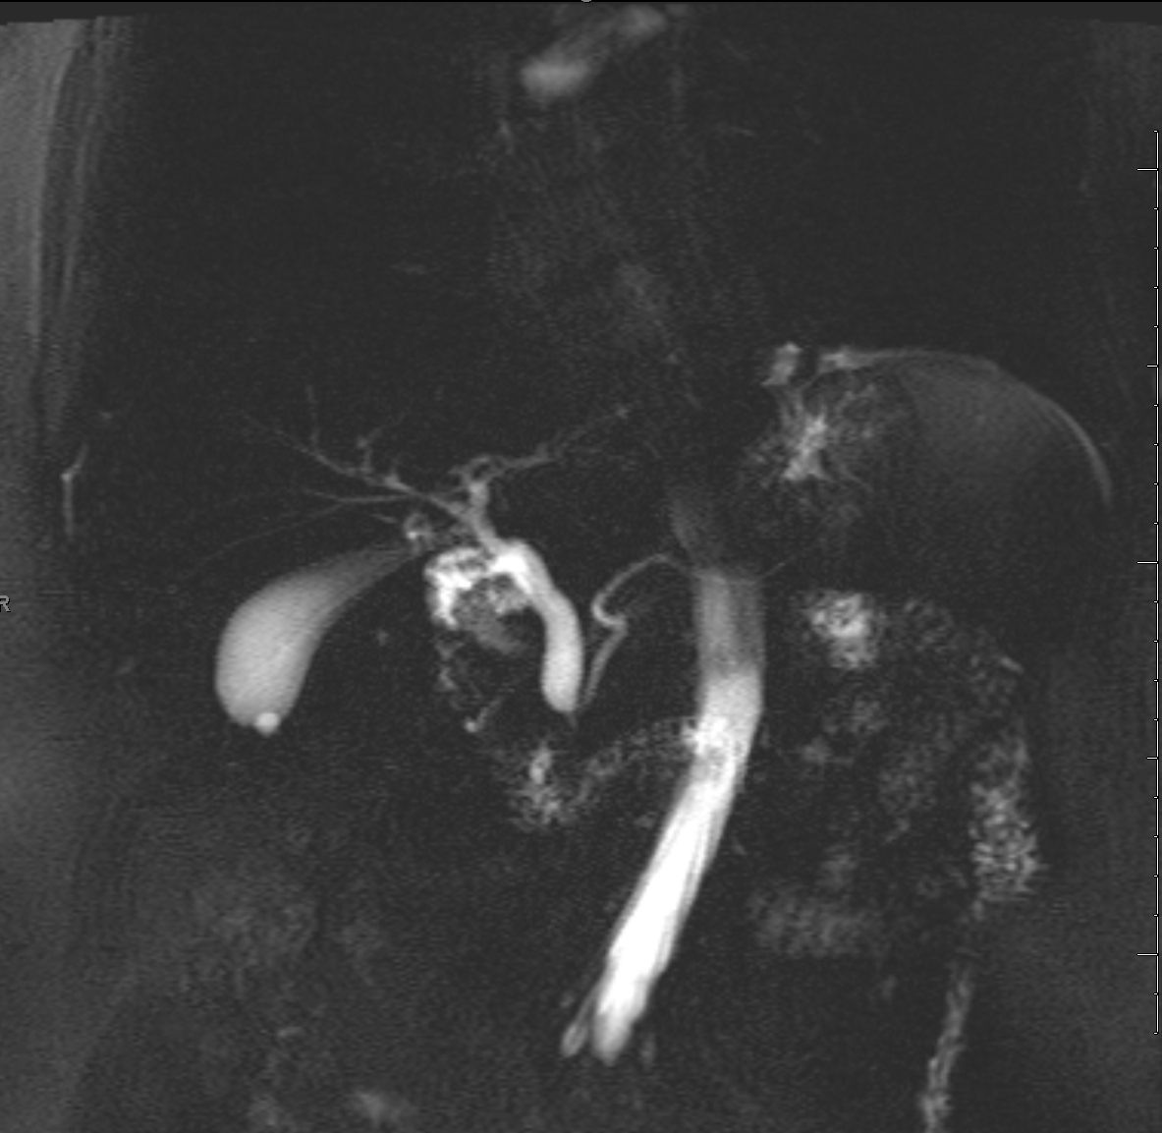
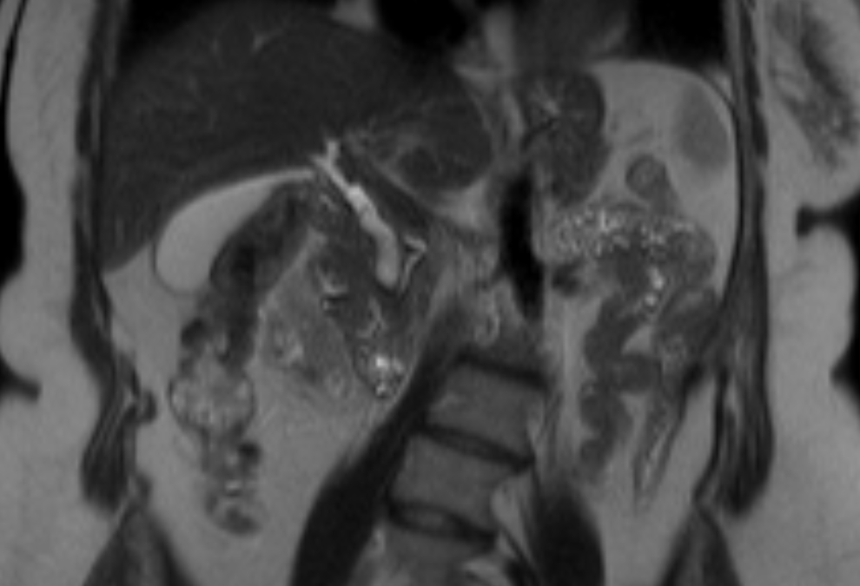
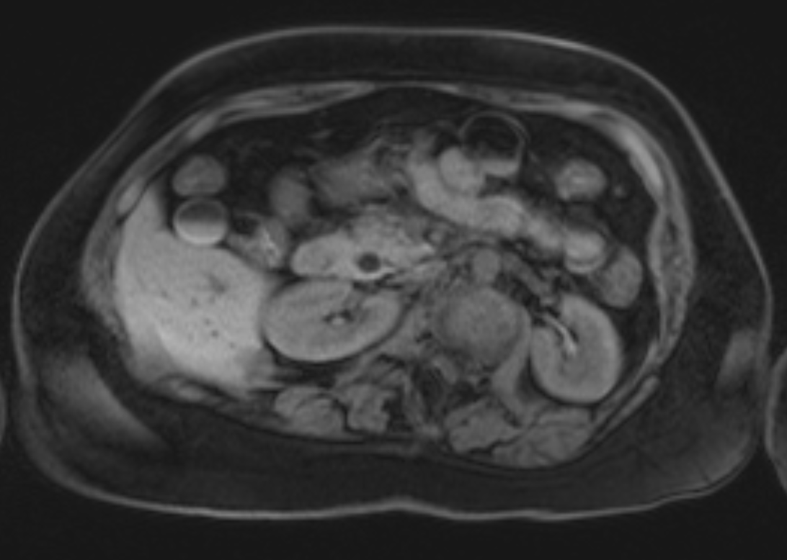
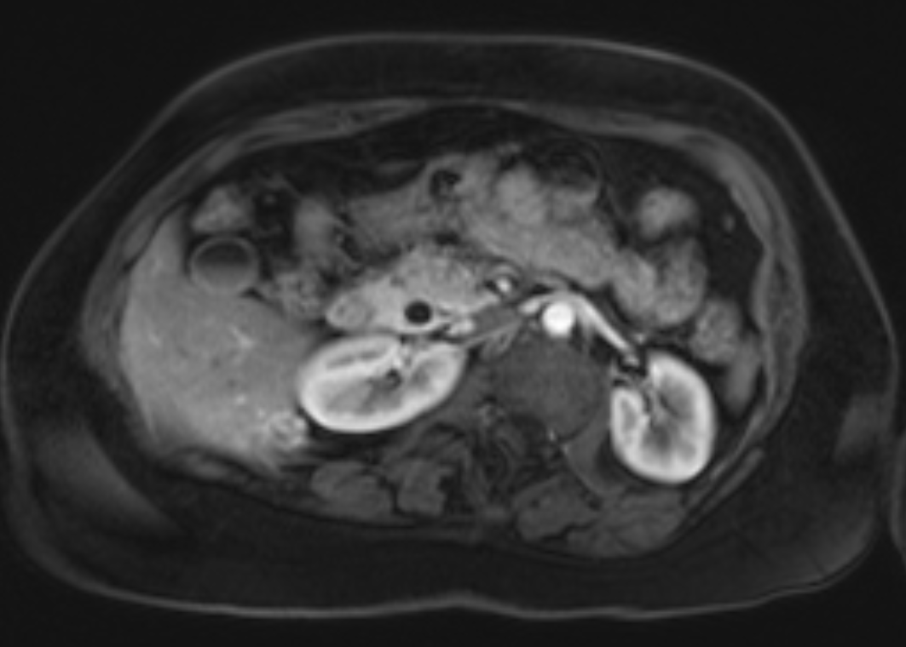
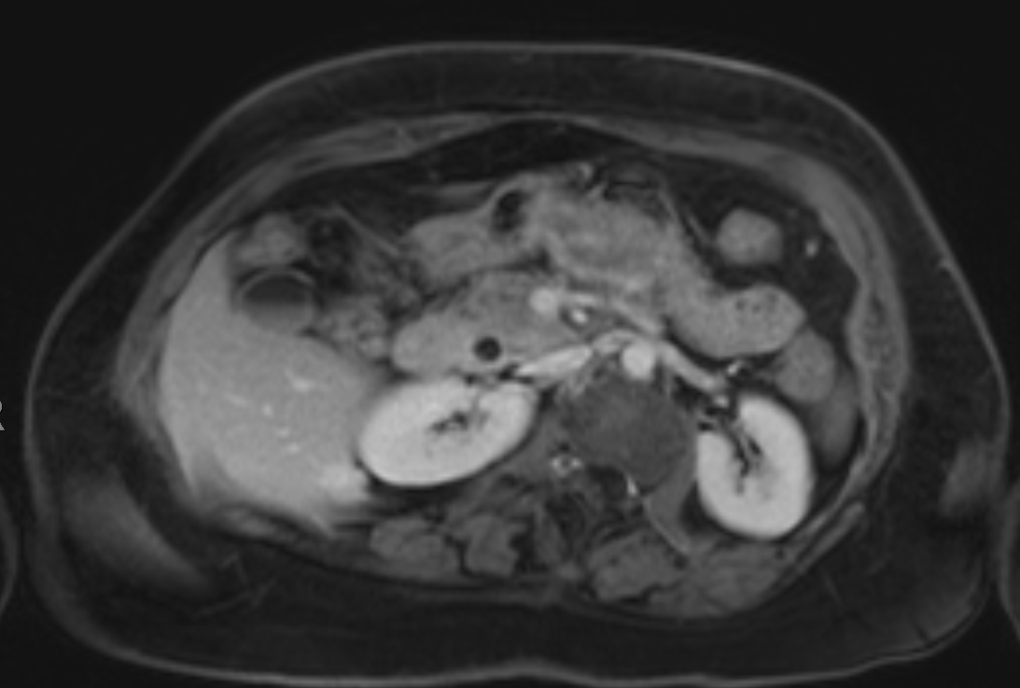
Figure 1a: axial MRCP
Figure 1b: Coronal thick slab MRCP
Figure 1c: coronal T2
Figure 1d: axial T1 precontrast
Figure 1e: axial T1 arterial phase
Figure 1f: axial T1 delayed phase
Figure 1: 35 year old female with chronic epigastric pain. MRI images show fusiform dilatation of the mid and distal common bile duct without intrahepatic biliary ductal dilatation (Fig 1a-b-c). Low signal on T1 precontrast image (Fig 1d) with no abnormal enhancement on dynamic images (Fig 1e-f). Finding is consistent with a type I choledochal cyst.
Notes:
JIMENEZ, TABITA PID: 02509701, Sex: F, D.O.B: 8/21/1963
Fusiform dilatation of the mid and distal common bile duct, measuring up to 10 mm, without associated intrahepatic biliary ductal dilatation which is most consistent with a type I choledochal cyst. Continued follow-up is recommended

Slide 13
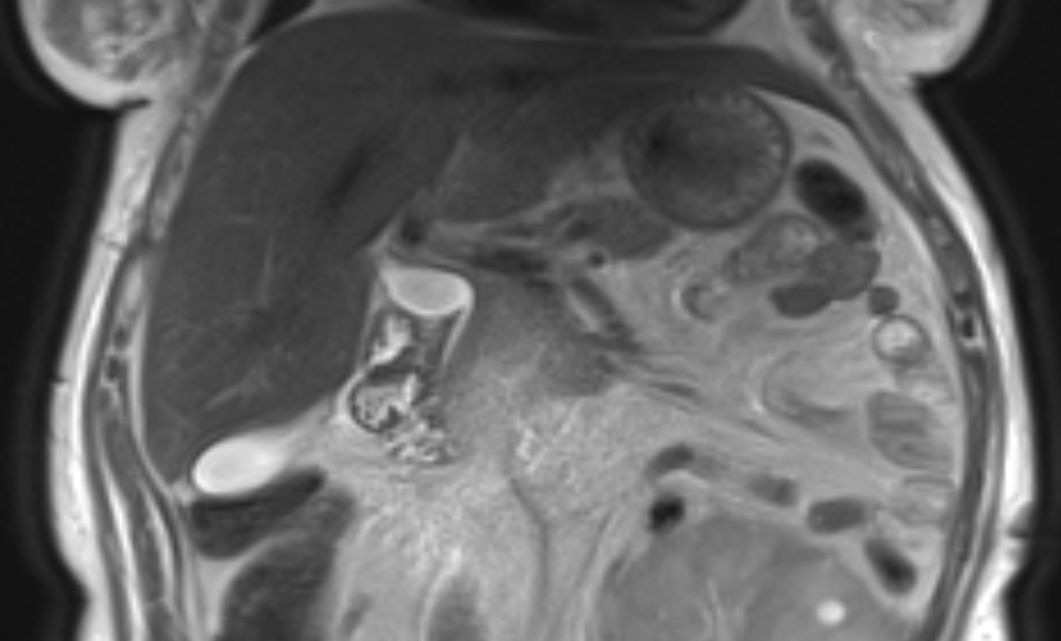
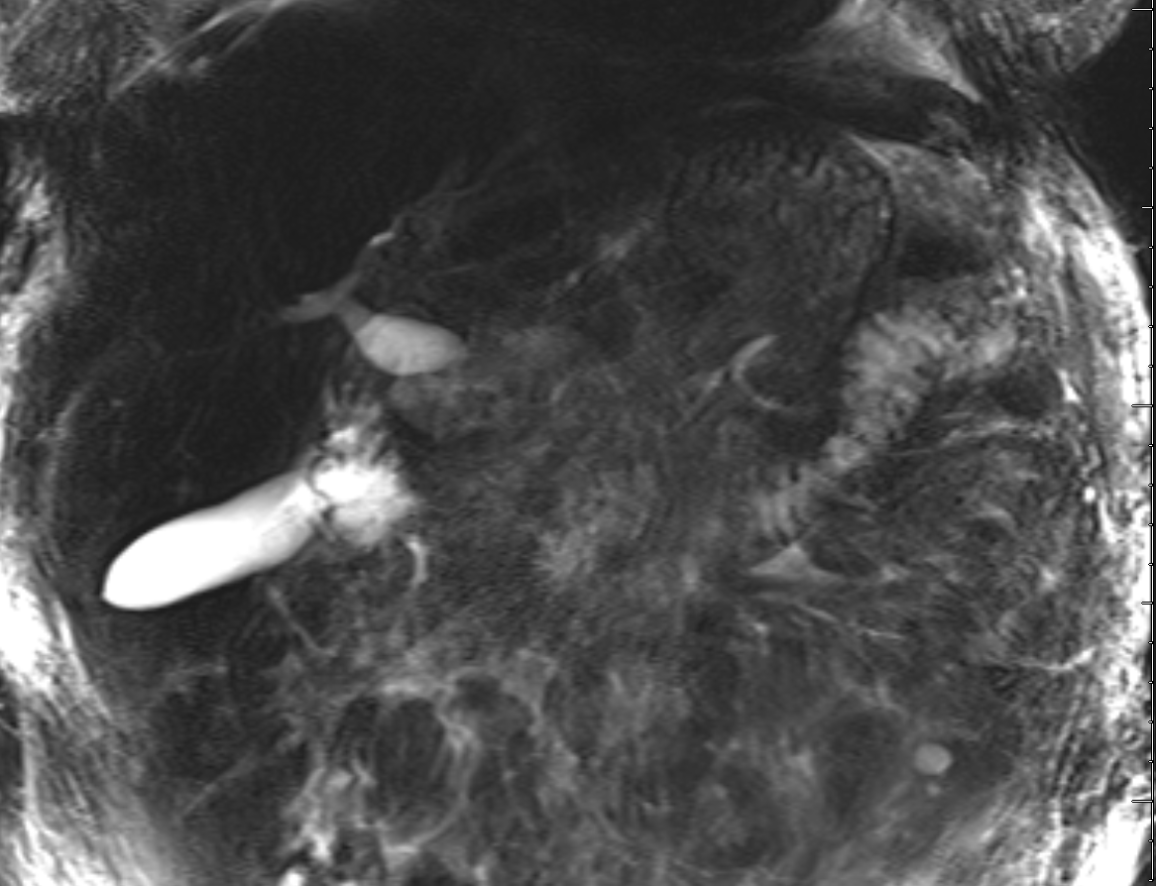
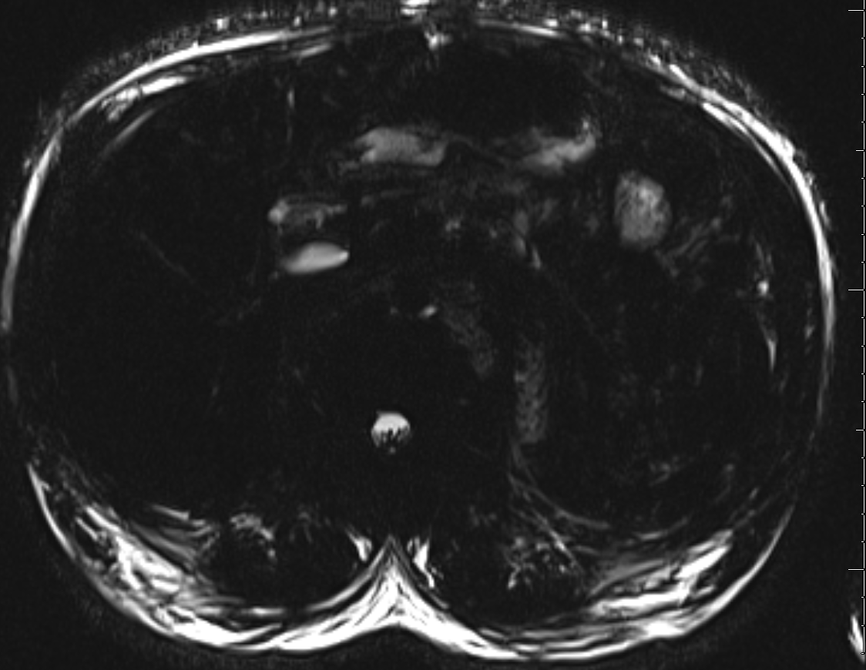
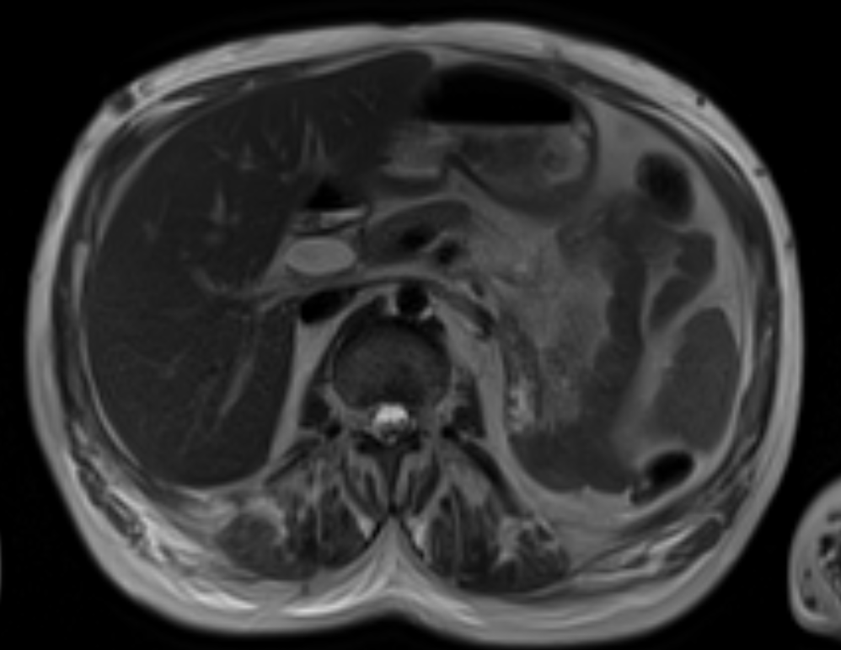
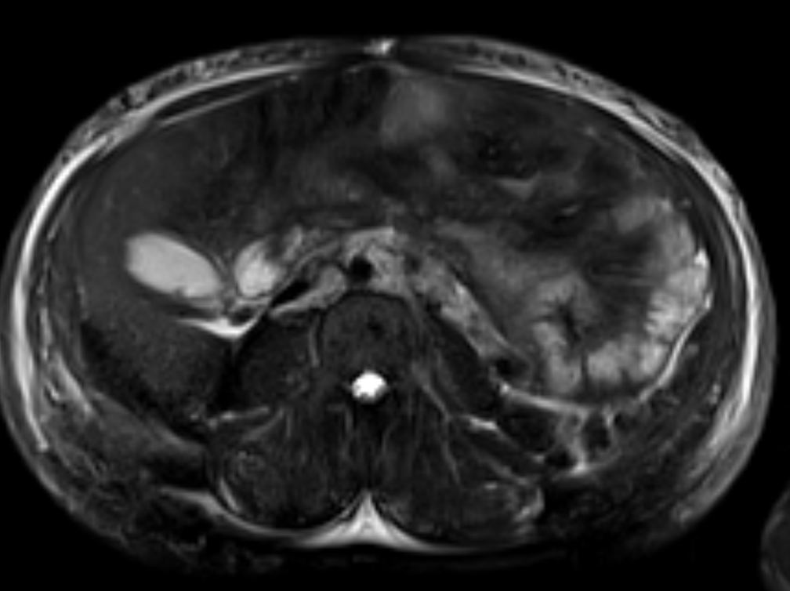
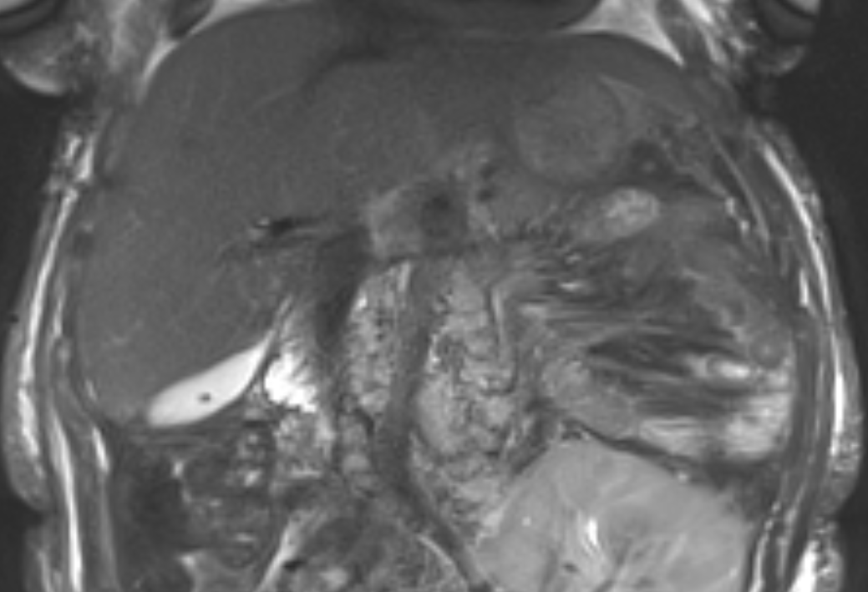
Figure 2a: coronal T2
Figure 2b: coronal MRCP
Figure 2c: axial MRCP
Figure 2d: axial T2
Figure 2e: axial T2 SPAIR
Figure 2f: coronal T2 SPAIR
Figure 2: 40 year old female with abdominal pain and nausea. MR images show a focal segmental dilatation of the extrahepatic biliary tree on coronal T2, single shot fast spin echo heavily T2 weighted and axial MRCP sequences (Fig 2a-b-c-d) consistent with type Ib choledochal cyst of the common bile duct. Cholelithiasis noted on axial and coronal T2 fat saturated images ( Fig 2e-f).
Notes:
ALBELAIZ, YAHAERA, GABRIELA PID: 31101244, Sex: F, D.O.B: 12/22/1992
Acc#: 38854326
. A type Ib choledochal cyst of the common bile duct measures 3.1 x 1.4 cm (coronal T2 image 14, series 100). Cholelithiasis noted.

Slide 14
Type I cysts are most common, accounting for 50%-80% of all cysts.
Focal or diffuse fusiform dilatation of the common bile duct without associated intrahepatic biliary ductal dilatation
Similar pathologic features to type II and IV
Optimal treatment is total cystectomy and Roux-en-Y hepaticojejunostomy

Slide 15
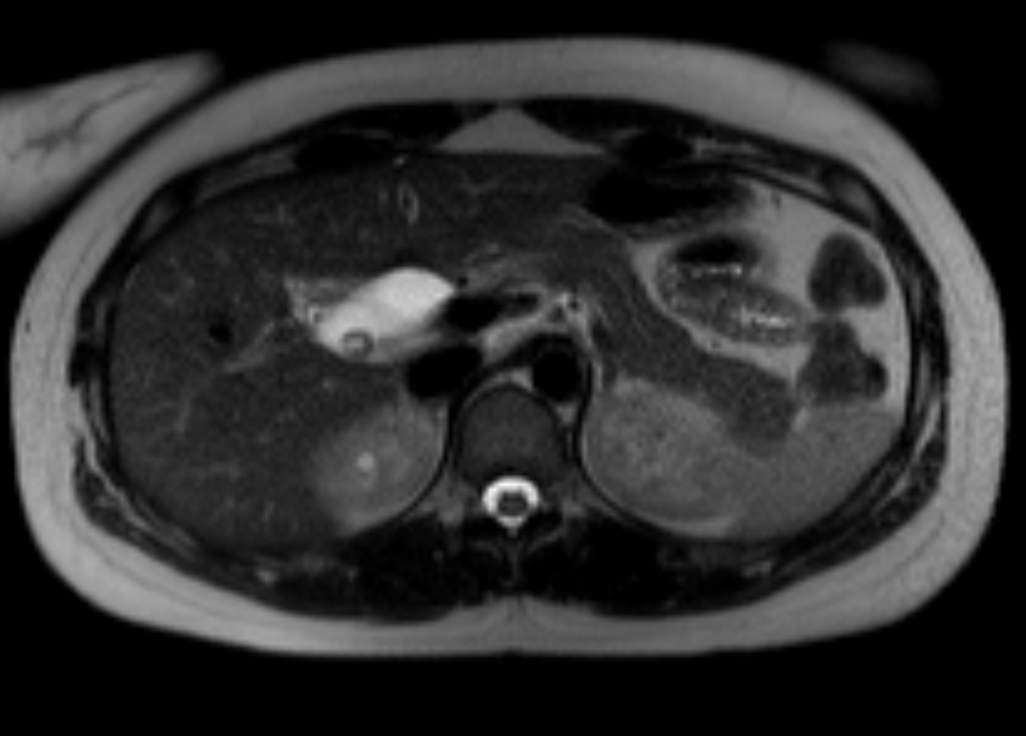
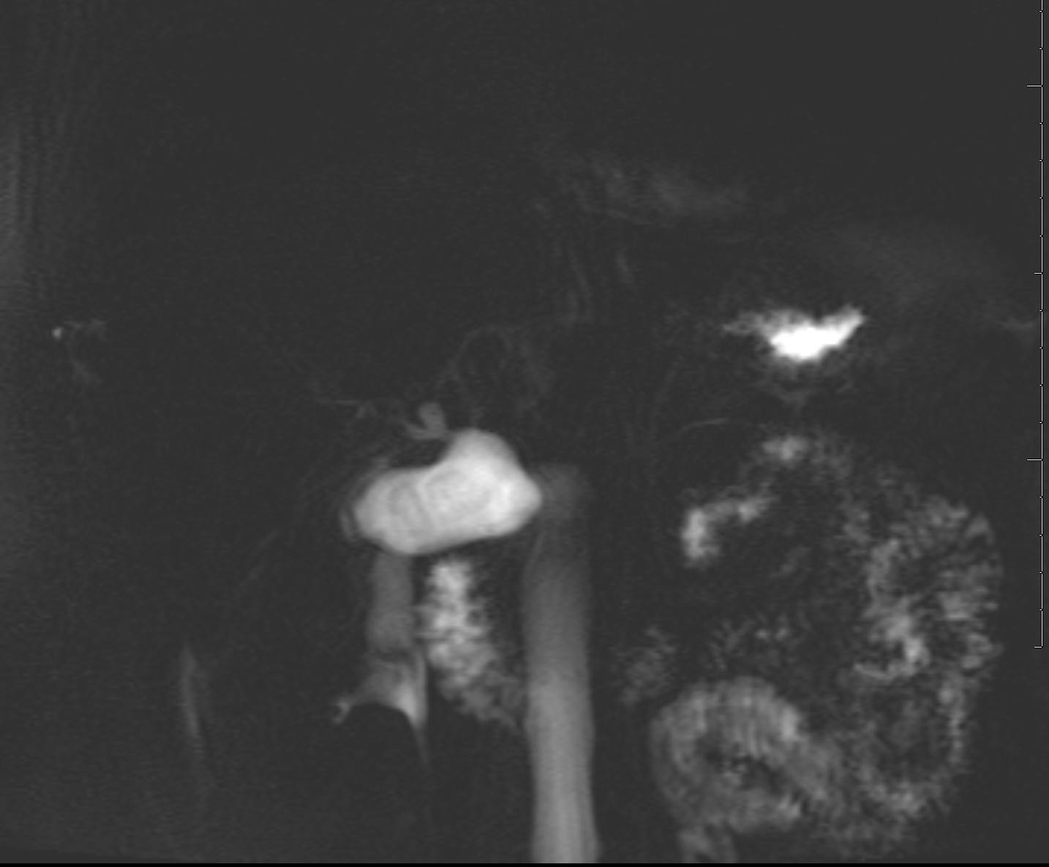
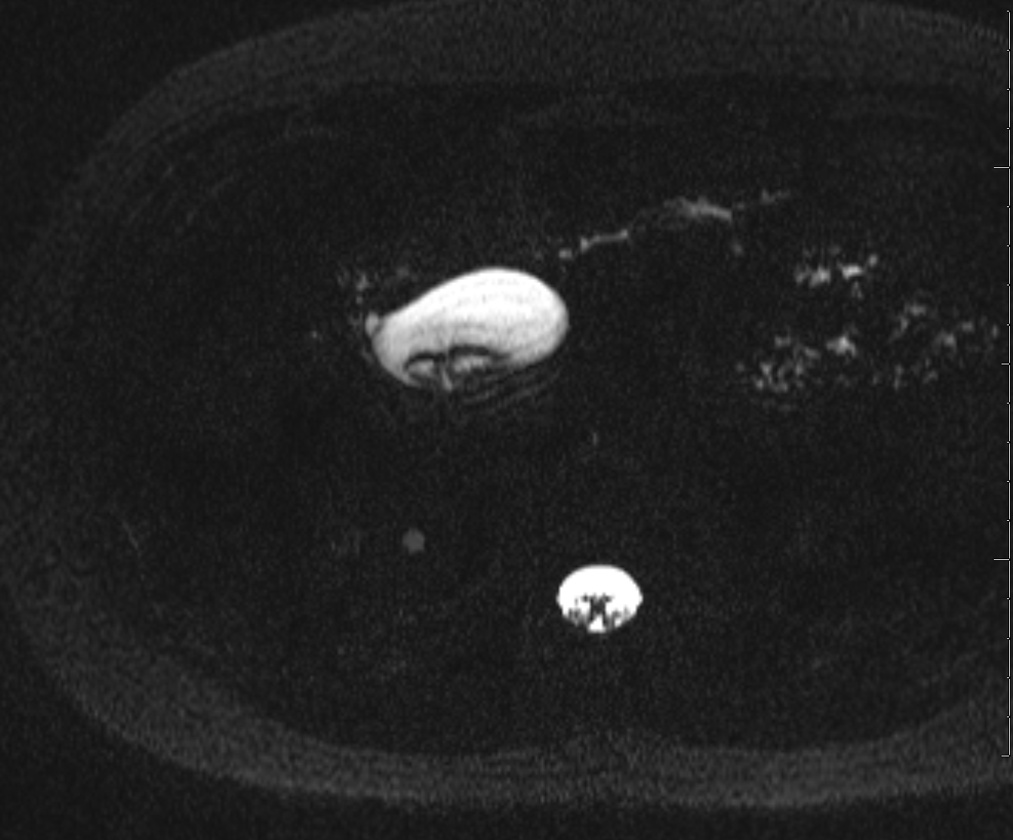
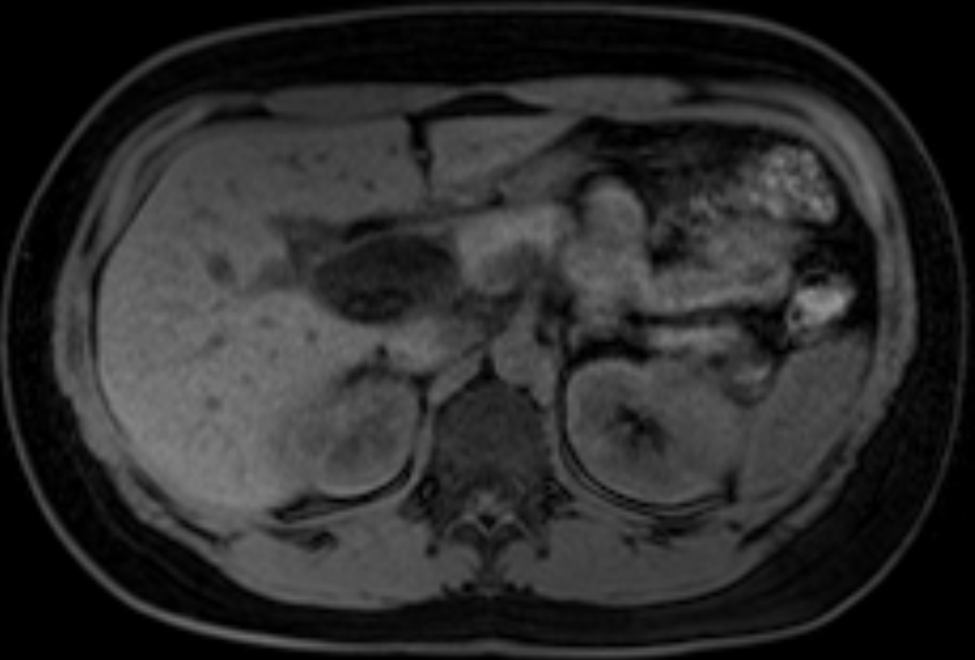
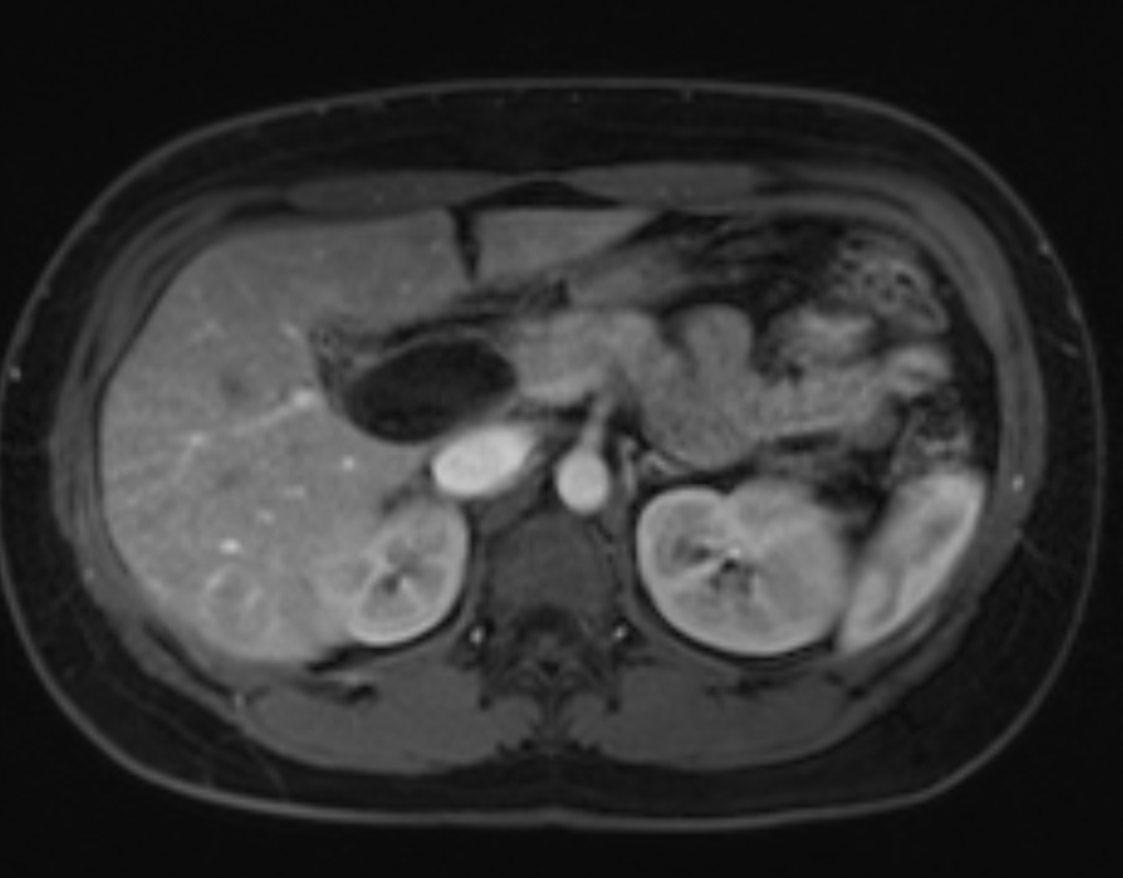
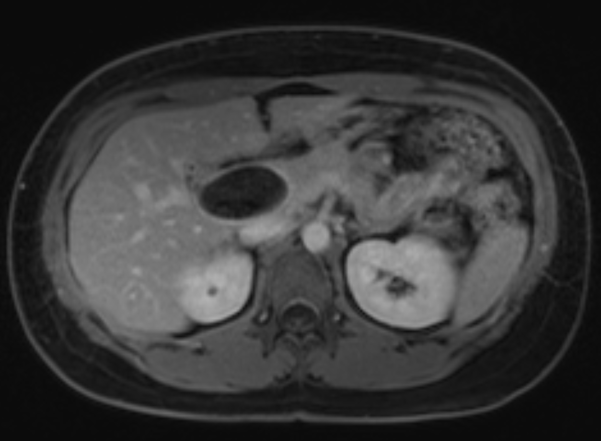
Figure 3a: axial T2 HASTE
Figure 3b: coronal MRCP
Figure 3c: axial MRCP
Figure 3d: axial T1w precontrast
Figure 3e: axial T1 arterial phase
Figure 3f: axial T1w 240 sec delayed
Figure 3: 25 year old female presented with abdominal pain. MR shows a diverticulum arising from the common bile duct which contains gallstones on T2 weighted HASTE MR image (Fig 3a). Axial and thick section single shot fast spin echo heavily T2 weighted MR images show the supraduodenal dilated portion of common bile duct with gallstones (Fig 3b-c). Low signal on T1 precontrast (Fig 3d) with no arterial or delayed enhancement (Fig 3e-f). Primary diagnosis is type II choledochal cyst arising from the common bile duct containing gallstones with no malignant transformation.

Slide 16
Gallstones form due to bile stasis in the saccular diverticulum of the CBD. Note that type II cysts are true diverticula.
Type II cysts account for 2% of choledochal cysts
On MRCP appear as anechoic cysts juxtaposed to the CBD with a normal appearing gallbladder and CHD
Type II cysts can be removed with simple excision

Slide 17
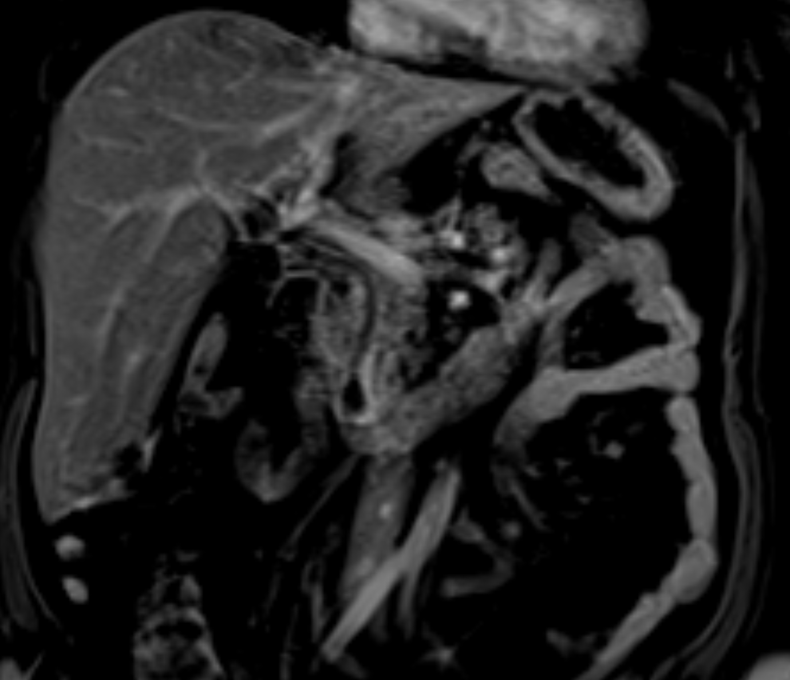
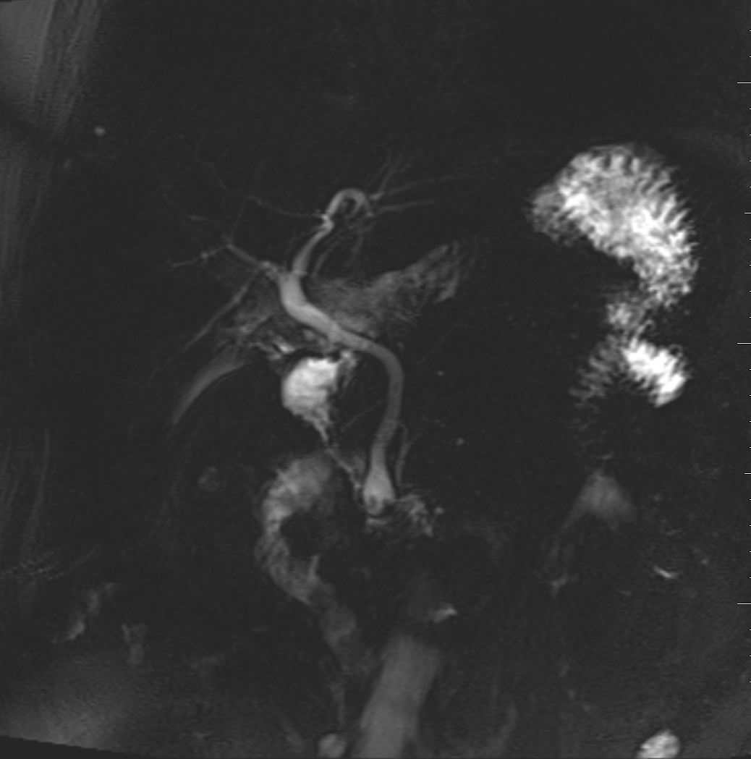
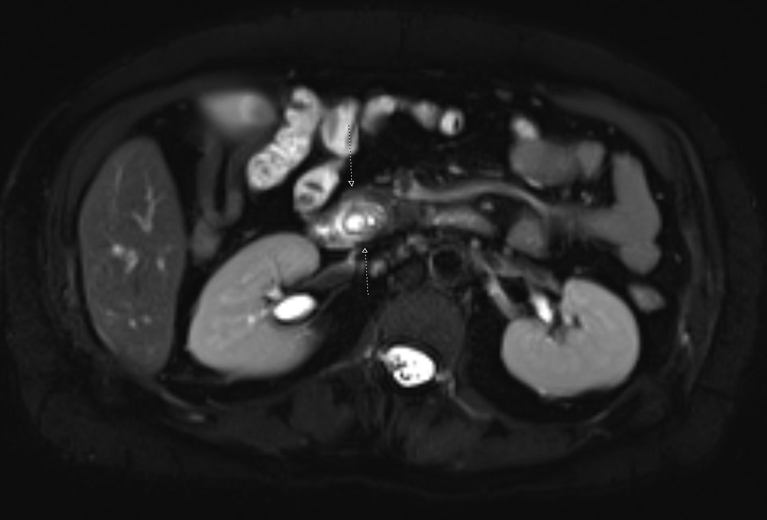
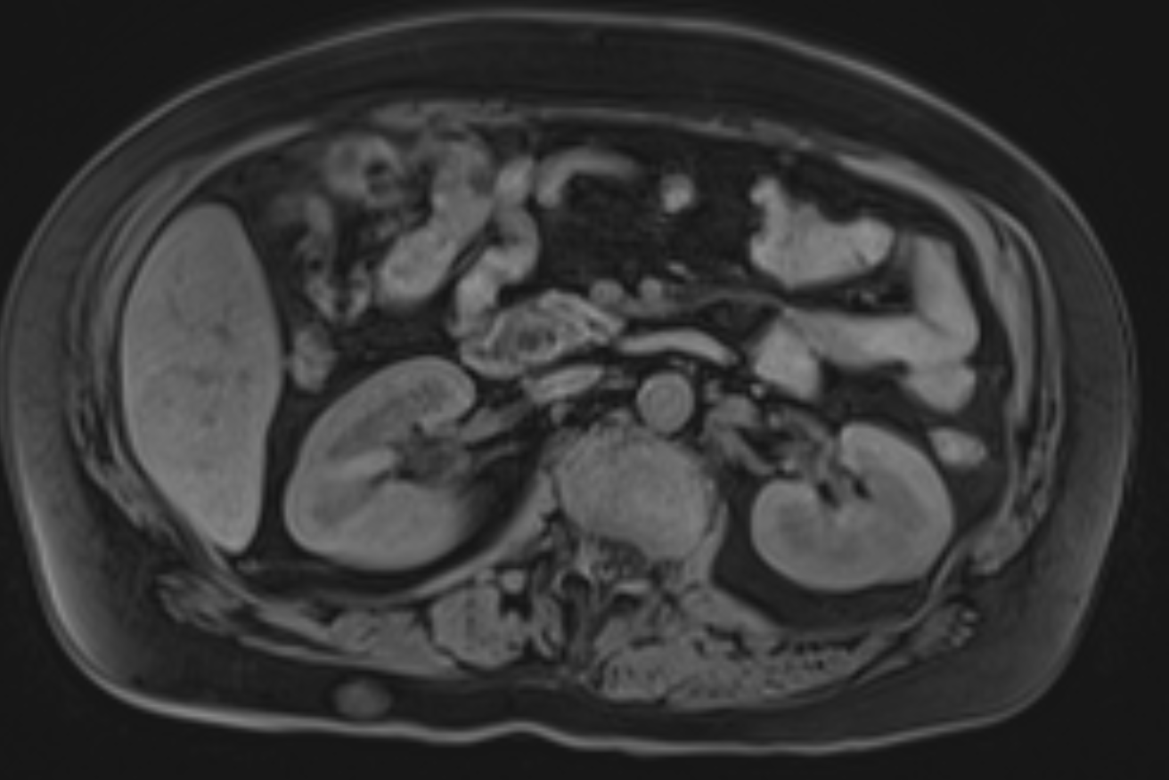
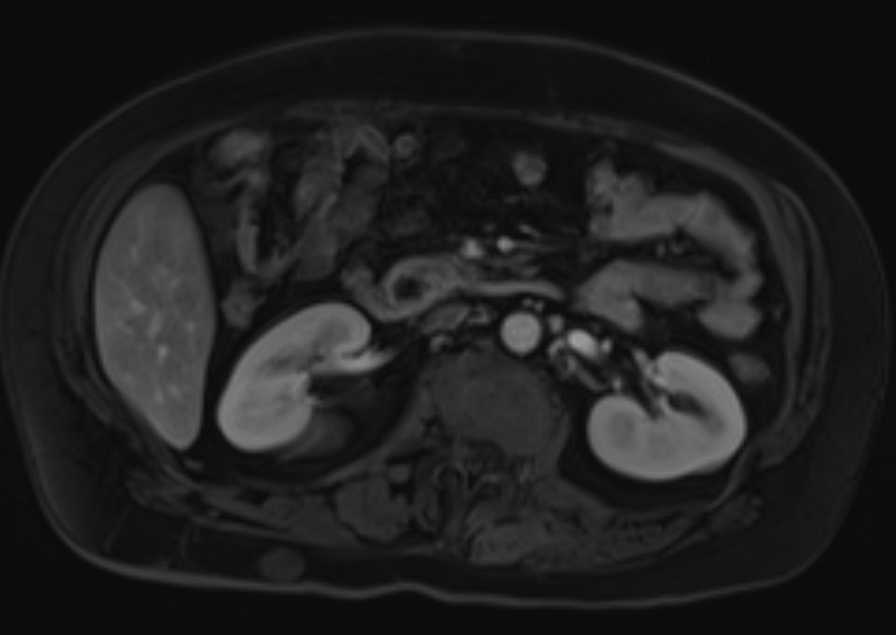
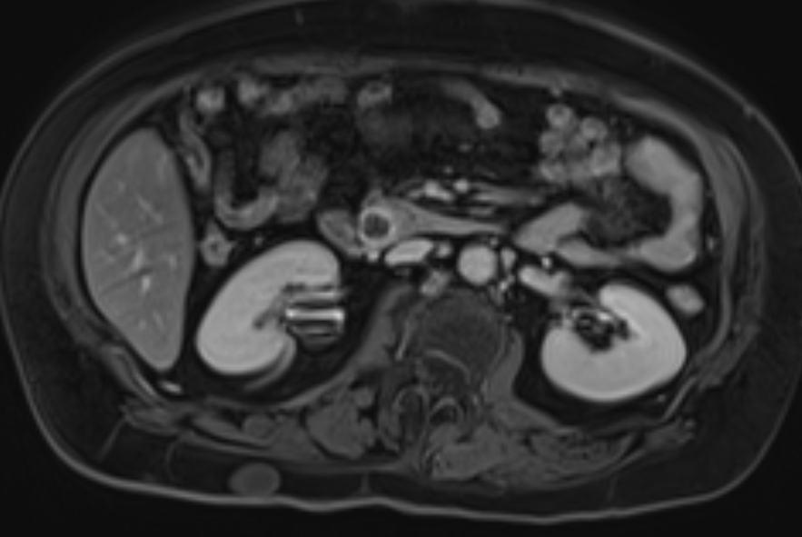
Figure 4a: coronal post contrast
Figure 4b: coronal MRCP
Figure 4c: T2 SPAIR
Figure 4d : axial T1 precontrast
Figure 4e: axial T1w arterial phase
Figure 4f T1w 240 sec delayed phase
Figure 4: 49 year old female presented with acute abdominal pain. MRI shows focally dilated segment of the distal common bile duct about the duodenum with layering filling defects and mild intrahepatic biliary ductal dilatation on T1 coronal post contrast and coronal MRCP images (Fig 4a-b). Hyperenhancement of the distal common bile duct with reactive inflammatory change of the surrounding pancreatic head on delayed images (Fig 4d-e-f). Primary diagnosis is Todani 3 choledochocele with gallstones and distal common bile duct cholangitis. ERCP was performed and pathology demonstrated tubulovillous adenoma with high grade dysplasia. Patient underwent Whipple pancreaticoduodenectomy.

Slide 18
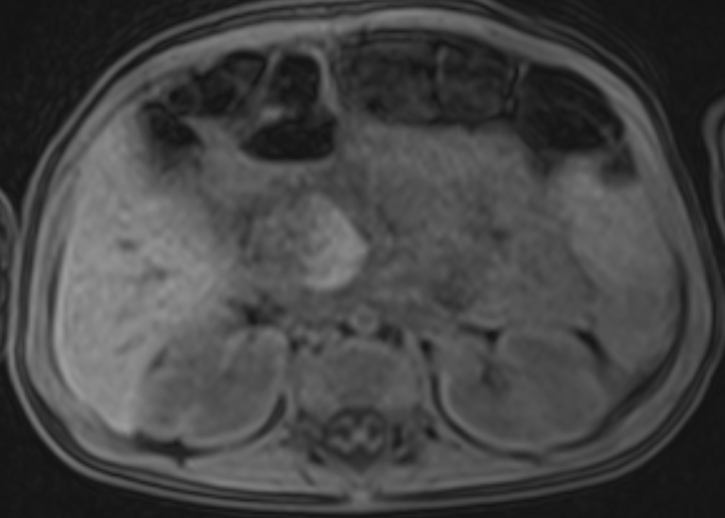
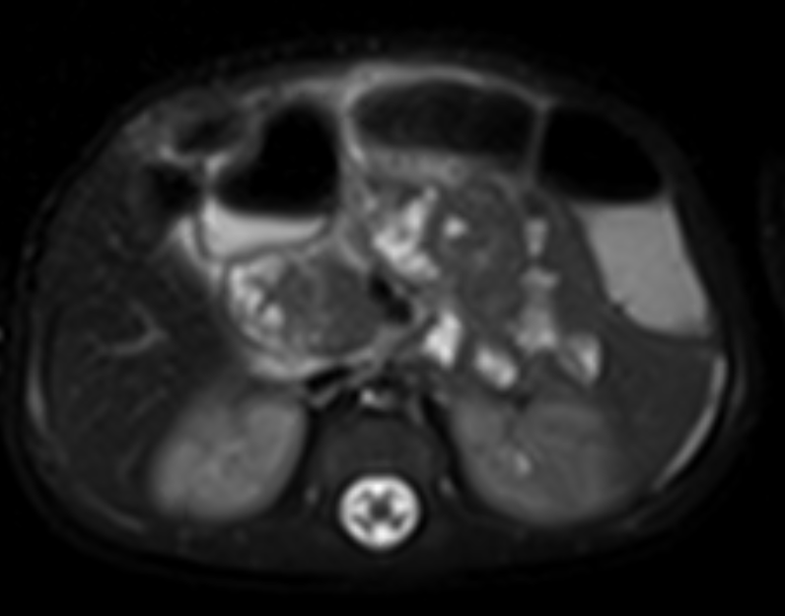
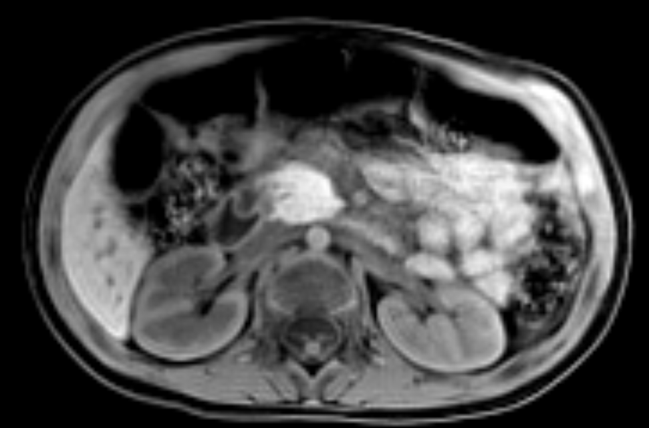
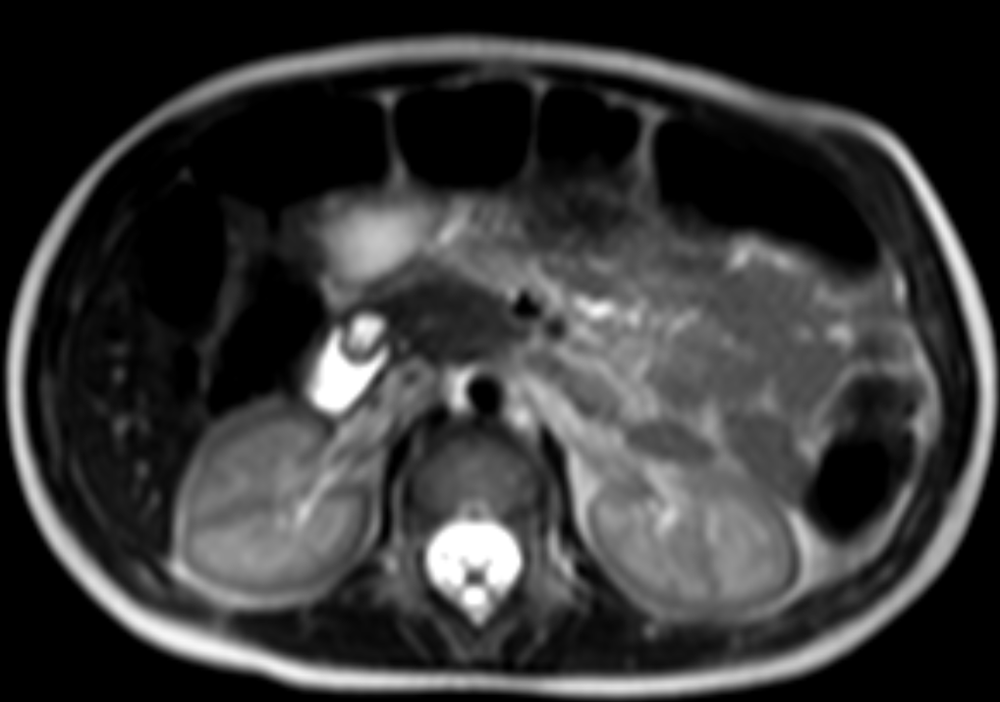
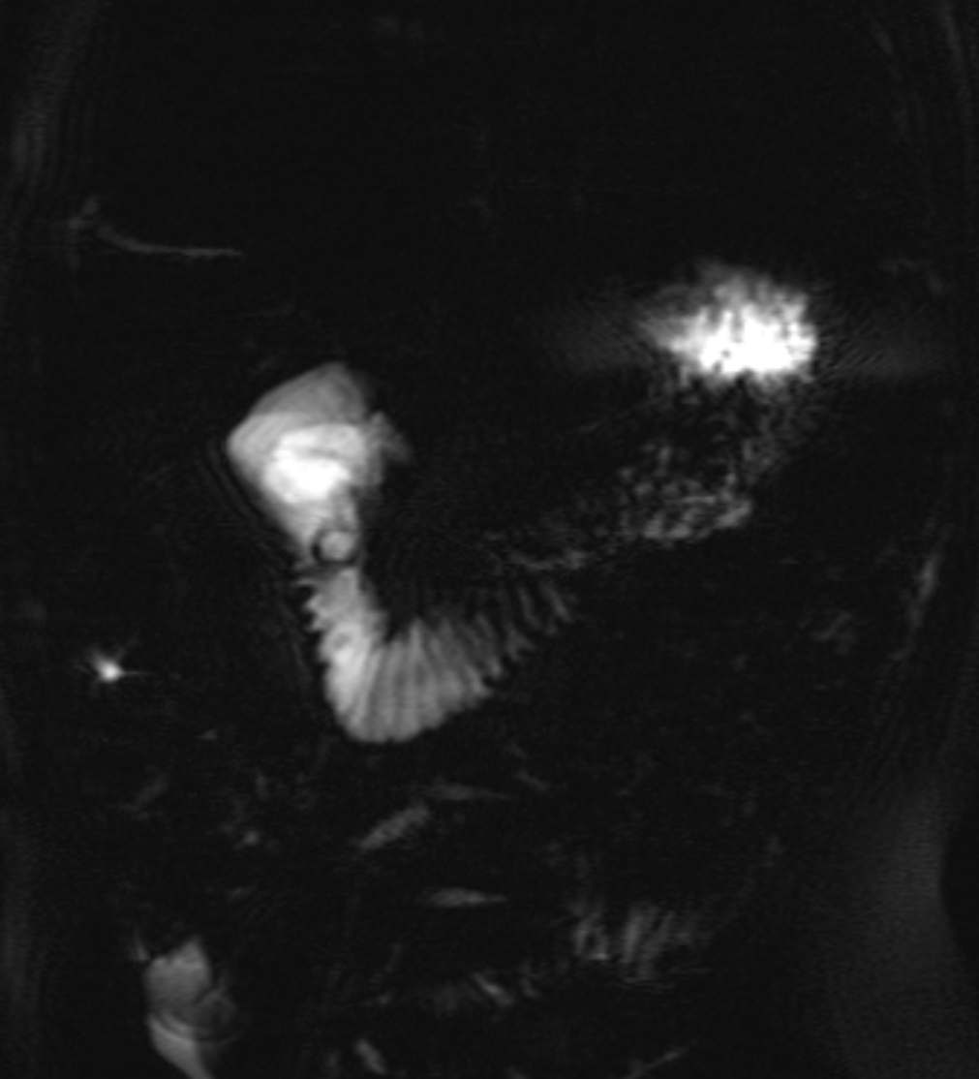
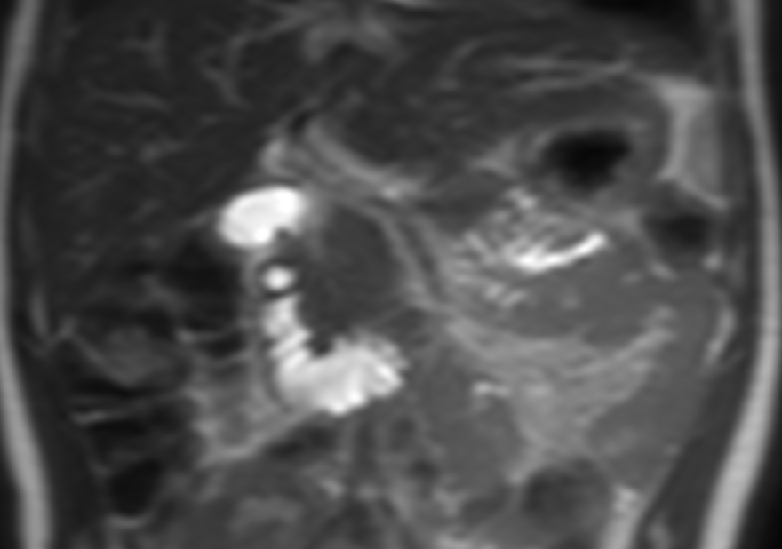
Figure 5a: axial T1
Figure 5b: T2 SPAIR
Figure 5c: STARVIBE precontrast
Figure 5d: Axial T2
Figure 5e: Coronal thick slab MRCP
Figure 5f: Coronal t2
Figure 5: 33 year old male with acute abdominal pain. Cystic structure projecting along the medial wall of the second part of the duodenum at the expected location of the major papilla consistent with a type III choledochal cyst (choledochocele) (Fig 5d-e-f). There is enlargement and increased SPAIR signal noted in the pancreatic head with peripancreatic free fluid (Fig 5b) and loss of T1 signal (Fig 5a-c) in keeping with acute pancreatitis involving the pancreatic head.
Notes:
MCLEAN, HUNTER PID: 31053975, There is a 7 mm cystic structure projecting along the medial wall of the second part of the duodenum at the expected location of the major papilla (axial T2 series 5 image 19) which most likely represents a type III choledochal cyst (choledochocele). Acc#: 36660295 There is enlargement and increased SPAIR signal noted in the pancreatic head, with peripancreatic free fluid. The pancreas body and tail demonstrates normal signal intensity. There is no pancreatic ductal dilatation. 1. Findings of acute pancreatitis involving the pancreatic head. Acc#: 8303236

Slide 19
1.4%-4.5% of choledochal cysts are Type III
Intraduodenal location at pancreaticobiliary junction
Pancreatitis commonly seen, biliary tract symptoms are less common
Type III cysts are more evenly distributed between the sexes than other types where there is a female predominance
2.5% of Type III cysts progress to malignancy
Overall risk for choledochal cysts is 10%-15%

Slide 20
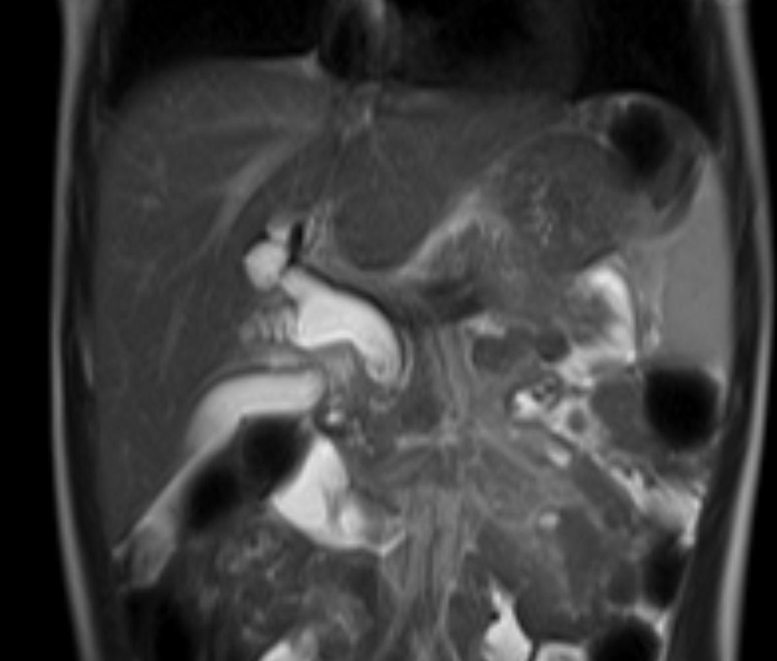
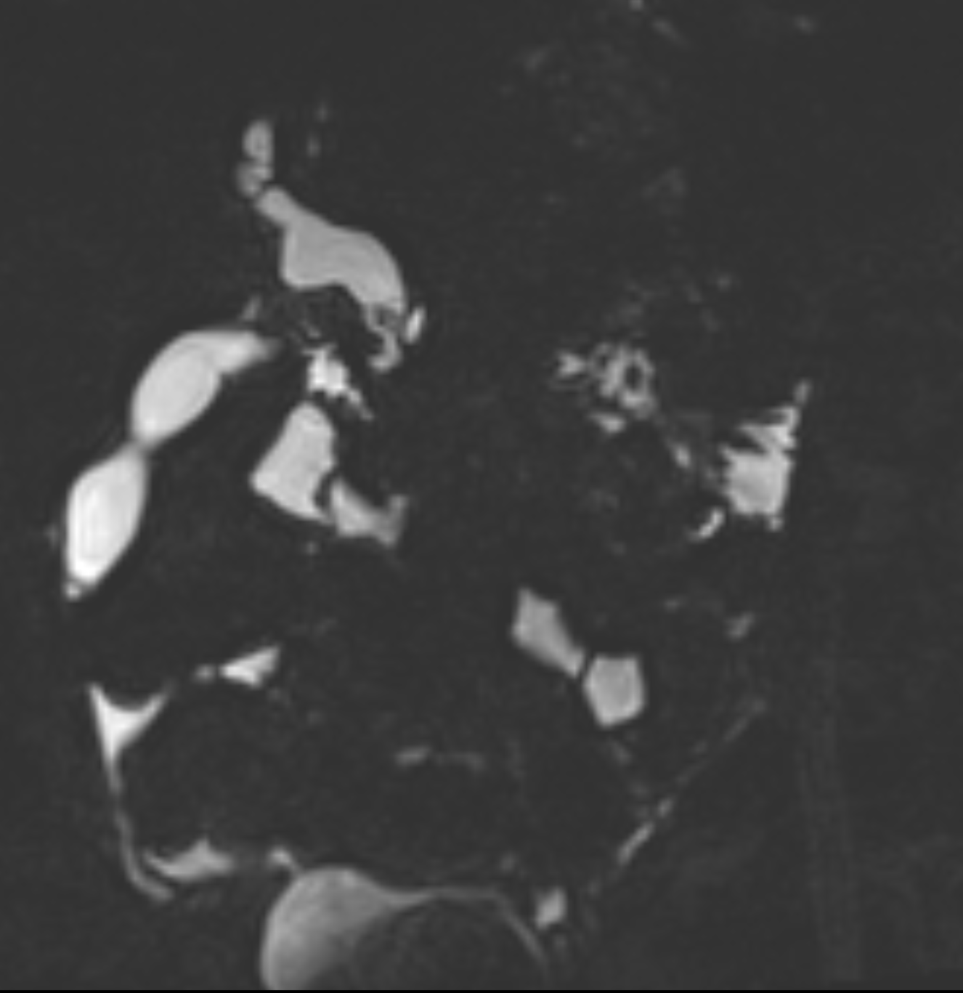
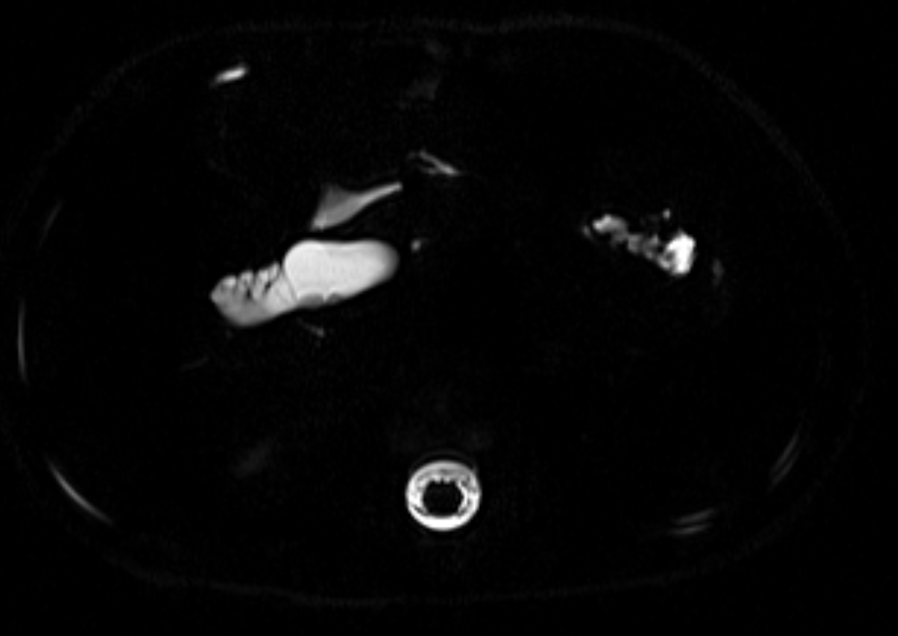
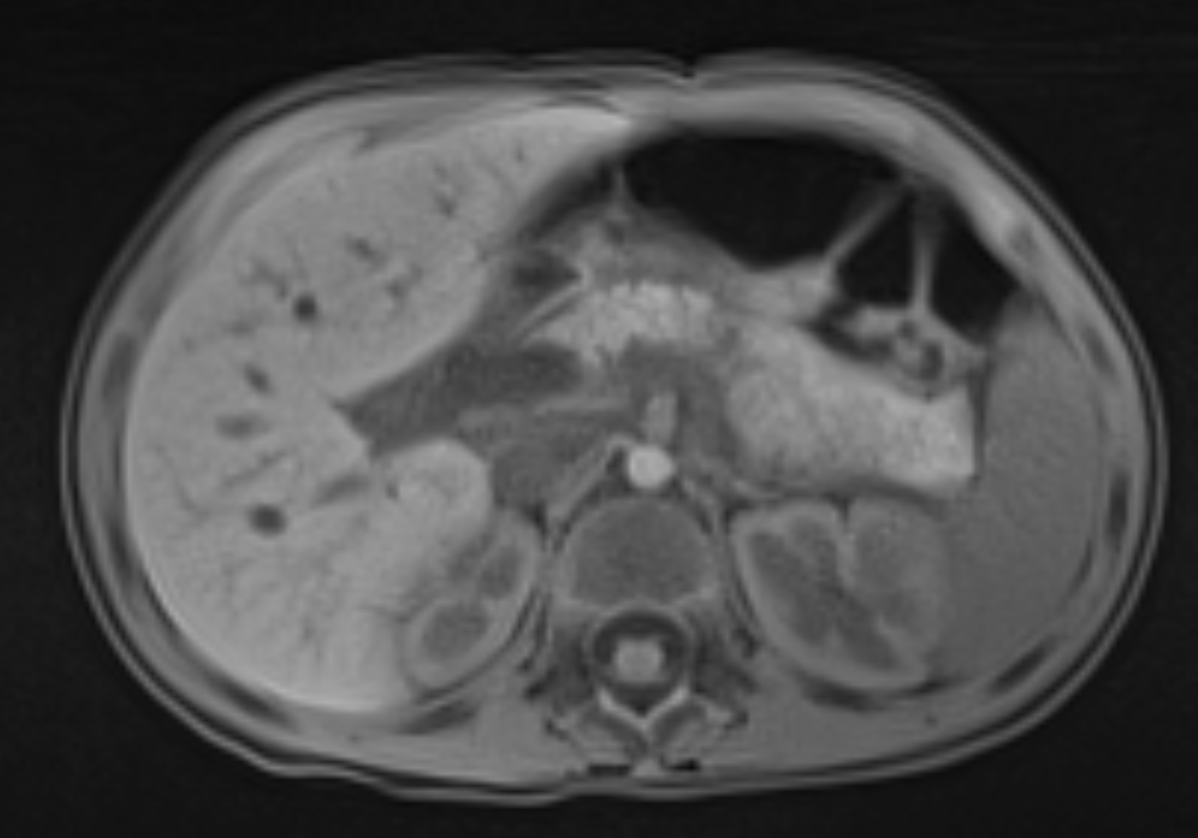
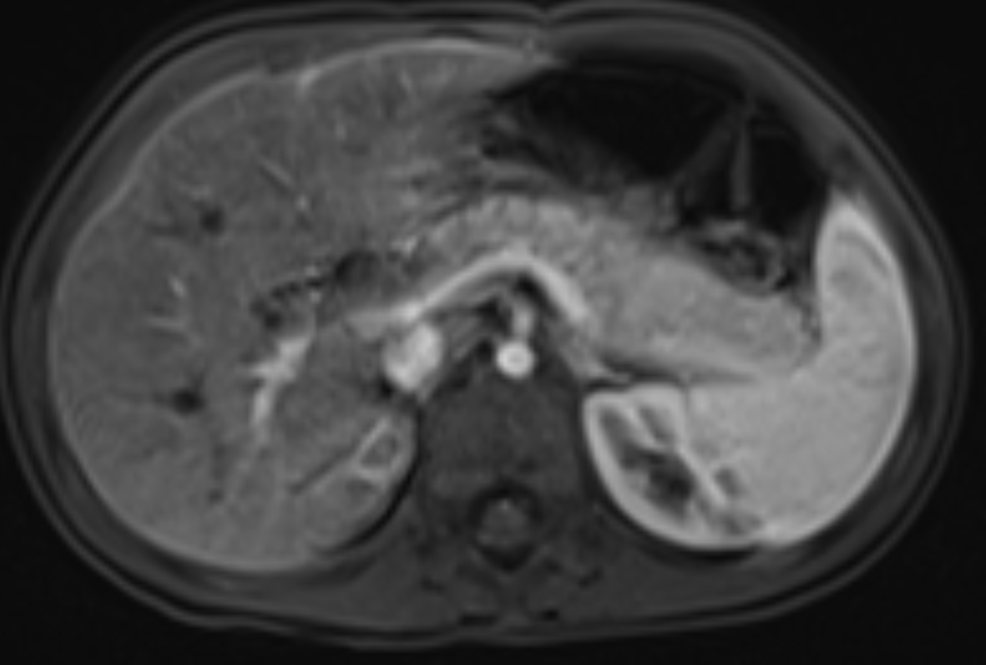
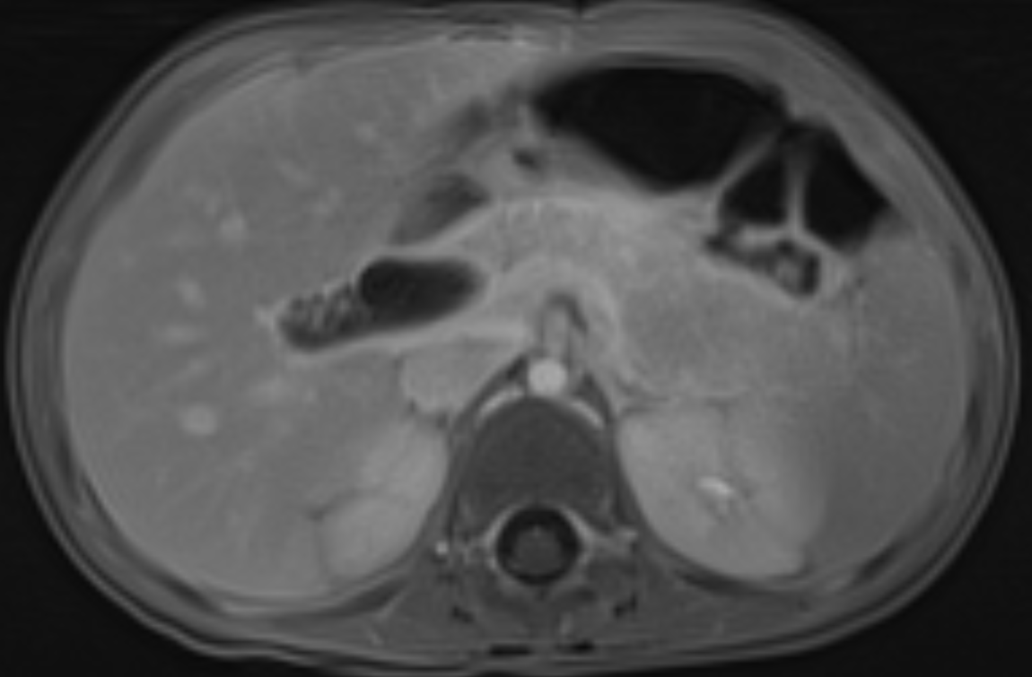
Figure 6a: coronal T2 HASTE
Figure 6b: coronal T2 3D MRCP
Figure 6c: axial T2 MRCP
Figure 6d: axial T1 precontrast
Figure 6e: axial T1w arterial phase
Figure 6f: axial T1w 240 sec delayed
Figure 6: 28 year old female with acute abdominal pain. Fusiform biliary ductal dilation involving the CBD extending superiorly into the proximal cystic duct, the common hepatic and central right and left intrahepatic bile ducts on coronal T2 weighted MR image (Fig 6a) and 3D MRCP image (Fig 6b). Axial T2 MRCP (Fig 6c) shows small rounded filling defects in the common bile duct. Mild diffuse intrahepatic biliary ductal dilation with hypointense peripancreatic fluid on T1 (Fig 6d). Diffuse edema of the pancreas with arterial hyperenhancement and delayed enhancement on dynamic images (Fig 6e-f). Primary Diagnosis is Todani Type IVA choledochal cyst with gall stones and acute on chronic pancreatitis.

Slide 21
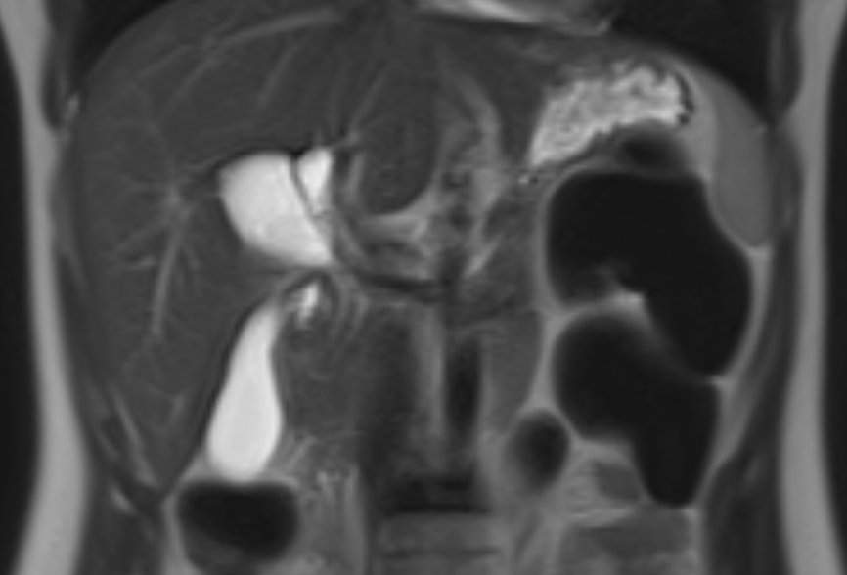
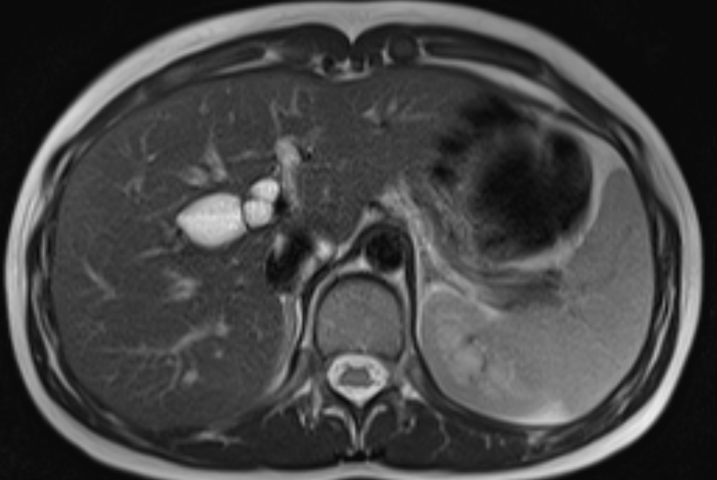
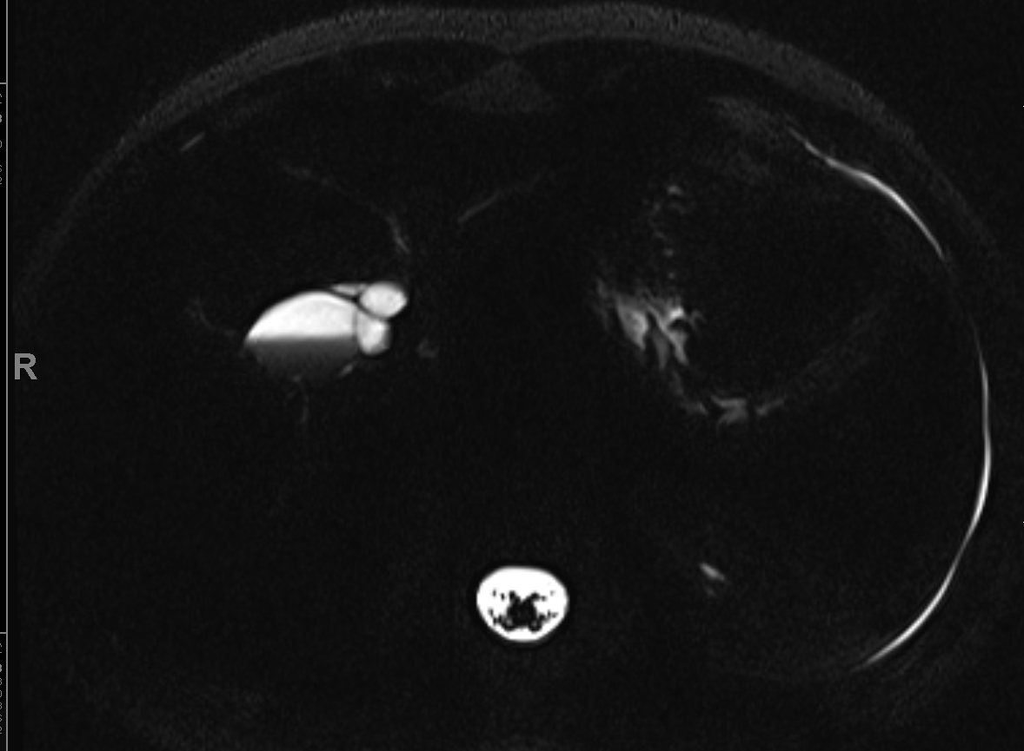
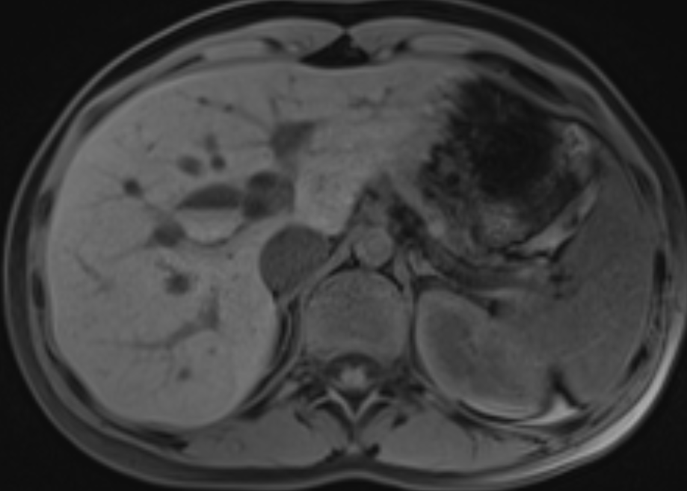
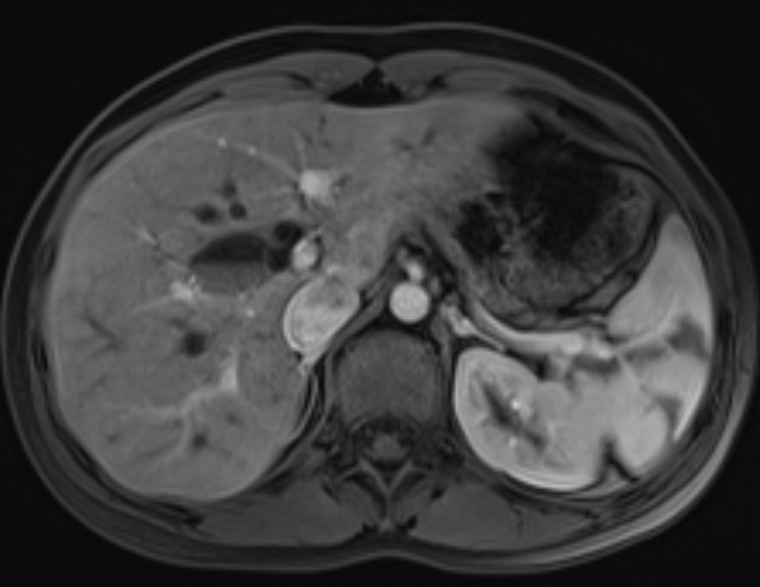
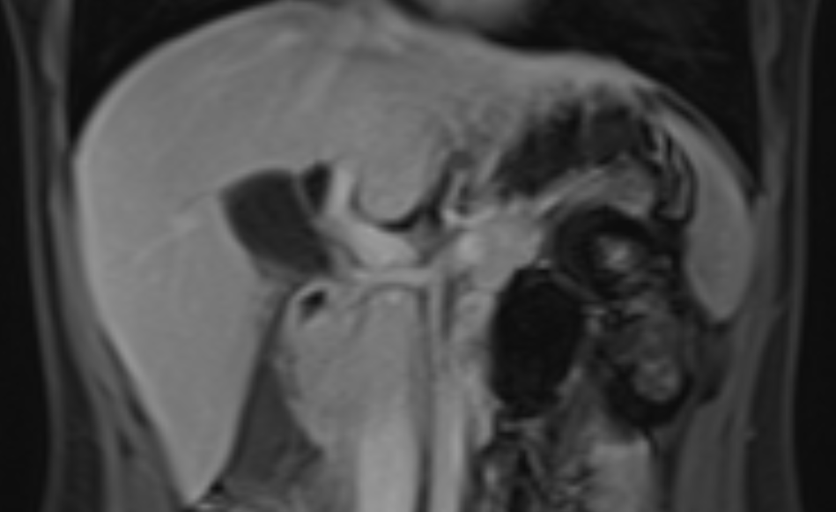
Figure 7a: Coronal T2
Figure 7b: axial T2
Figure 7c: Axial MRCP
Figure 7d: axial T1 precontrast
Figure 7e: axial T1w arterial phase
Figure 7f: coronal T1w 240 sec delayed phase
Figure 7: 32 year old female with vague abdominal pain. MR images demonstrate fusiform dilatation of the common bile duct at the level of the cystic duct insertion with associated beaded appearance of the adjacent intrahepatic biliary ducts (Fig 7a-b-c), low signal on axial T1 image (Fig 7d) with no abnormal enhancement on dynamic images (Fig 7e-f). Findings in keeping with a Todani type IVA choledochal cyst.
Notes:
ARGOTA, LUCY PID: 18825026, Sex: F, D.O.B: 6/18/1999
There is fusiform dilatation of the CBD at the level of the cystic duct insertion with associated beaded appearance of the adjacent intrahepatic biliary ducts, in keeping with a Todani type IVA choledochal cyst.

Slide 22
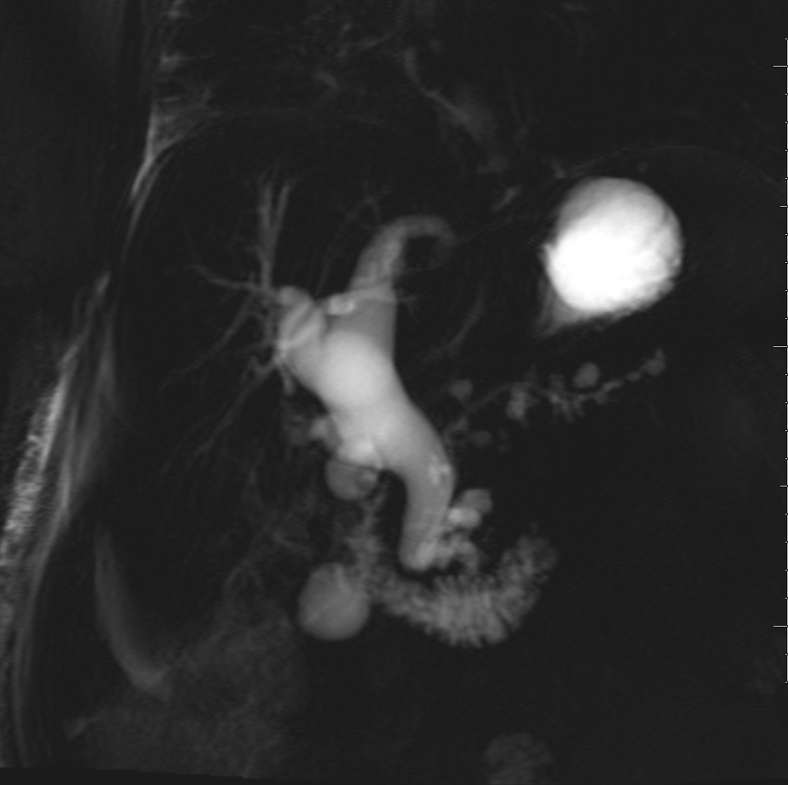
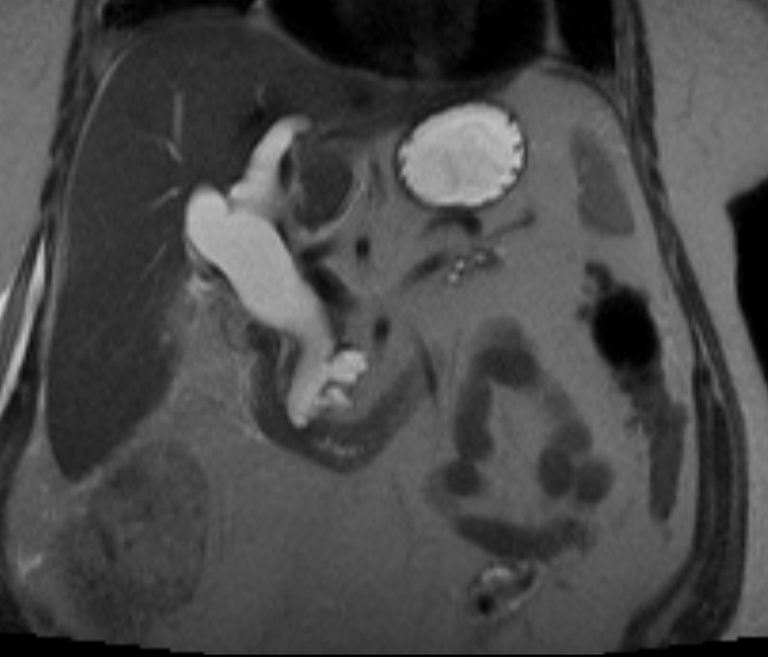
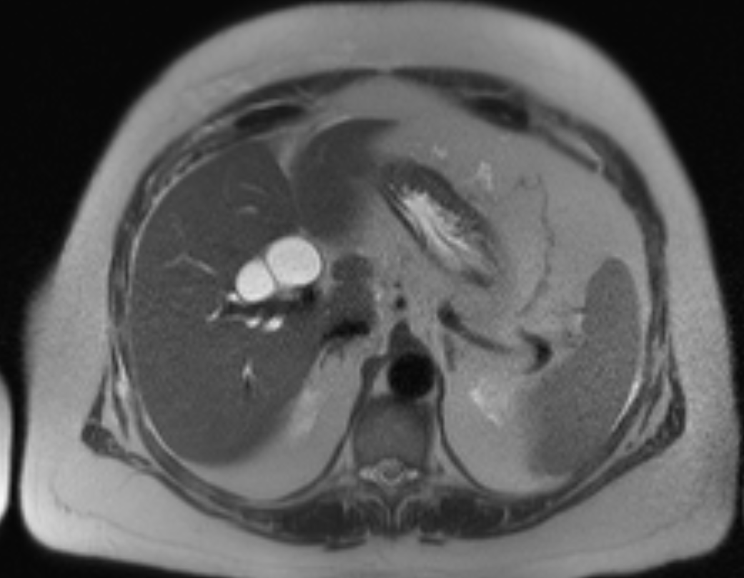
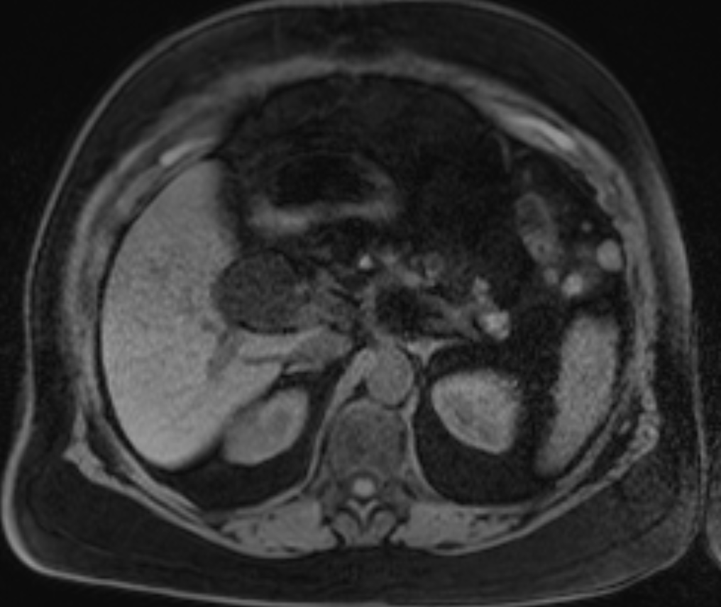
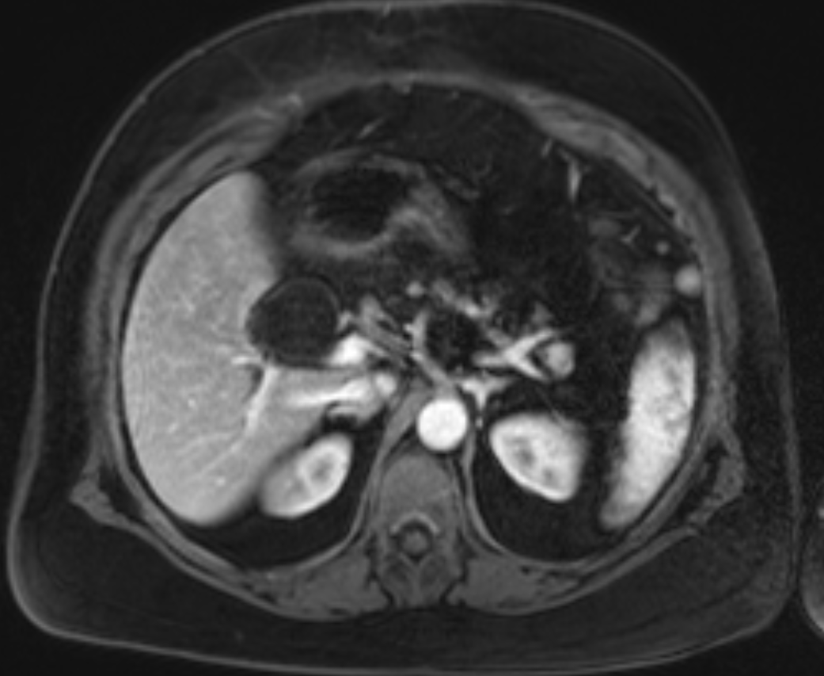
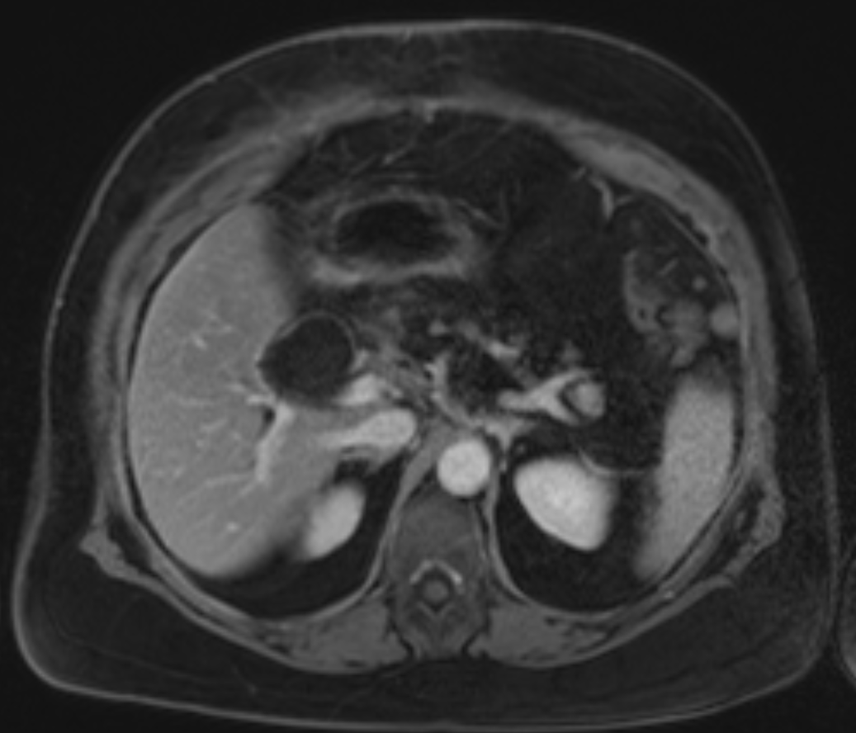
Figure 8a: coronal MRCP
Figure 8b: T2 coronal
Figure 8c: axial T2 dilat of hepatic ducts
Figure 8d: axial T1 precontrast
Figure 8e: axial T1 arterial phase
Figure 8f: axial T1 delayed phase
Figure 8: Dilatation of the extrahepatic common bile duct and both main intrahepatic ducts (Fig 8a-b-c) in keeping with a type IV choledochal cyst. This patient is status post recentlaparoscopic cholecystectomy. Type IV choledochal cyst without stones, debris, blood products and no changes on dynamic images to suggest cholangiocarcinoma (Fig 8d-e-f).
Notes:
WINFIELD, MYRNA PID: 19105766, Sex: F, D.O.B: 11/12/1942
Acc#: 8027732
Postsurgical changes from recent laparoscopic cholecystectomy are Again demonstrated is dilatation of the extrahepatic common bile duct and both main intrahepatic ducts in keeping with a type IV choledochal cyst. The extrahepatic common bile duct measures 2.7 cm, previously 2.4 cm, slightly more distended since the prior exam. There is mild thickening and enhancement of the common bile duct. Type IV choledochal cyst without stones, debris, blood products and no changes to suggest cholangiocarcinoma.

Slide 23
15%-35% of choledochal cysts are Type IV
Type IVA includes both intrahepatic and extra-hepatic duct involvement
Type IVB consists of multiple dilations of the extrahepatic biliary tree with an uninvolved intrahepatic biliary tree
"string of beads appearance"
Type IVA dilatation extends from CBD and CHD into intrahepatic biliary tree
Primary ductal stricture around the hepatic hilum is commonly seen

Slide 24
Pancreatitis pathogenesis
Bile stasis --> stone formation + infected bile
Chronic inflammation + formation of albumin-rich exudates or hypersecretion of mucin from dysplastic epithelium --> protein plugs in pancreatic duct
Protein plugs + distal CBD stone --> pancreatitis
Treatment for type IVA cyst is debated:
Excision of extrahepatic component with hepaticojejunostomy
Hepatic resection in case of unilobar disease and liver transplantation in bilobar disease

Slide 25
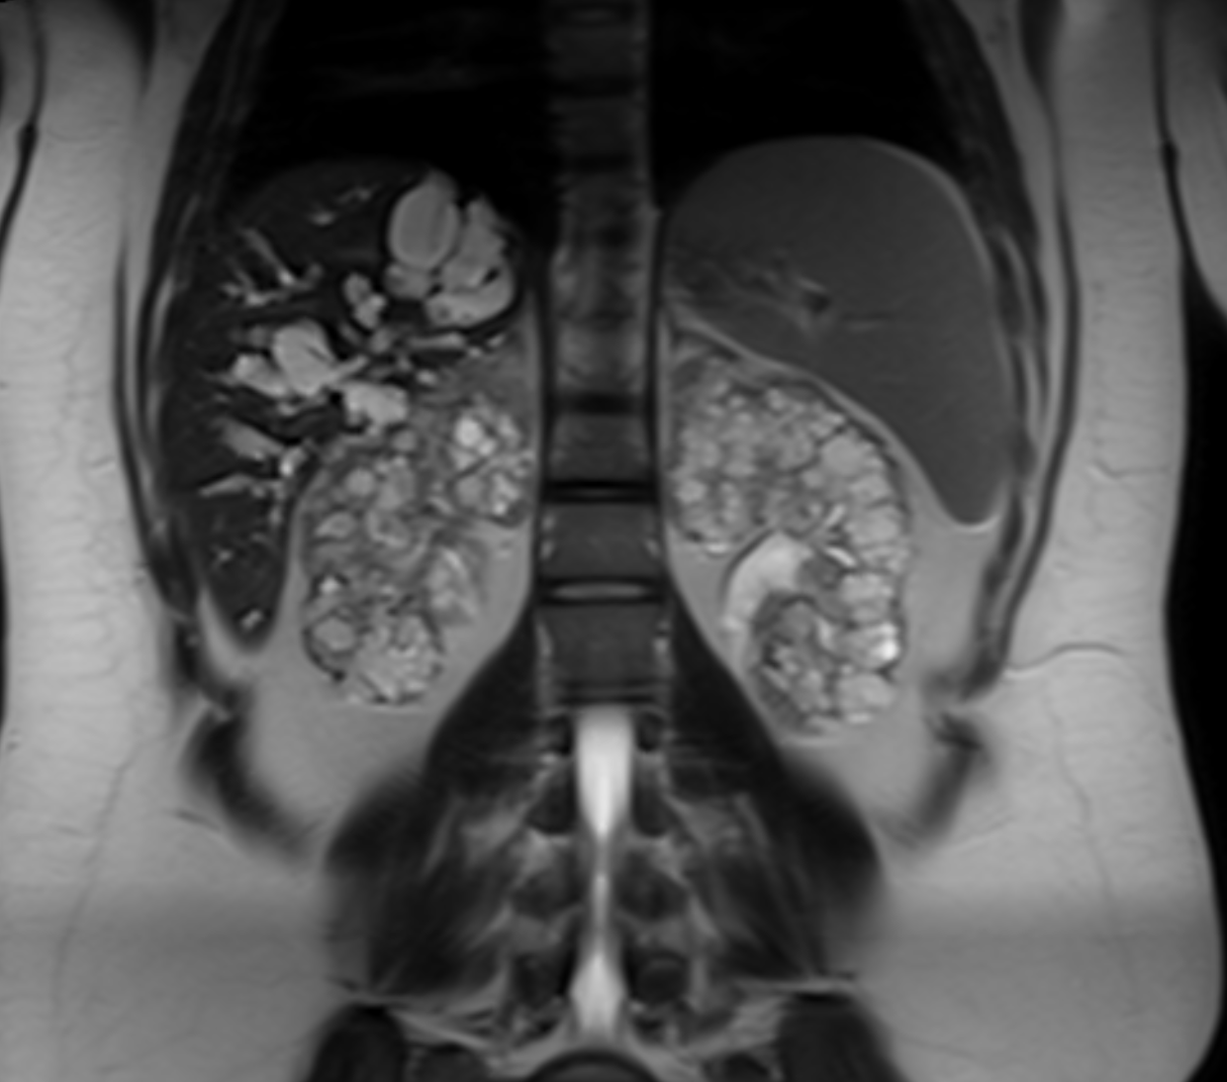
Figure 9a: coronal T2 HASTE
Figure 9b: axial MRCP
Figure 9c: coronal T2 MRCP
Figure 9d: axial T1 precontrast
Figure 9e: axial T1w arterial phase
Figure 9f: axial T1w 240 sec delayed
Figure 9: 31 year old female with recurrent fever. MR images show extensive saccular and fusiform intrahepatic biliary duct dilation most pronounced in the right hepatic lobe on coronal T2 HASTE, axial MRCP and coronal T2 MRCP (Fig 9a-b-c). bilateral native kidneys are replaced with innumerable small cysts. No abnormal enhancement on dynamic images (Fig 9d-e-f). Primary diagnosis is Caroli’s syndrome with intrahepatic biliary duct dilatation and findings of autosomal recessive polycystic kidney disease of the bilateral native kidneys.

Slide 26
Type V choledochal cyst "Caroli’s disease"
Intrahepatic saccular/fusiform dilatation with no underlying obstruction or extrahepatic biliary tree involvement
20% of choledochal cysts are Type V
Type V cyst + association with congenital hepatic fibrosis or autosomal recessive polycystic kidney disease = Caroli syndrome
Enhancement of portal vein surrounded by dilated intrahepatic bile ducts (“central dot sign") is suggestive of Caroli's disease

Slide 27
Caroli’s disease likely mechanism involves derangement in normal embryonic remodeling of ducts and causes varying degrees of destructive inflammation and segmental dilation of intrahepatic bile ducts
Malignancy in Caroli's disease is about 7–15%

Slide 28
Clinical Implications
MR Imaging and Magnetic resonance cholangiopancreatography (MRCP) demonstrate high diagnostic performance for choledochal malformations and early detection of cyst complications
MRI and MRCP are crucial for preoperative planning to delineate anatomy and exclude malignant transformation

Slide 29
References
Atkinson H, Fischer C, Jong CD, Madhavan K, Parks R, Garden O. Choledochal cysts in adults and their complications. Hpb. 2003;5(2):105-110.
Giriyappa V, Bhavsar M, Vora H. Choledochal cysts : A review of literature. Saudi Journal of Gastroenterology. 2012;18(4):230.
I, Drriad, CC BY-SA 3.0, https://commons.wikimedia.org/w/index.php?curid=2309266
Jabłońska B. Biliary cysts: Etiology, diagnosis and management. World Journal of Gastroenterology. 2012;18(35):4801.
Soares KC, Arnaoutakis DJ, Kamel I, et al. Choledochal Cysts: Presentation, Clinical Differentiation, and Management. Journal of the American College of Surgeons. 2014;219(6):1167-1180.
Todani T, Watanabe Y, Narusue M, Tabuchi K, Okajima K. Congenital bile duct cysts: Classification, operative procedures, and review of thirty-seven cases including cancer arising from choledochal cyst. Am J Surg. 1977;134:263–269.
Todani T, Watanabe Y, Toki A, Morotomi Y. Classification of congenital biliary cystic disease: special reference to type Ic and IVA cysts with primary ductal stricture. J Hepatobiliary Pancreat Surg. 2003;10:340–344.
Wiseman K, Buczkowski AK, Chung SW, Francoeur J, Schaeffer D, Scudamore CH. Epidemiology, presentation, diagnosis, and outcomes of choledochal cysts in adults in an urban environment. The American Journal of Surgery. 2005;189(5):527-531.
Caroli's Syndrome with Autosomal Recessive Polycystic Kidney Disease in a two month old Infant. Jeong Tae Kim, Yoon Jeong Hur, Jee Min Park, Myung Joon Kim, Young Nyun Park, and Jae Seung Lee. Yonsei Med J. 2006 Feb 28; 47(1): 131–134.
Diagnosis and Management of Choledochal Cysts. Chiranjiva Khandelwal, Utpal Anand, Bindey kumar, and Rajeev N. Priyadarshi. Indian J Surg. 2012 Feb; 74(1): 29–34.

Slide 30
Thank you
Contact: Salbayati@radiology.arizona.edu

