Slide 1
Role of MR imaging in accurate diagnosis of primary peritoneal serous carcinoma
Shahad Al Bayati, David Nolte, Bobby Kalb, James Sowby, Dheeraj Reddy Gopireddy, Neeraj Lalwani, Chandana Lall, Hina Arif
Department of Radiology
University of Arizona, Tucson AZ

Slide 2
Disclosure
The authors have no conflicts of interest to disclose

Slide 3
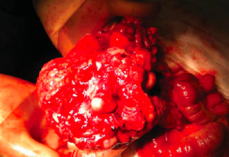
Natural History of PPSC
Peritoneal thickening and omental masses without evidence of primary source of tumor in the ovaries or GI tract
Identical CT and MR findings to metastatic serous ovarian carcinoma
Gross image of resected mesenteric mass consistent with PPSC. No primary tumor was detected in the ovaries.
Picture: http://www.rcsismj.com/4th-edition/peritoneal-ca/
Notes:
Picture: https://www.ncbi.nlm.nih.gov/pmc/articles/PMC4888242/

Slide 4
Demographics and clinical Features
Demographics: most common in postmenopausal women with no prior history of malignancy
Majority of patients diagnosed in advanced stages of disease
Signs and symptoms:
Abdominal pain and distention
Unexplained weight loss
Bowel obstruction
Ascites

Slide 5
Gynecology Oncology Group criteria
Ovaries are either absent or normal in size
Extraovarian sites involvement is greater than the involvement of the surface of either ovary
Ovaries are not associated with the tumor or demonstrate only serosal or cortical invasions with dimensions smaller than 5×5 mm
Histopathological characteristics of the tumor are predominantly of the serous type
https://www.ncbi.nlm.nih.gov/pmc/articles/PMC2739319/
https://www.ncbi.nlm.nih.gov/pmc/articles/PMC5159466/

Slide 6
Pathologic Features
Papillary clusters of malignant cells with atypical mitosis
Eccentric nuclei and prominent nucleoli
Numerous psammoma bodies
Histologically similar to high grade serous ovarian carcinoma

Slide 7
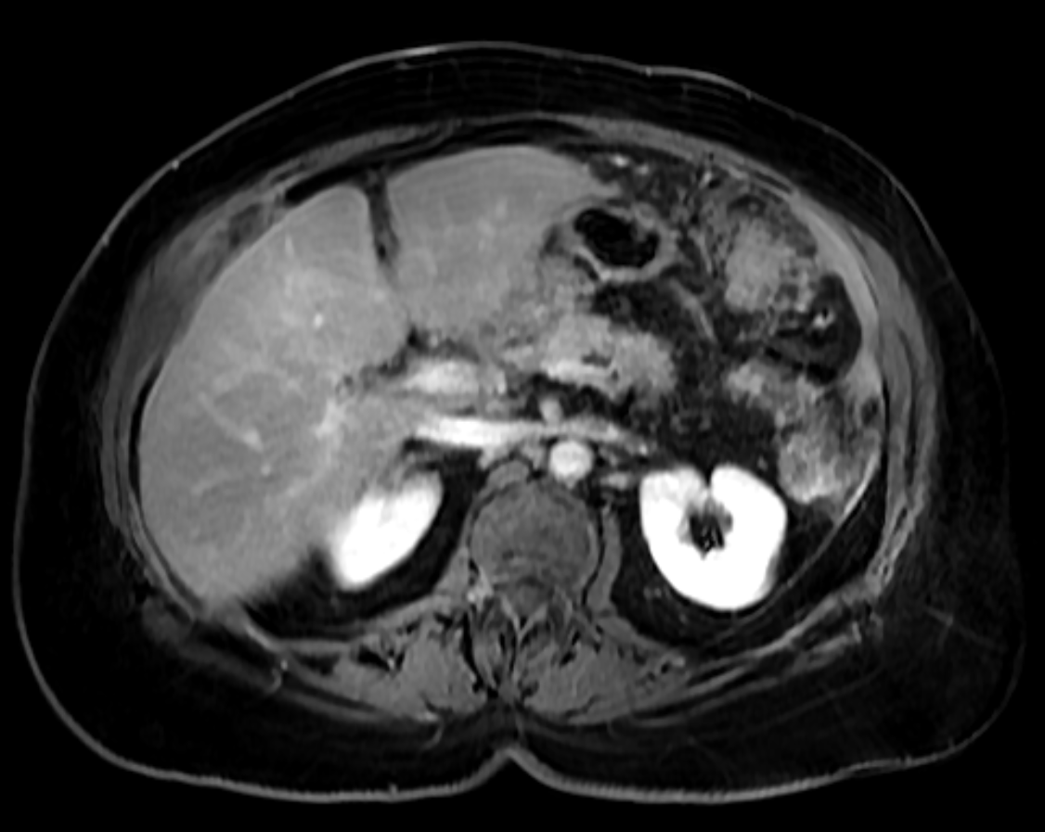
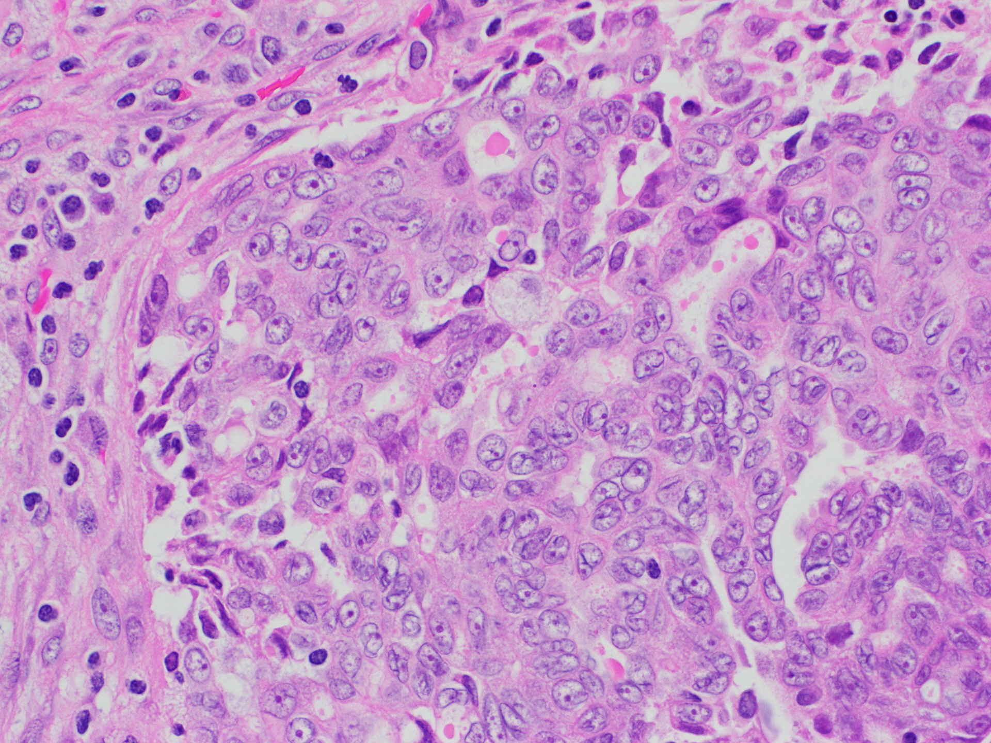
Figure 1a: axial T1w fat sat delayed phase
Figure 1b
Figure 1: MR image shows diffuse enhancing peritoneal thickening with omental implants (arrows) (Fig 1a). Hematoxylin & Eosin, 400X original magnification (Fig 1b) shows glandular architecture composed of large cells with abundant eosinophilic cytoplasm and large ovoid nuclei with irregular nuclear contours and prominent nucleoli consistent with serous carcinoma
Notes:
Mrn 31083975 Acc#: 37865174Diffuse peritoneal thickening and enhancement seen

Slide 8
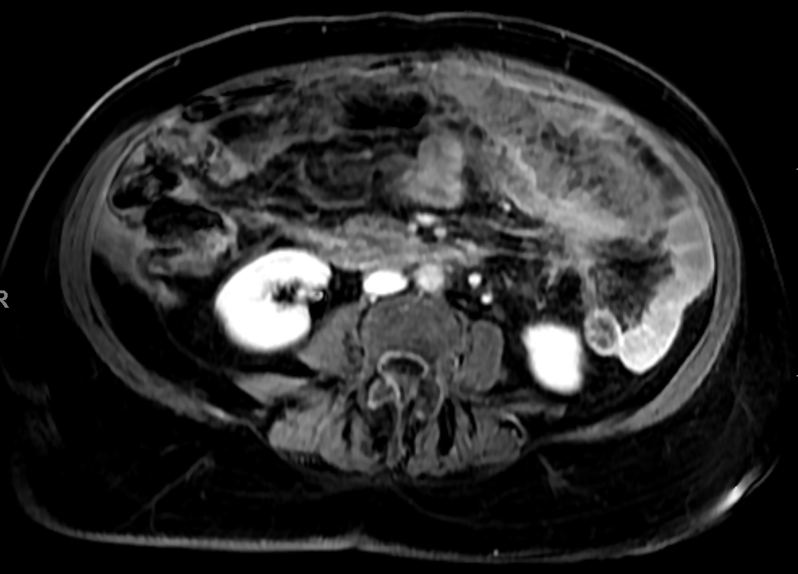
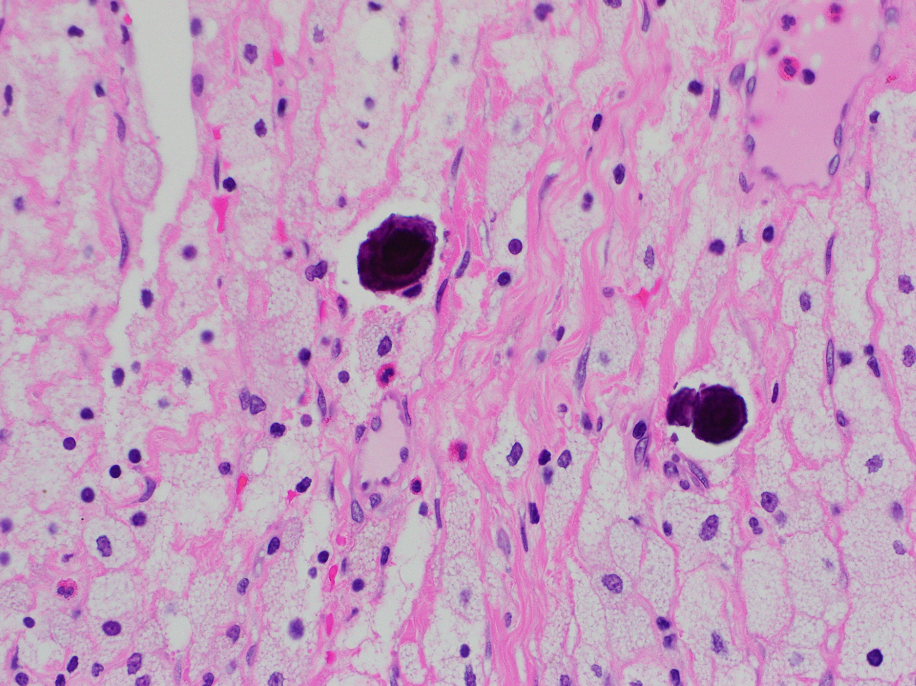
Figure 1c: axial T1w fat sat delayed phase
Fig 1d
Figure 1c of the same patient shows diffuse omental thickening with heterogenous enhancement representing omental implants (arrowhead) with diffuse serosal involvement of the bowel walls (arrows). Hematoxylin & Eosin, 400X original magnification (Fig 2b) shows psammoma bodies: dark purple calcified bodies within sheets of "foamy" macrophages

Slide 9
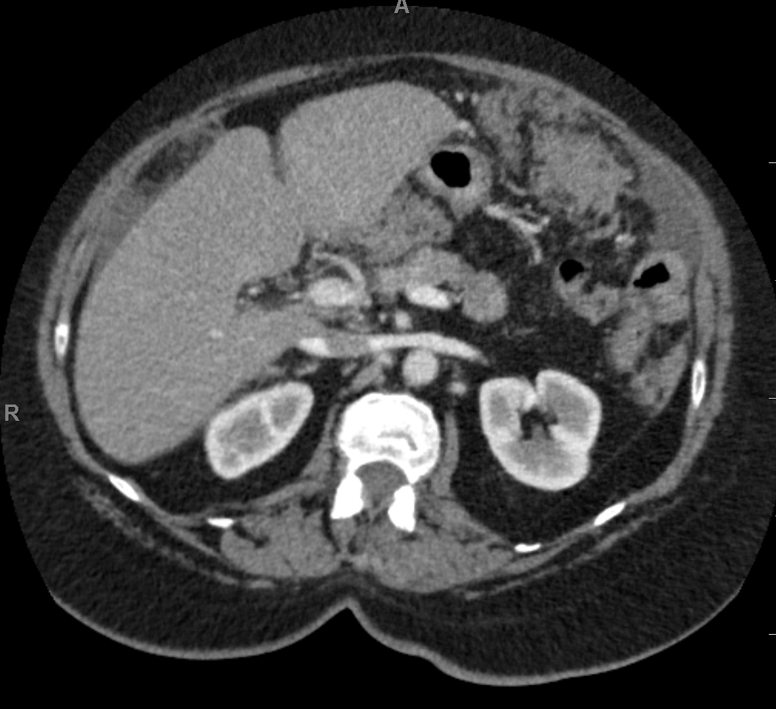
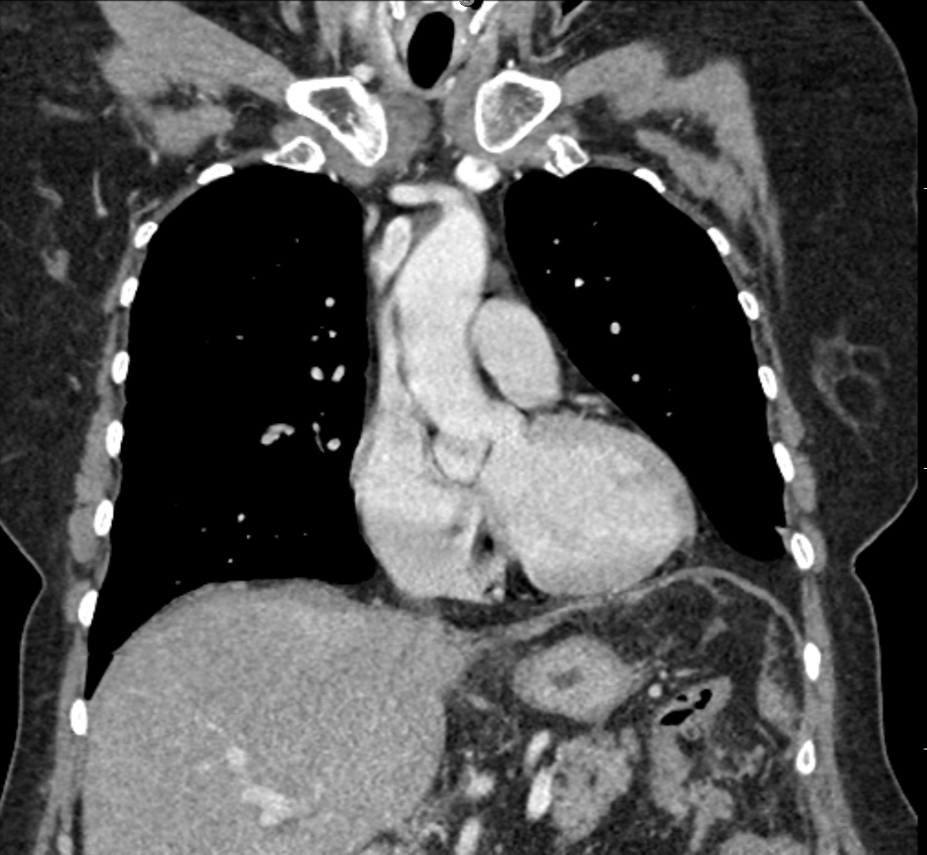
CT Imaging features of PPSC
Figure 2a: axial contrast enhanced CT
Figure 2b: coronal contrast enhanced CT
Figure 2: axial and coronal IV contrast enhanced images show thickening of the omentum with heterogenous attenuation in the anterior omentum suggestive for omental caking. Small amount of perihepatic ascites is present.
Notes:
Thickening of the omentum with heterogenous attenuation in the anterior omentum suggestive for omental caking. Small amount of perihepatic ascites is identified. 31083975

Slide 10
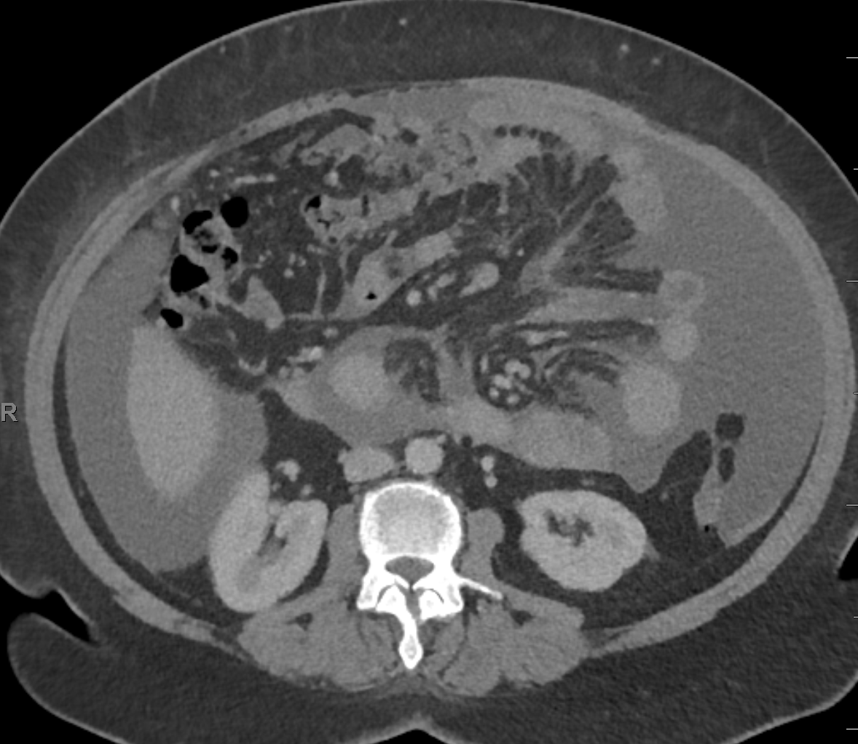
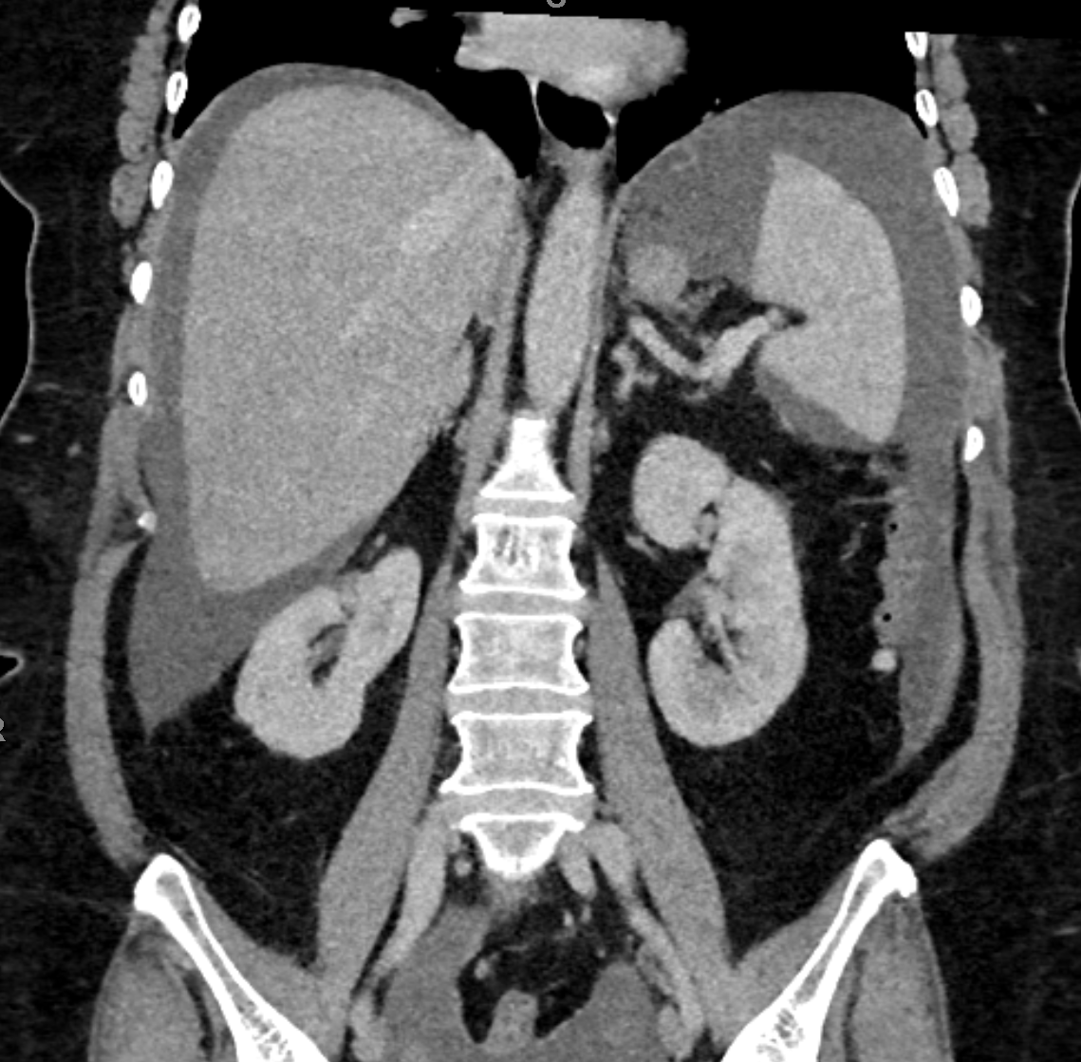
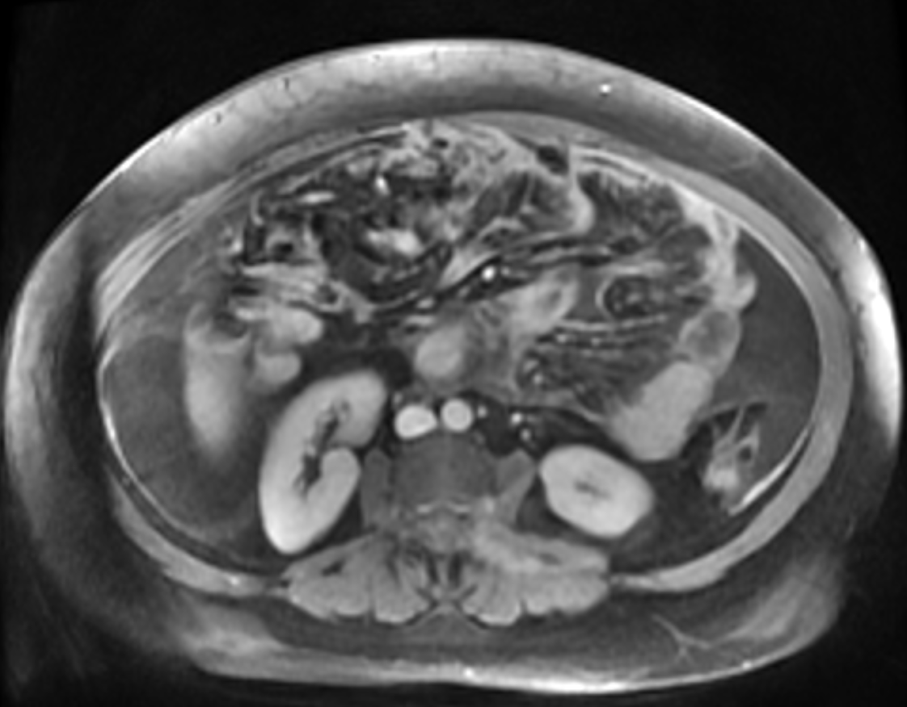
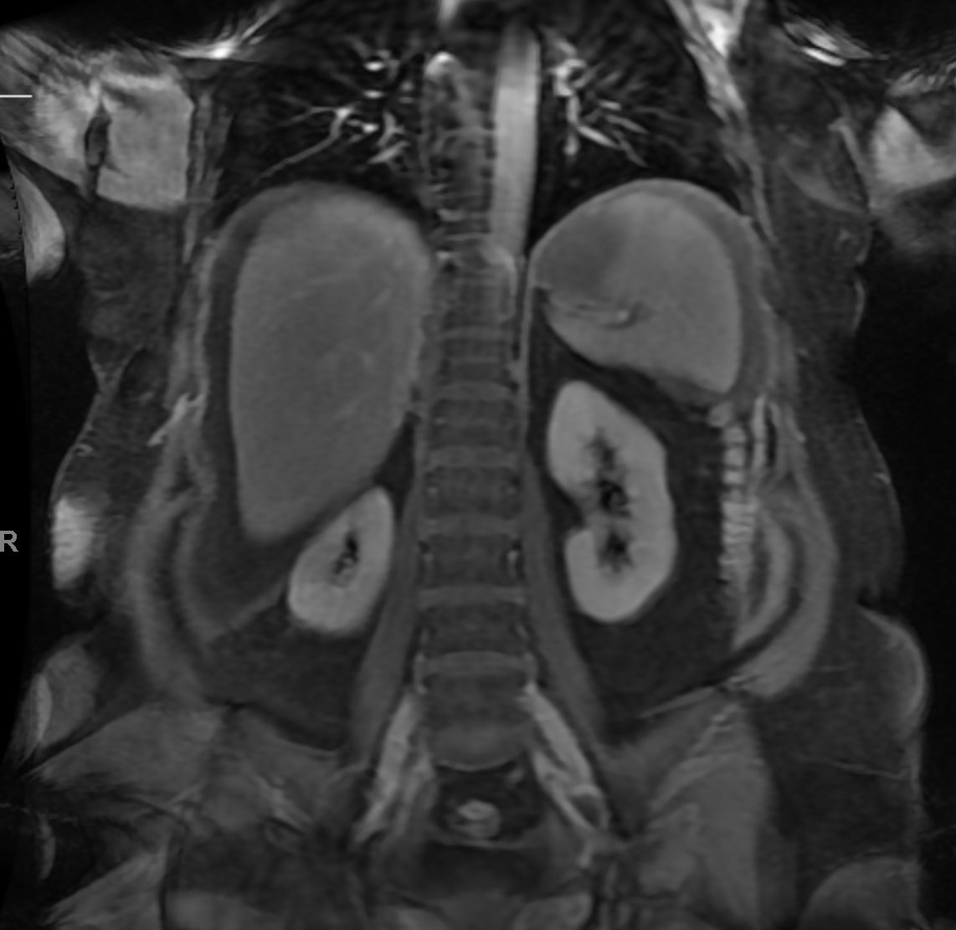
Figure 3a: contrast enhanced axial CT
Figure 3b: contrast enhanced coronal CT
Figure 3c: axial T1w postcontrast venous phase
Figure 3d: Coronal T1 postcontrast venous phase
Figure 3: 56 year old female with abdominal distention. Axial and coronal CT shows ascites and peritoneal thickening (Fig 3a-b). Enhancing peritoneal nodularity and extension is better assessed on MR images (Fig 3c-d). Omental caking is demonstrated better on MR image (Fig 3c) (arrowhead). Findings are consistent with primary primary peritoneal serous carcinoma
Notes:
Peritoneal thickening and enhancement are noted (series 2655 image 47). Omental caking is also present (series 2655 image 52). Ct PERITONEAL THICKENING MORE OBVIOUS ON mri
ZAZUETA, ESTHER PID: 02446466, Sex: F, D.O.B: 4/18/1956 : 62-year-old woman with left lower quadrant abdominal pain.

Slide 11
Diagnostic Imaging features of PPSC
Peritoneal thickening and nodularity
Omental caking
Malignant ascites
CT: heterogenous appearance with internal necrosis
MR imaging: low signal on T1 with high T2 signal and heterogenous enhancement following contrast administration
No evidence of primary ovarian or GI malignancy

Slide 12
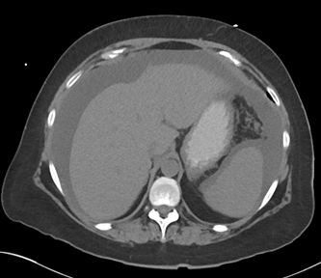
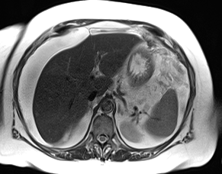
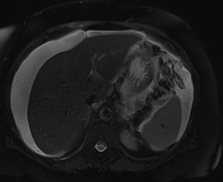
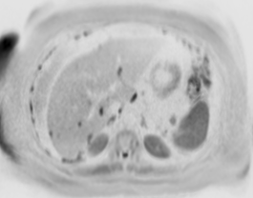
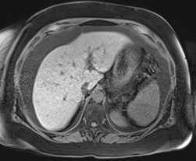
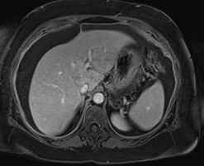
Figure 4a: axial CT
Figure 4b: axial T2w
Figure 4c: axial T2w fat saturated
Figure 4d: DWI
Figure 4e: axial T1w fat sat pre-contrast
Figure 4f: axial T1w fat sat venous phase
Figure 4: 62 year old female with abdominal pain. Nodular peritoneal thickening and ascites in the abdomen is better characterized on T2w MRI (Fig 4b-c) than CT (Fig 4a). Tumor restricts diffusion on DWI sequence (Fig 4d). Enhancement of the nodular peritoneal thickening is well seen on T1w pre and post contrast imaging (Fig 4e-f). Imaging findings favor primary peritoneal serous carcinoma (PPSC) rather than peritoneal carcinomatosis given no evidence of other primary tumor in this post menopausal female. Upon biopsy, pathology proved this to be a case of PPSC

Slide 13
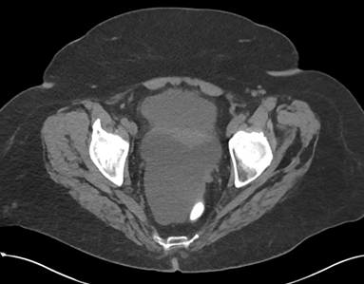
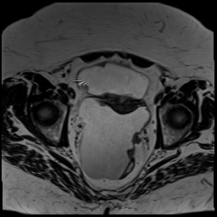
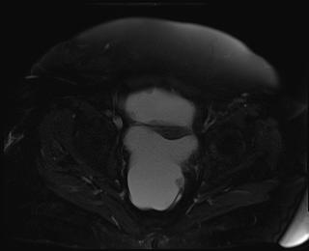
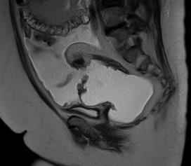
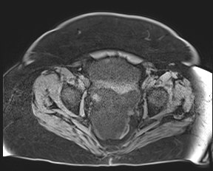
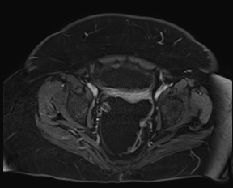
Figure 5a: axial CT
Figure 5b: axial T2w high resolution
Figure 5c: axial T2w fat saturated
Figure 5d: sagittal T2w
Figure 5e: axial T1w fat sat pre-contrast
Figure 5f: axial T1w fat sat delayed phase
Figure 5: Postmenopausal female with weight loss. Nodular peritoneal thickening and ascites in the pelvis are better characterized on T2w MRI (Fig 5b-d) than CT (Fig 5a). Enhancement of the nodular peritoneal thickening is seen on T1w pre and post contrast images (Fig 5e-f). No evidence of tumor in the ovaries. Findings favor primary peritoneal serous carcinoma (PPSC)

Slide 14
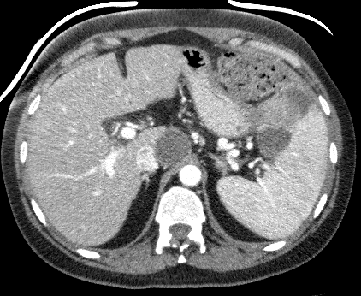
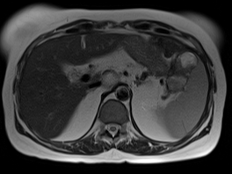
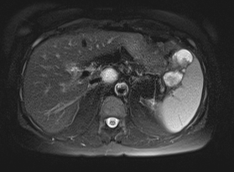
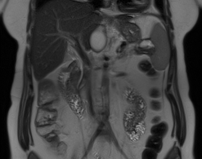
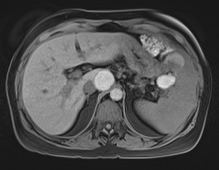
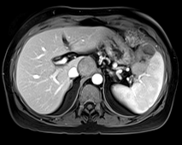
Figure 6a: axial CT
Figure 6b: axial T2w
Figure 6c: axial T2w fat saturated
Figure 6d: coronal T2w
Figure 6e: axial T1w fat sat pre-contrast
Figure 6f: axial T1w fat sat venous phase
Figure 6: 53 year old female with history of primary peritoneal carcinomatosis post omentectomy and chemotherapy. A solid and cystic perisplenic metastatic implant is better characterized on T2w MRI (Fig 6b-c-d) than CT (Fig 6a). Internal hemorrhage and enhancement of the perisplenic impant is well demonstrated on T1w pre and post contrast imaging (Fig 6e-f)

Slide 15
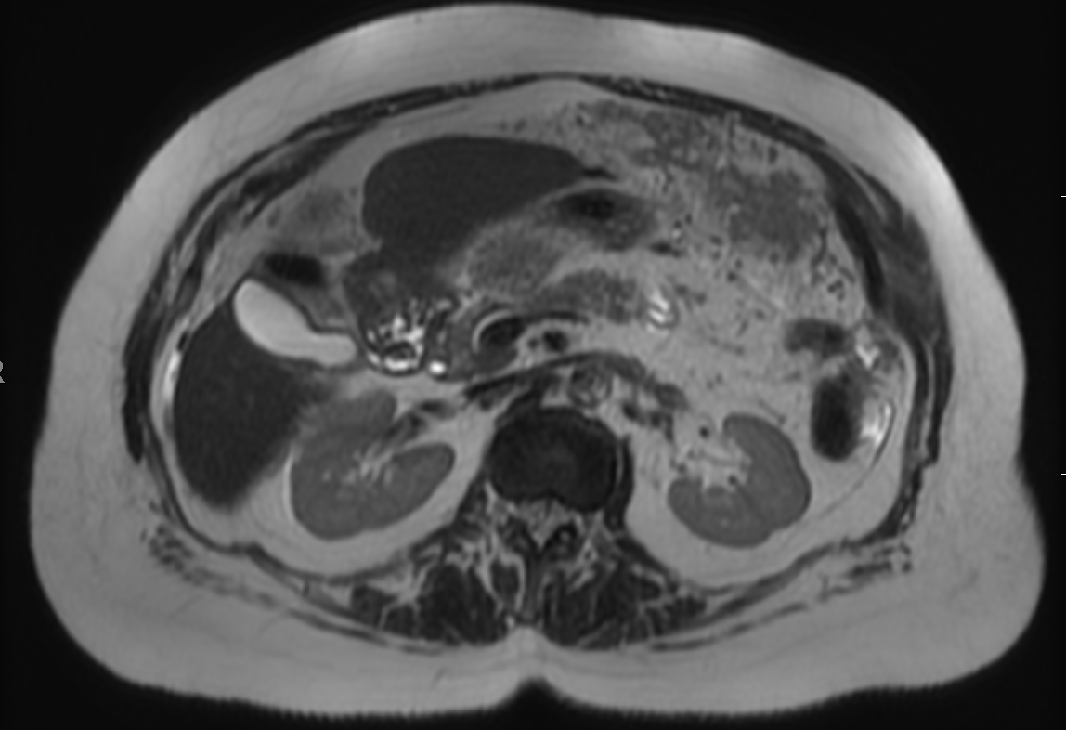
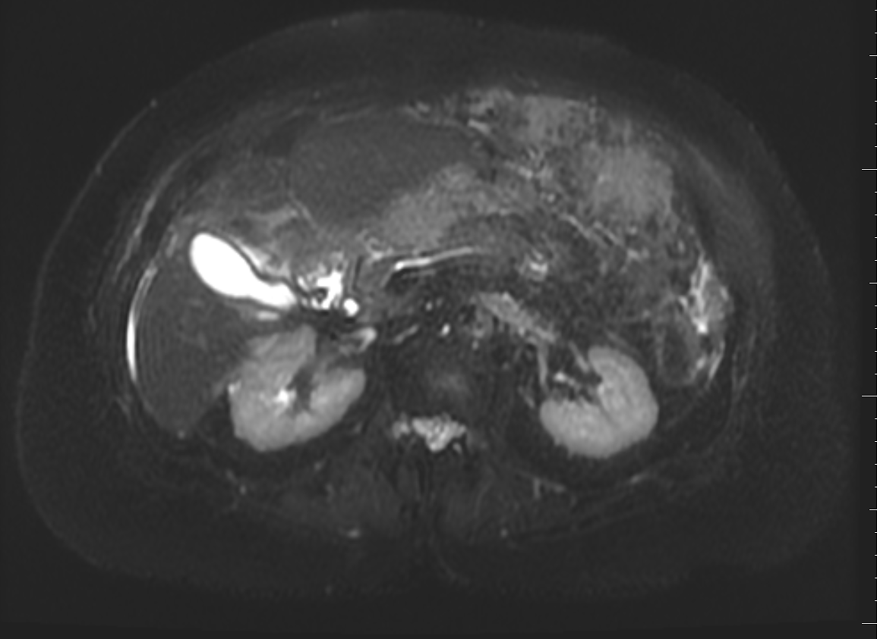
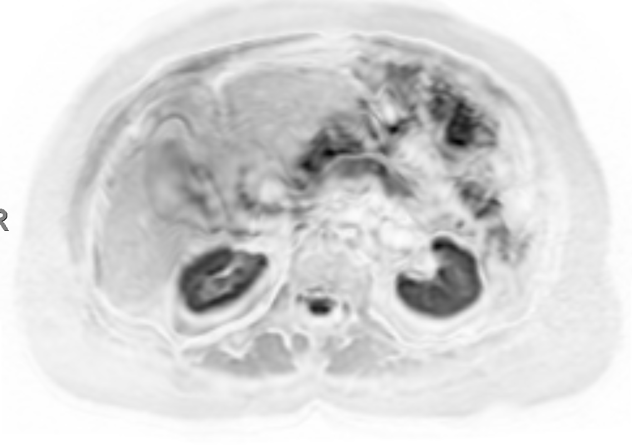
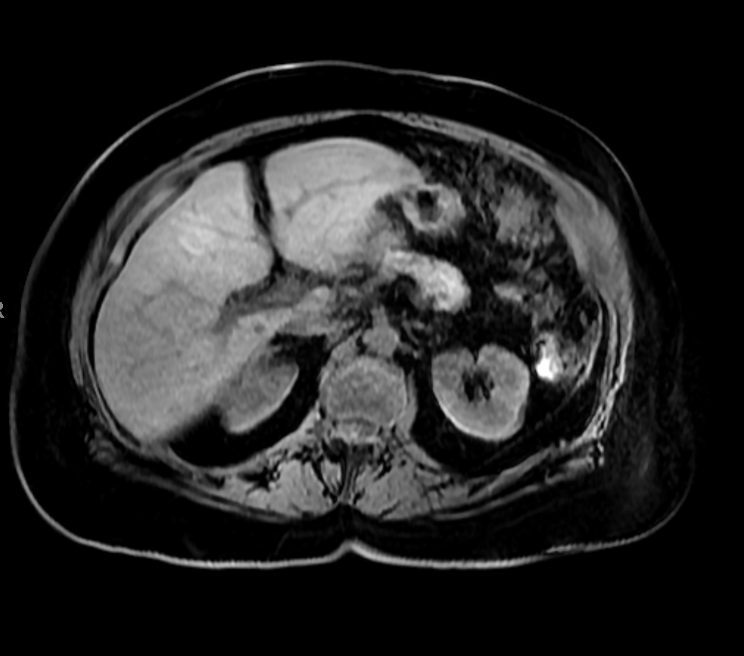
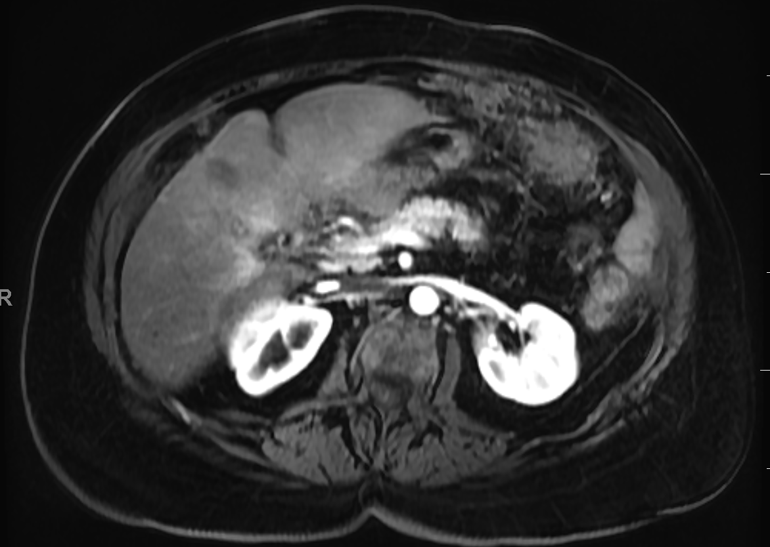
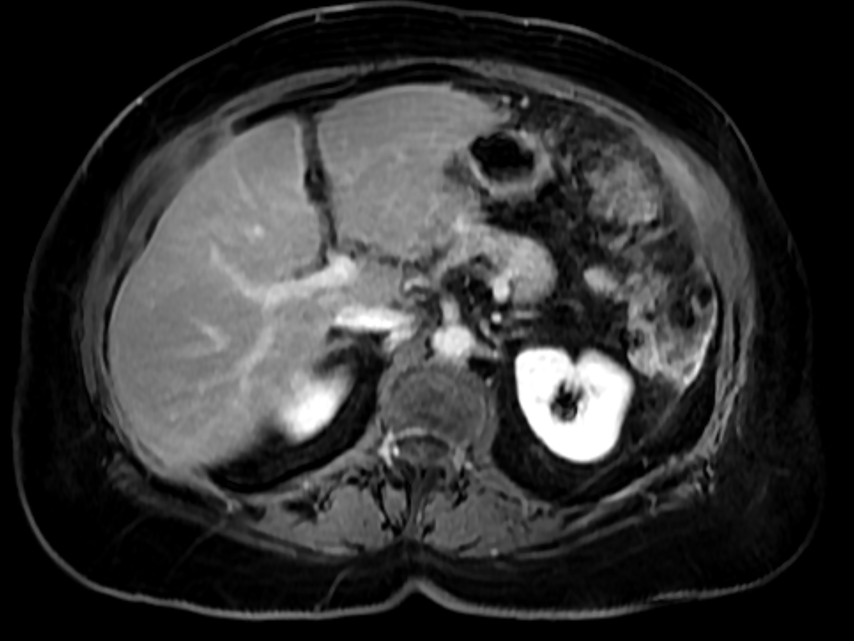
Figure 7a: axial T2w
Figure 7b: axial T2w fat saturated
Figure 7c: DWI
Figure 7d: axial T1w fat sat pre-contrast
Figure 7e: axial T1w fat sat arterial phase
Figure 7f: axial T1w fat sat delayed phase
Figure 7: 64 year old female with abdominal pain. Sheetlike thickening of the greater omentum seen with nodular peritoneal thickening demonstrate hypointense T2w signal (Fig 7a-b). Heterogeneously enhancing soft tissue in the omentum is seen on T1w pre and post contrast imaging (Fig 7d-e-f). The tumor restricts diffusion (Fig 7c). Imaging findings consistent with primary peritoneal serous carcinoma (PPSC). No evidence of other primary tumor.

Slide 16
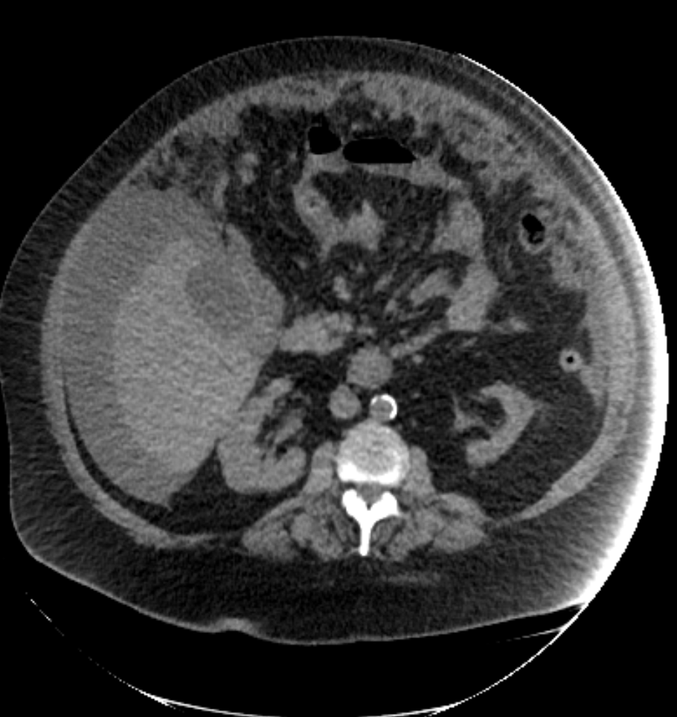
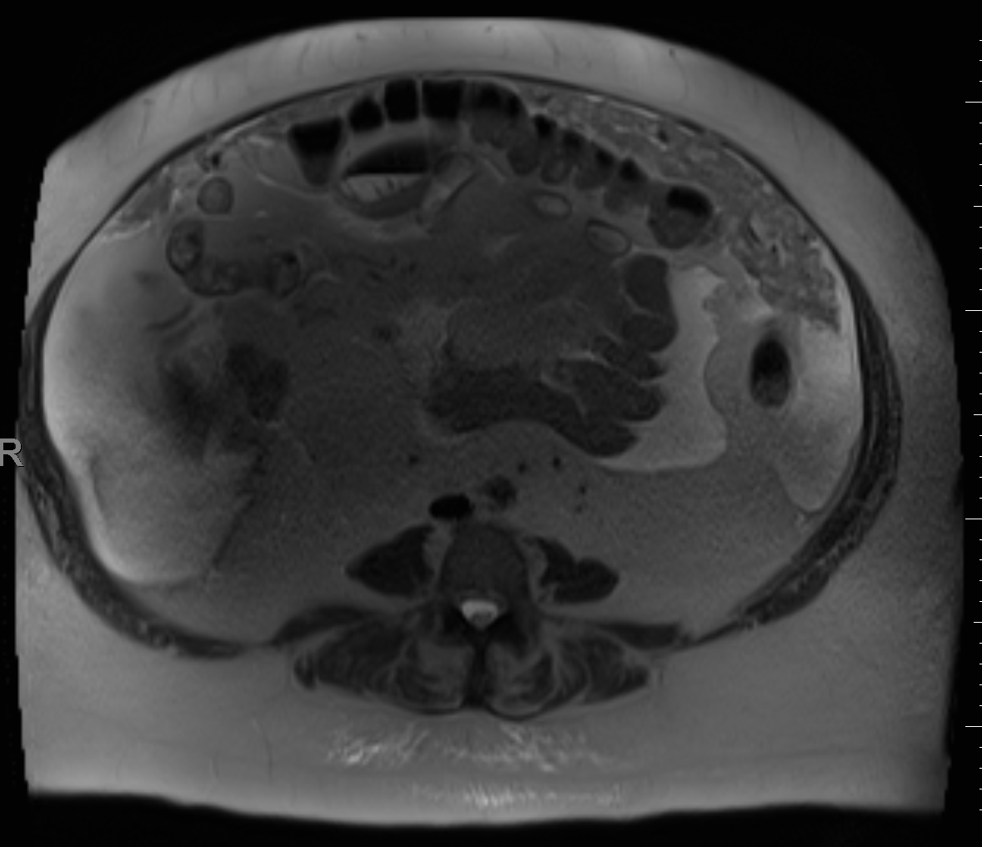
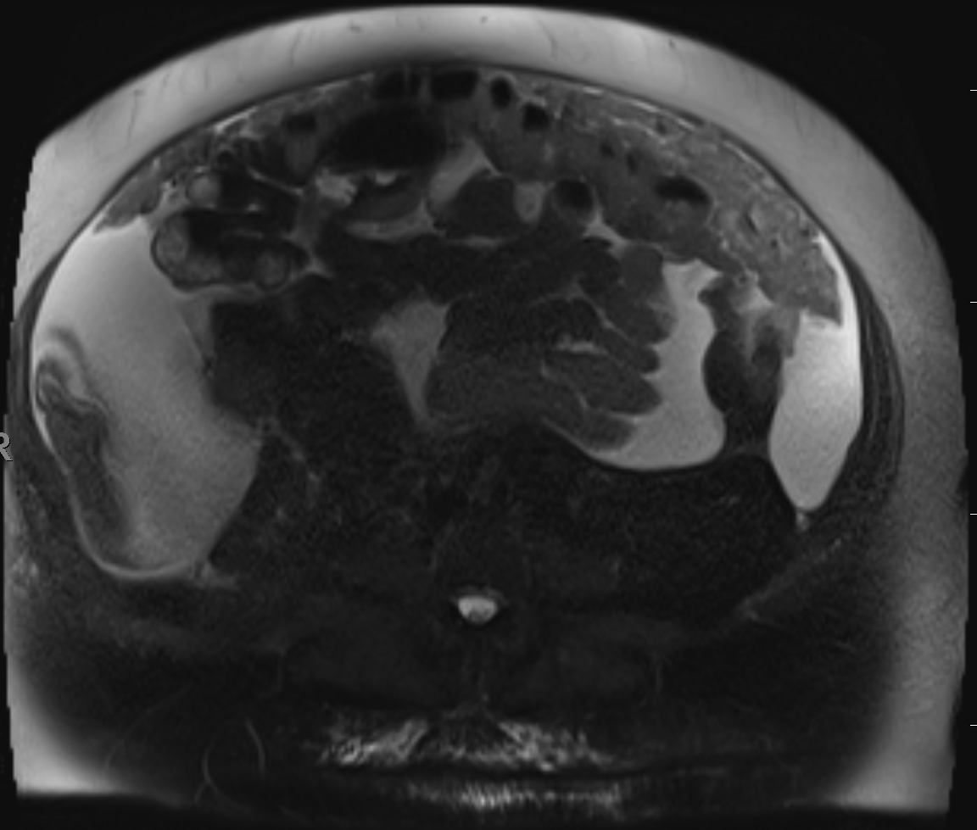
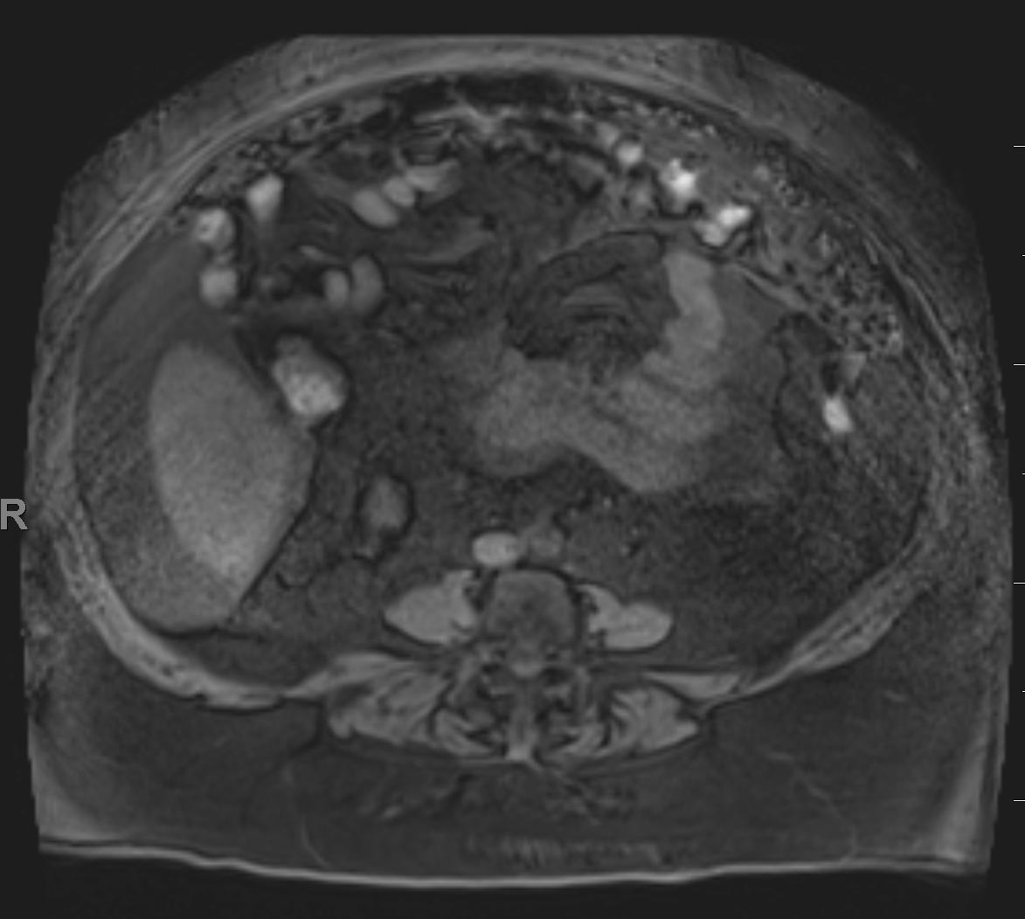
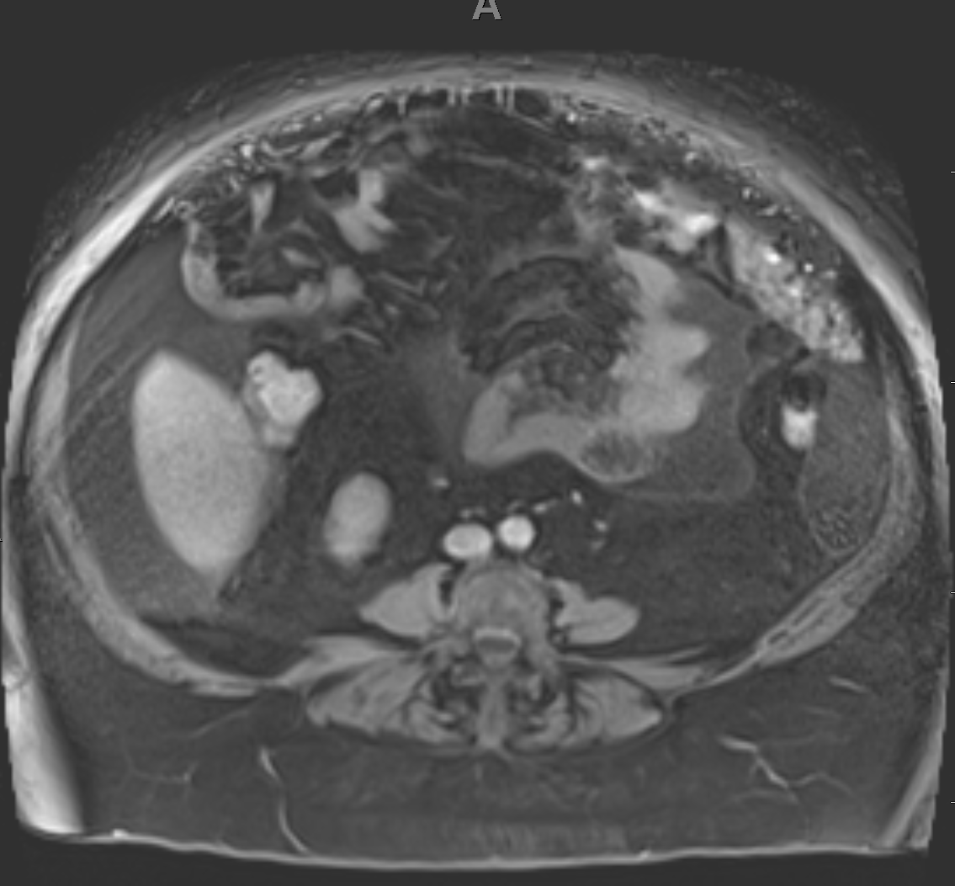
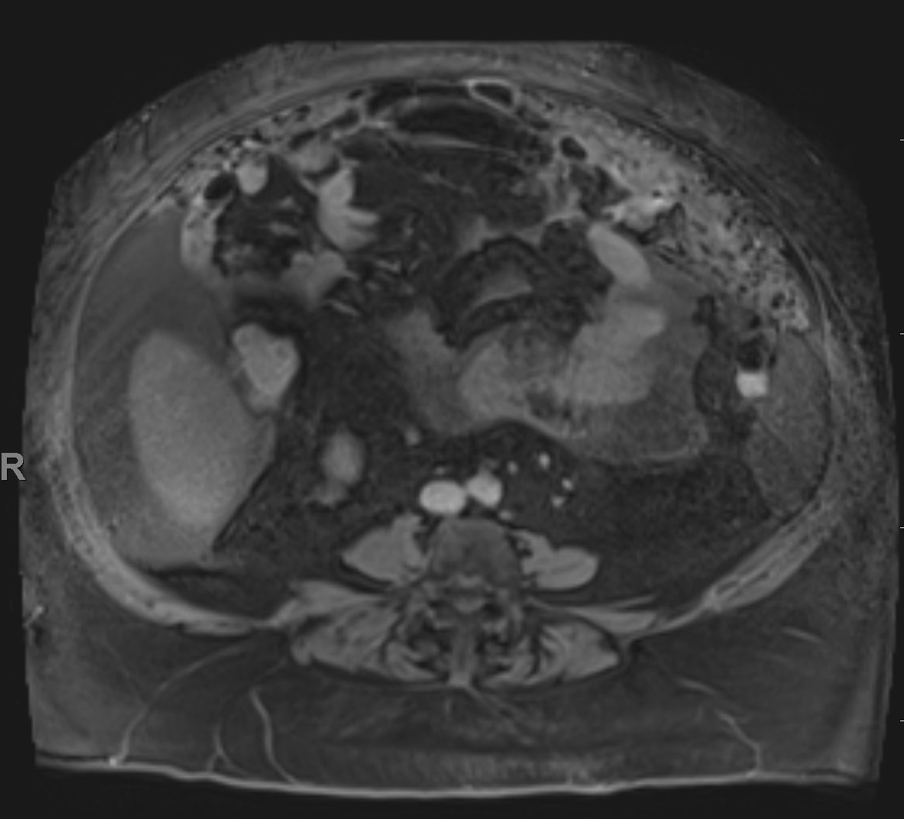
Figure 8a: axial CT
Figure 8b: axial T2w
Figure 8c: axial T2w fat saturated
Figure 8d: axial T1w fat sat pre-contrast
Figure 8e: axial T1w fat sat arterial phase
Figure 8f: axial T1w fat sat delayed phase
Figure 8: 61 year old female with abdominal distention. MR images show peritoneal/omental tumor infiltrate with peritoneal thickening and nodular components, better characterized on T2w (Fig 8b-c) than CT (Fig 8a). Enhancement of the omental infiltrates is seen on dynamic images (Fig 8d-e-f). A primary uterine/ovarian neoplasm is not identified. Primary diagnostic consideration is primary peritoneal papillary serous carcinoma.

Slide 17
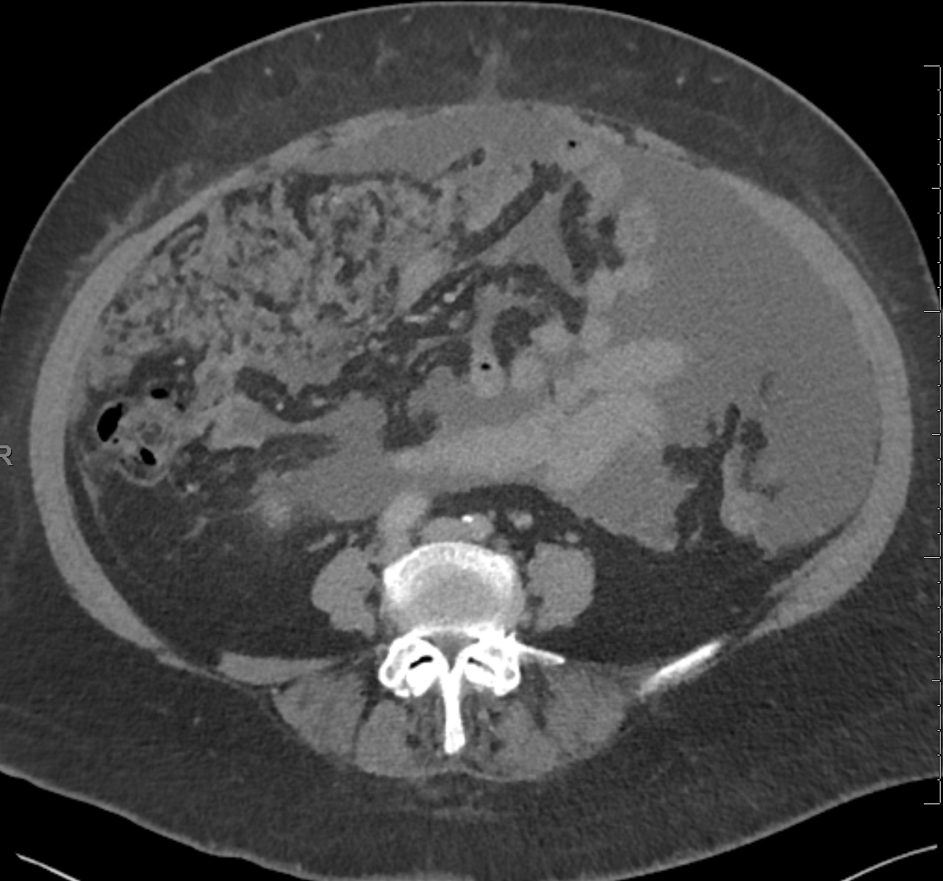
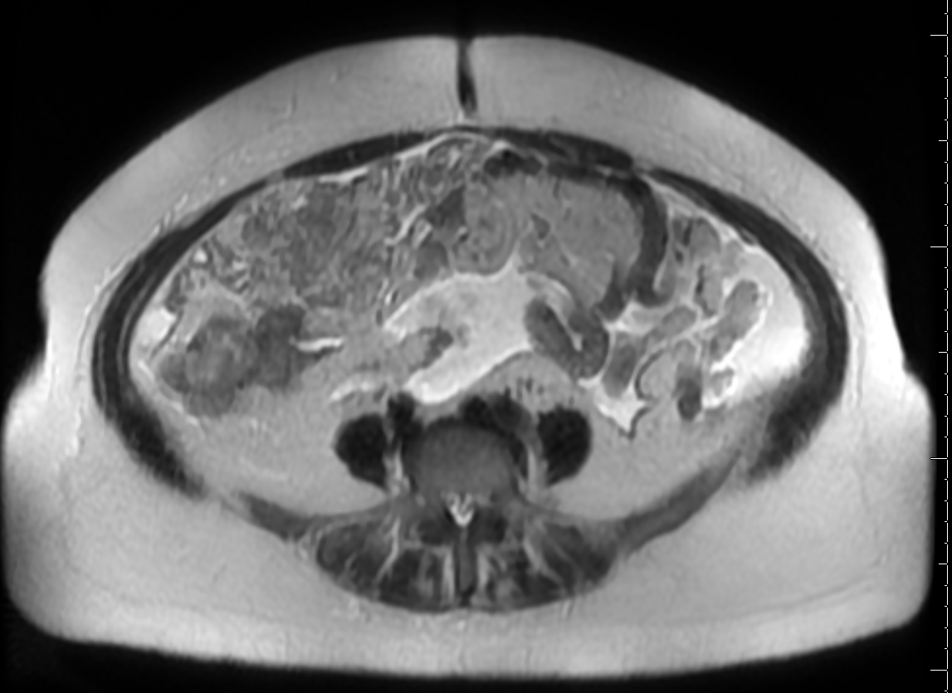
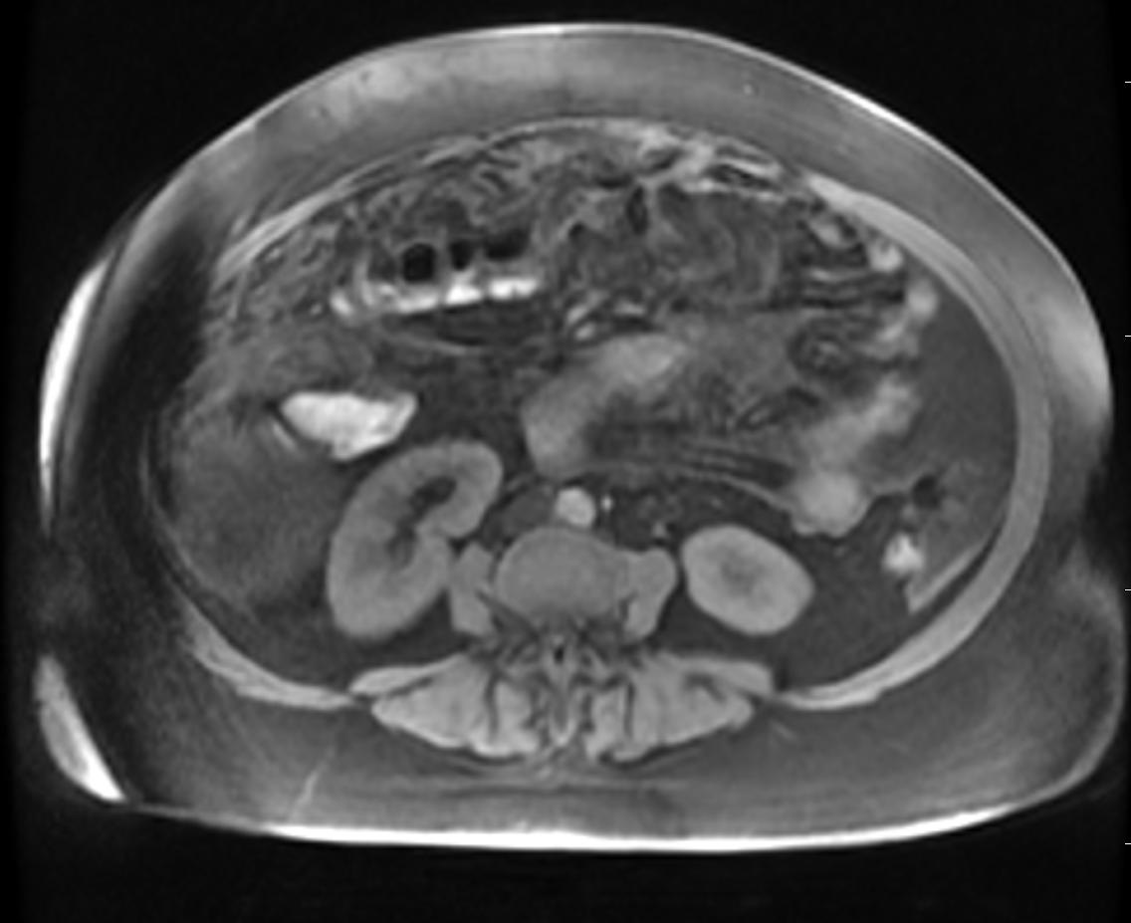
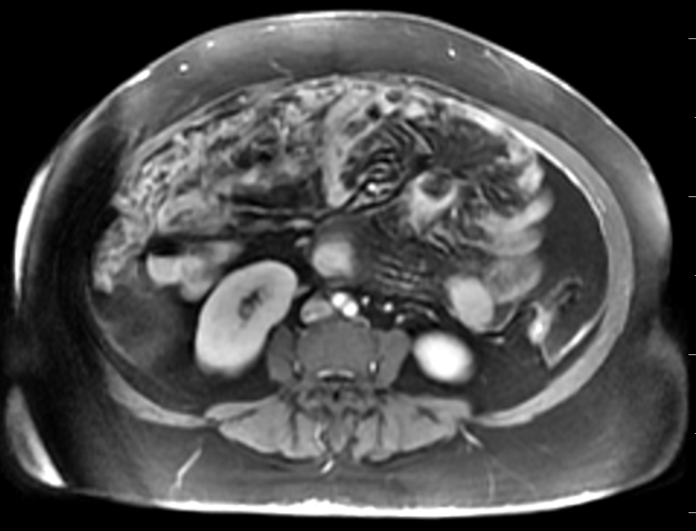
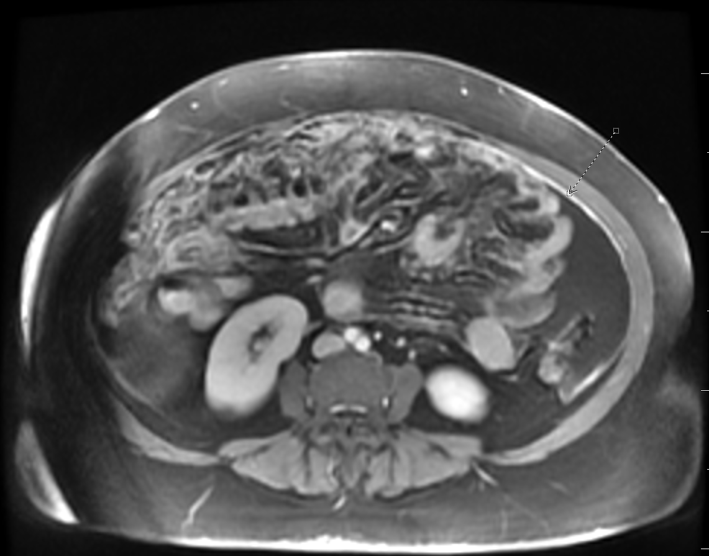
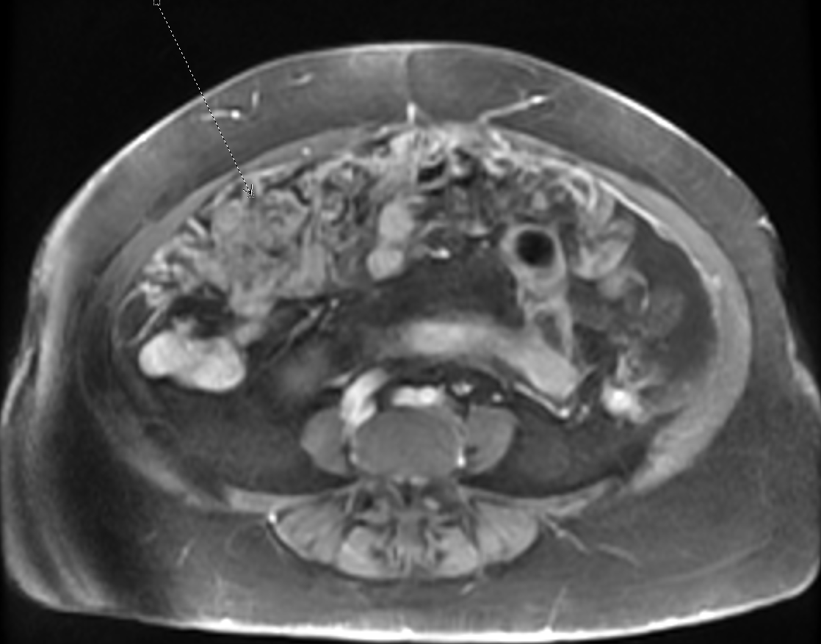
Figure 9a: axial CT
Figure 9b: axial T2w
Figure 9c: axial T1w precontrast
Figure 9d: axial T1w fat sat arterial phase
Figure 9e: axial T1w fat sat venous phase
Figure 9f: axial T1w fat sat delayed phase
Figure 9: 56 year old female with increasing abdominal fullness and pain. CT image (Fig 9a) shows ascites, diffuse peritoneal nodularity and enhancement. Nodularity in the region of the omentum is better visualized on MR images (Fig 9b-c) consistent with omental caking. Enhancing omental masses with peritoneal thickening and nodularity are seen on dynamic images (Fig 9d-e-f). Primary diagnosis of primary serous tumor of the peritoneum given absence of known history of prior malignancy.
Notes:
Diffuse peritoneal nodularity and enhancement is seen. Nodularity in the region of the omentum in the right lower quadrant is seen concerning for peritoneal carcinomatosis. In absence of known history of prior malignancy, workup for a primary tumor is recommended. Differential of primary serous tumor of the peritoneum is also considered. Further characterization with MRI of the abdomen with and without contrast will be helpful.

Slide 18
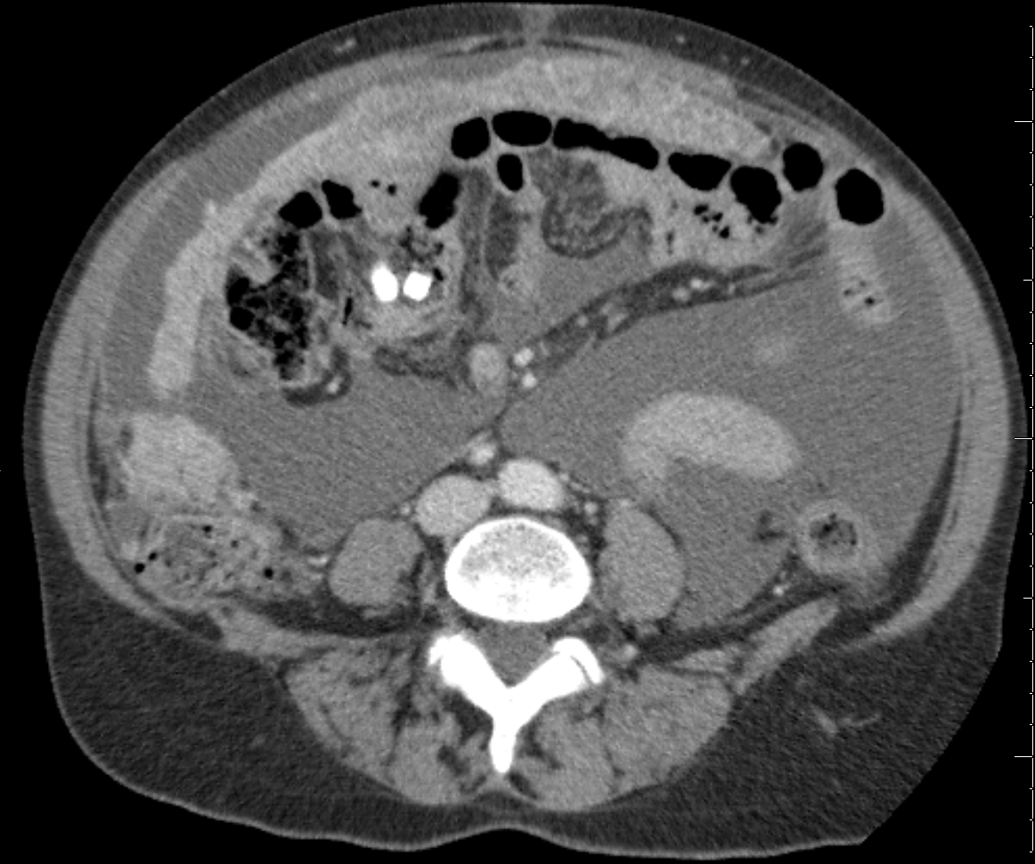
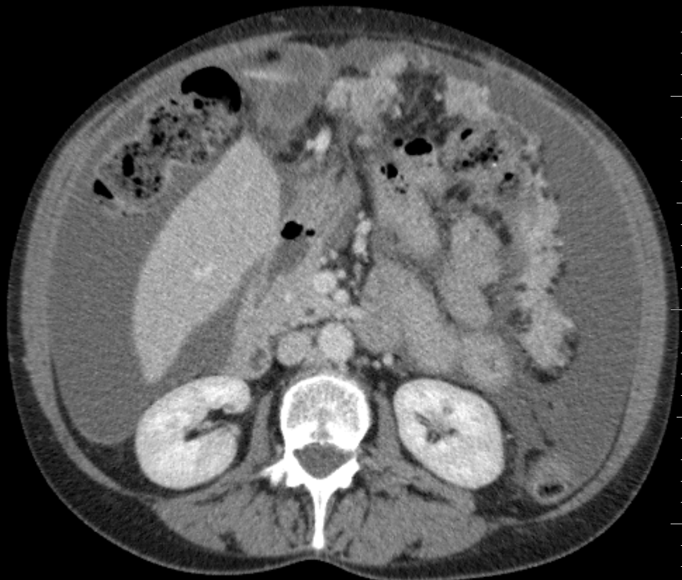
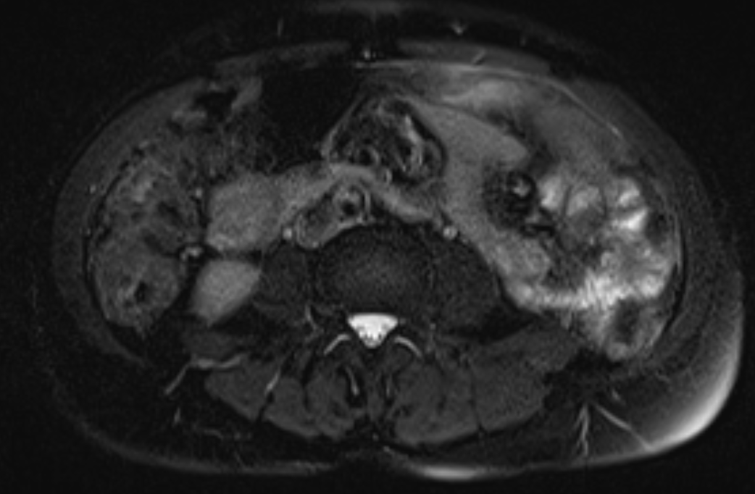
Figure 10a: axial CT
Figure 10b: axial CT
Figure 8c: axial T2w SPAIR
Figure 10d: axial T1w precontrast
Figure 10e: axial T1w fat sat arterial phase
Figure 10f: axial T1w fat sat delayed phase
Figure 10: 58-year-old female with shortness of breath and abdominal distention. Nodular thickening of the omentum and ascites on CT images (Fig 10a-b). Peritoneal nodular thickening, diffuse enhancement and omental caking extension within the abdominal cavity is better assessed on the dynamic MR images (Fig 10d-e-f). No primary tumor was found in the ovary. Imaging findings favor primary peritoneal serous carcinoma (PPSC)
Notes:
MARTIN, RHONDA, JOY PID: 58-year-old female with shortness of breath and abdominal distention. 7/17/2016

Slide 19
Figure 11a: axial CT
Figure 11b: axial T2w
Figure 11c: axial T2w SPAIR
Figure 11d: axial T1w precontrast
Figure 11e: axial T1w fat sat arterial phase
Figure 11f: axial T1w fat sat delayed phase
Figure 11: 61 year old female with nausea and vomiting. Axial CT image shows ill defined nodular thickening (Fig 11a). Diffuse smooth nodular enhancement of the peritoneum is better seen on MR images in keeping with primary peritoneal serous carcinoma in this post menopausal female given no evidence of primary tumor was found in the ovary
Notes:
CT Again noted is diffuse peritoneal carcinomatosis, with thickening and enhancement of the peritoneum. Nodular thickening and enhancement of the omentum diffusely is present for example seen in series 7, image 88. Peritoneal nodular thickening and enhancement within the abdominopelvic cavity seen for example seen in series 7,
MRI has been interval development of diffuse smooth nodular as well as bulky peritoneal implants, with a previously unseen solid conglomerate in the lesser sac measuring 1.9 x 4.0 cm anterior to the neck of the pancreas (axial T2 series 14/image 19). MARTIN, RHONDA, JOY PID: 58-year-old female with shortness of breath and abdominal distention. , Sex: F
Omental implants 12/27/2018 CT
MR 6/25/2019

Slide 20
Clinical Implications
Primary peritoneal serous carcinoma (PPSC) comprises 15% of ovarian epithelial carcinomas and almost always occurs in postmenopausal women.
PPSC is indistinguishable from metastatic serous ovarian carcinoma on histology.
PPSC can be a difficult diagnosis to make and MRI is both more sensitive and specific than CT.
Imaging features of PPSC include enhancing peritoneal, retroperitoneal, and omental nodules as well as ascites without other primary tumor.
Accurate diagnosis by MRI can save time and resources by preventing an extensive workup looking for another primary tumor and also provides answers for the patient and allows clinicians to plan the best course of treatment.

Slide 21
References
Kah Poh Loh, Hatem Ghorab et al. Royal College of Surgeons in Ireland Student Medical Journal 2011;4(1):28-30
WOO-SUNG YUN and JUNG-MIN BAE. Primary peritoneal serous carcinoma, an extremely rare malignancy: A case report and review of the literature. Oncol Lett. 2016 Jun; 11(6): 4063–4065.
Angela D. Levy, Javier Arnáiz, Janet C. Shaw, Leslie H. Sobin. Primary Peritoneal Tumors: Imaging Features with Pathologic Correlation. RadioGraphics. Mar 1 2008. https://doi.org/10.1148/rg.282075175
Kusum Heda, Varna Indushekar, Geeta Pachori, Astha Sharma. Primary peritoneal serous carcinoma: A diagnostic dilemma of pelvic epithelial neoplasms. 2015; 551-554. DOI: 10.4103/2278-0513.157944
Jingping Yuan, Liang He, Bing Han & Yan Li. Long-term survival of high-grade primary peritoneal papillary serous adenocarcinoma: a case report and literature review. World Journal of Surgical Oncology volume 15, Article number: 76 (2017)
Delores J. Grant,1 Patricia G. Moorman,2 Lucy Akushevich,2 Rachel T. Palmieri,3 Rex C. Bentley,4 and Joellen M. Primary peritoneal and ovarian cancers: an epidemiological comparative analysis.Cancer Causes Control. 2010 Jul; 21(7): 991–998.

Slide 22
Thank you
Contact: Salbayati@radiology.arizona.edu

