Slide 1

Quantitative novel rapid high resolution coronal T1 and T2 mapping sequences of the sacroiliac joints at 3T
Matthew Kay MBBS¹, John Hurlbert MD/PhD¹, Nikolay Martirosyan MD/PhD¹, Kevin Johnson BA¹, Mihra Taljanovic MD/PhD¹, Jennifer Becker BMBS¹
¹University of Arizona, Tucson, AZ, USA

Slide 2
DISCLOSURES
Jennifer Becker has a research contract with syngo.via (Siemens Healthineers, Erlangen, Germany), with money paid to the University of Arizona.
No other relevant conflict of interest.

Slide 3
OBJECTIVE
To evaluate the feasibility of performing high-resolution coronal T1 and T2 mapping sequences of the sacroiliac joints (SIJs) in heathy volunteers in a clinically useful time frame
To obtain and compare T1 and T2 quantitative values of the cartilaginous and non-cartilaginous compartments of the SIJs in healthy volunteers without history of back pain
To compare the values of volunteers under or over 40-years-of-age to evaluate for age related change
To use this data as a baseline for further study of symptomatic patients

Slide 4
BACKGROUND
SIJs are the pain generators in up to 30% of people with lower back pain
Currently no reliable imaging biomarker exists for evaluating SIJ pain
T1 and T2 mapping has been successfully used in other joints to quantitatively evaluate for cartilaginous degenerative change and is a potential quantitative imaging biomarker for degenerative SIJ disease
For MRI to be a useful biomarker, imaging needs to be performed in a short, clinically appropriate, time frame
To date T2 mapping of the SIJs requires long acquisition times
T1 imaging has been proven to be more sensitive to early cartilaginous degenerative change than T2 imaging in the knee, but has not been evaluated in the SIJ

Slide 5
METHODS & MATERIALS
32 SIJs from 16 healthy volunteers imaged with IRB approval
MRI at 3T (Skyra, Siemens Healthineers, Erlangen, Germany) using:
  Torso and spine phase array coils
  FOV of 165x165
T1 3D spoiled gradient echo sequence (3D SPGR) VIBE
  Matrix 256x256
  3 flip angles 2º, 10º and 15º with B1 correction
  Each flip angle <2 mins, combined = <6 mins
T2 radial turbo spin-echo sequence (RADTSE)
  Matrix 230x256 interpolated to 256x256
  8 echoes = 7.44 mins

Slide 6
METHODS & MATERIALS
T1 and T2 maps were generated in syngo.via VB40A (Siemens Healthineers, Erlangen, Germany)
SIJ segmented into anterior, middle and posterior regions
3 freehand region of interests (ROIs) measured bilaterally for each anterior, middle and posterior region –
  Inferior third (synovial compartment), (0.2cm²)
  Superior third (non-synovial compartment), (0.2cm²)
  Whole SIJ (including upper and lower thirds), (0.5-1.2cm²)
Minimum (min), maximum (max), mean and SD recorded for all ROIs
2 tailed student’s T-Test performed to evaluate for difference between the values obtained for those under vs. over 40 years

Slide 7
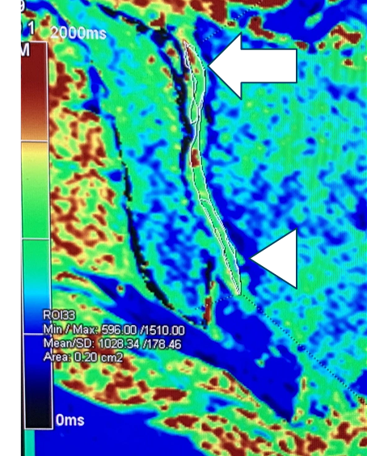
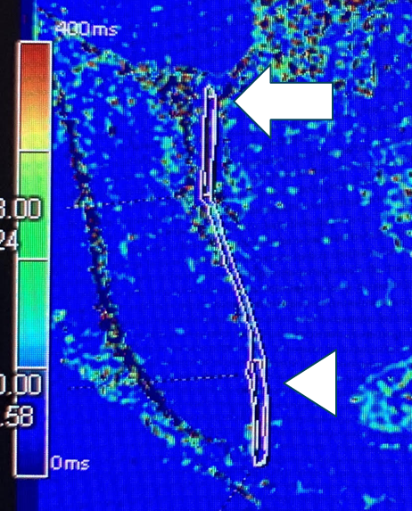
Figure 1: Coronal 3D SPGR T1 map (A) of the right posterior SIJ and coronal T2 RADTSE map (B) of the right anterior SIJ in a 39-year-old female volunteer, showing ROIs within the superior (white arrow) and inferior (white arrowhead) thirds of the SIJs that are overlaid upon an ROI of the whole SIJ.
A
B

Slide 8
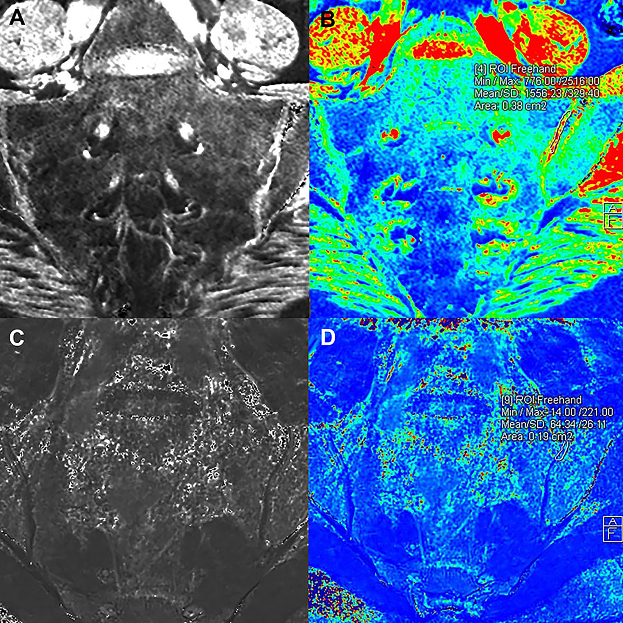
Figure 2: Coronal 3D SPGR T1 image (A) and T1 map (B) of the SIJs in a 53-year-old female asymptomatic volunteer. Coronal RADTSE T2 image (C) and T2 map (D) of the SIJs in a 21-year-old female asymptomatic volunteer. The ROIs (yellow arrows) on the T1 (B) and T2 (D) maps correspond to the superior (non-synovial) compartments of the left SIJs.

Slide 9
RESULTS
Excellent quality images obtained in all 32 joints evaluated
Table 1: Summary of the mean T1 and T2 values (in ms) for superior, inferior and whole SIJ ROIs.

Slide 10
RESULTS
4 male and 10 female volunteers; 8 under and 8 over 40-years
Age range 20- to 67-years, mean 42.25, SD 12.5
Comparing ROIs for those under or over 40-years:
  T1 values -
    No statistical significance for any ROI
    All p>0.05 (range 0.08-0.97)
  T2 values -
    No statistical significance except for right posterior inferior (or synovial) compartment
    For right posterior inferior compartment in those over vs. under 40-years
      Decreased minimum: 23 vs. 28 (p=0.03)
      Increased maximum: 241 vs. 90 (p=0.01)
      Increased mean 62 vs. 46 (p=0.03)

Slide 11
CONCLUSION
  The described T1 and T2 SIJ mapping techniques are robust and can successfully be performed in healthy volunteers in a clinically useful time frame
  T1 and T2 values can be obtained from these maps, showing variation between the synovial and non-synovial compartments as well as the anterior, middle and posterior regions of SIJs
  Comparing volunteers under vs. over 40-years –
    T1 values:
      No statistical significance for any ROIs in the inferior, superior or whole SIJs
    T2 values:
      No statistical significance except for right posterior inferior (or synovial) compartment where there was decreased minimum, increased mean and increased maximum values
      Likely reflecting early (clinically silent) degenerative cartilaginous changes

Slide 12
REFERENCES
Schwarzer AC, Aprill CN, Bogduk N. The sacroiliac joint in chronic low back pain. Spine. 1995;20(1):31–37.
Bernard TN Jr, Kirkaldy-Willis WH. Recognizing specific characteristics of nonspecific low back pain. Clin Orthop Relat Res. 1987;217:266–280.
Maigne JY, Aivaliklis A, Pfefer F. Results of sacroiliac joint double block and value of sacroiliac pain provocation tests in 54 patients with low back pain. Spine. 1996;21(16):1889–1892.
Lefebvre G et al. T2 mapping of the sacroiliac joints with 3-T MRI: A preliminary study. AJR. 2017; 209(2):389-394.
Albano D et al. T2-mapping of the sacroiliac joints at 1.5 Telsa: feasibility and reproducibility study. Skeletal Radiol. 2018;47(12):1691-1696.
Thüring J, Linka K, Itskov M, et al. Multiparametric MRI and computational modelling in the assessment of human articular cartilage properties: a comprehensive approach. BioMed Res Int. 2018;2018:9460456. Published online 2018 May 15.

