Slide 1
Magnetic Resonance Imaging of Biopsy Proven Benign and Malignant Pulmonary Nodules.

Slide 2
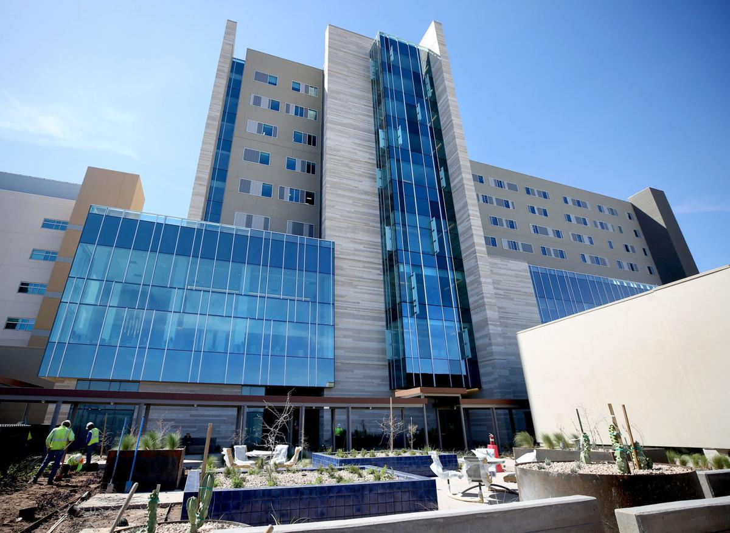
Gokhan Kuyumcu, MD, Charles Hennemeyer M.D., Quinlan Carlson, Cheyenne Moffet, Diana Palacio M.D
University of Arizona
Tucson Arizona

Slide 3
Disclosures
No Relevant Financial Disclosures.

Slide 4
Objective
Main Objective: Evaluate the signal characteristics of biopsy proven pulmonary nodules on MRI
Secondary objective: Determine sensitivity and specifity of different sequences in determining malignant potential of pulmonary nodules.

Slide 5
Materials and Methods
2360 patients who underwent lung nodule biopsy from 1/2014 to 1/2019
184 =>> MRI of the chest or abdomen (if the biopsied nodule was visible) and
biopsy results available.
136 patients => T1, T2 and normalized T1 and T2 values
127=>> Diffusion sequence available

Slide 7
Statistical Method
Correlation (Spearman rho) analyses were performed. All predictors that exhibited moderate correlation (p<0.1) were included in a multivariable logistic regression model with stepwise selection of predictors and with pathology as the outcome.
Effects associated with p<0.05 were considered statistically significant.
A multivariable logistic regression model with Firth’s bias correction was used to construct the receiver operating characteristic (ROC) curve, from which the area under the curve (AUC) along with the 95% Wald’s confidence limits (CL) were obtained.
Hosmer-Lemeshow goodness of fit tests were performed.

Slide 8
Results
Median age: 64 (47-72.5) years
Median size: 1.8 (1.2-2.2) cm

Slide 9
Results
Diffusion restriction was positively correlated with malignancy: rho=-0.341; p<0.001
Nodule-to-muscle ratio of the delayed phase T1 VIBE was positively correlated with malignancy: rho=0.257; p=0.012
Nodule-to-muscle ratio of T2 SPAIR and T1 VIBE – precontrast were marginally correlated with malignancy: rho=0.161; p=0.067, rho=0.148; p=0.089 respectively

Slide 10
Multivariate Regression Model
A multivariable logistic regression model with stepwise selection identified:
Diffusion (p=0.011),
2. Nodule-to-muscle ratio of precontrast T1 VIBE (p=0.01)
3. Nodule-to-muscle ratio of T2 SPAIR (p=0.051) as predictors of malignancy.

Slide 11
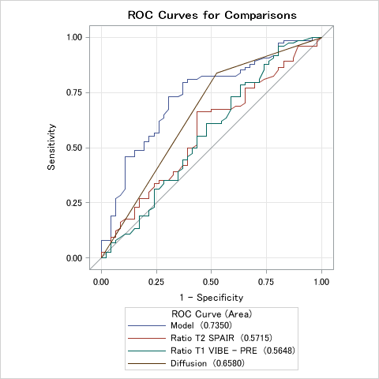
ROC Curves for MCR Model

Slide 12
Case 1
46 years old male, weight loss, muscle weakness. Left upper pulmonary nodules noted on Chest X-ray.

Slide 13
T1
T1 FatSat
T2
SPAIR
T1 Post
ADC
Diffusion

Slide 14
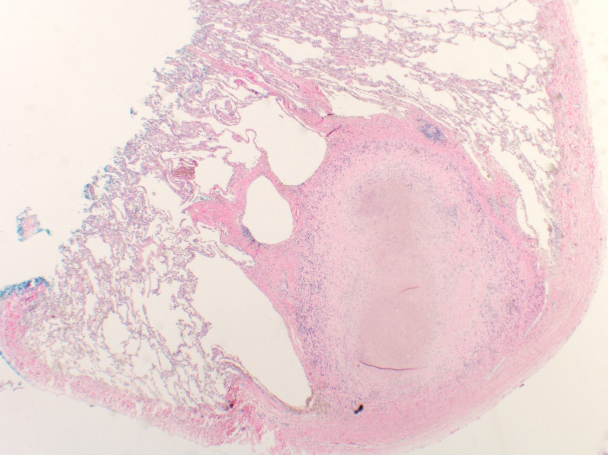
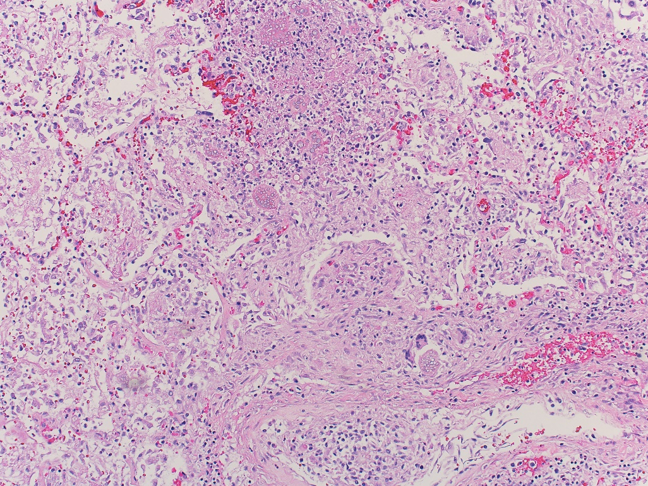
20x
100x
200x

Slide 15
Result: Cocci infection
Radiology: Right upper lobe nodule showing Left upper lobe nodule with intrinsic T1 hyperintensity, T2 hypointensity, no significant contrast enhancement, or diffusion restriction.
Pathology: A solid, well-circumscribed, subpleural granuloma with central necrosis typical of pulmonary coccidioidomycosis. At higher magnification, the mature organism can be identified as a large spherule, ranging in size from 30-100 μm, filled with numerous small endospores. This spherule is associated with several multi-nucleated giant cells.”

Slide 16
Case 2
62 years old male with right sided nephrectomy, Abdominal MRI for follow up

Slide 17
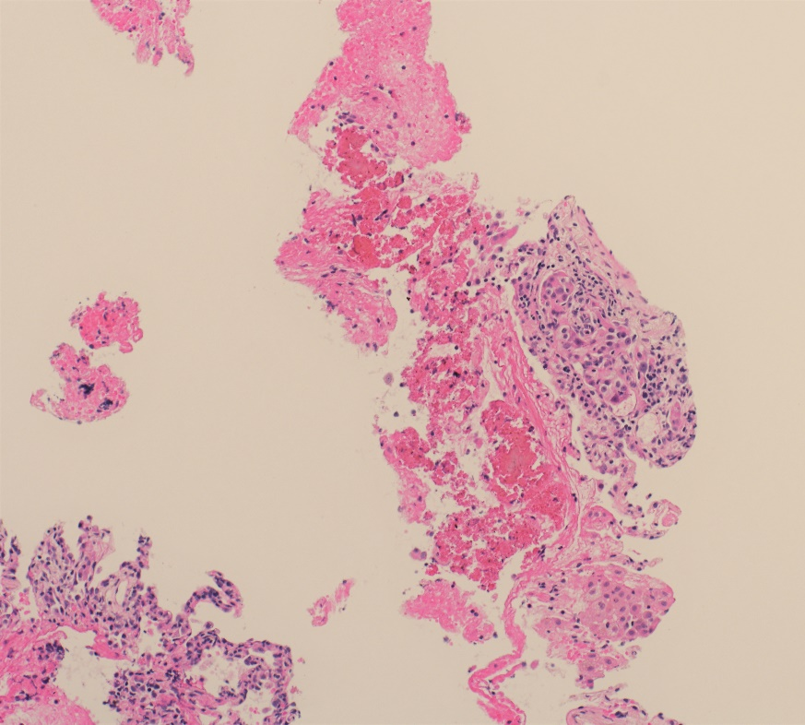
T2
Arterial
20x
o
o
Diffusion
ADC
200x
o
o

Slide 18
Results: Metastatic renal cell carcinoma.
Radiology Images: Left lower lobe nodule with T2 hyperintensity, post contrast enhancement, and diffusion restriction.
Pathology Images: Left lower lobe biopsy shows renal cell carcinoma metastasis with a focus of atypical, poorly differentiated cells with focal clear cell features and prominent nucleoli on higher magnification.

Slide 19
Case 3
64 years old female with shortness of breath, clinical concern for PE

Slide 20
T2
Diffusion
T1
Post
CT

Slide 21
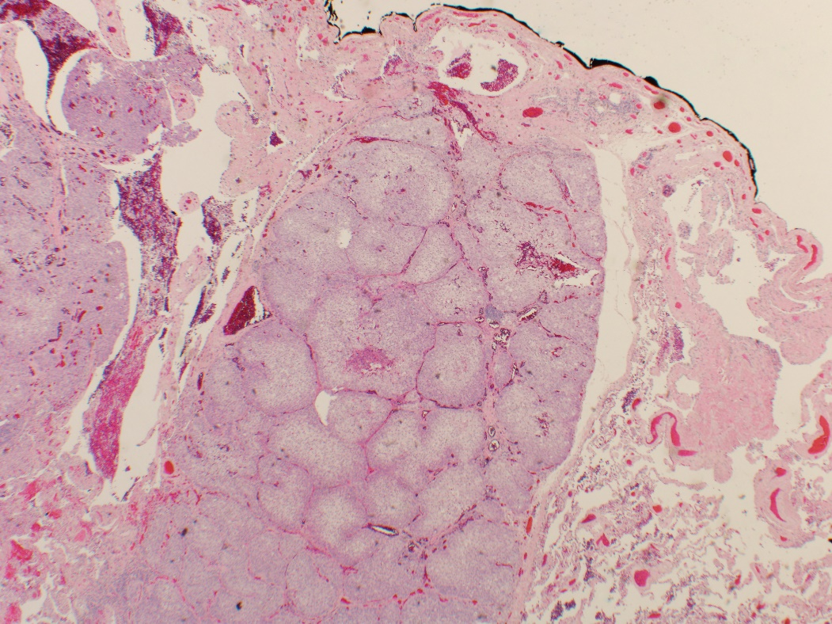
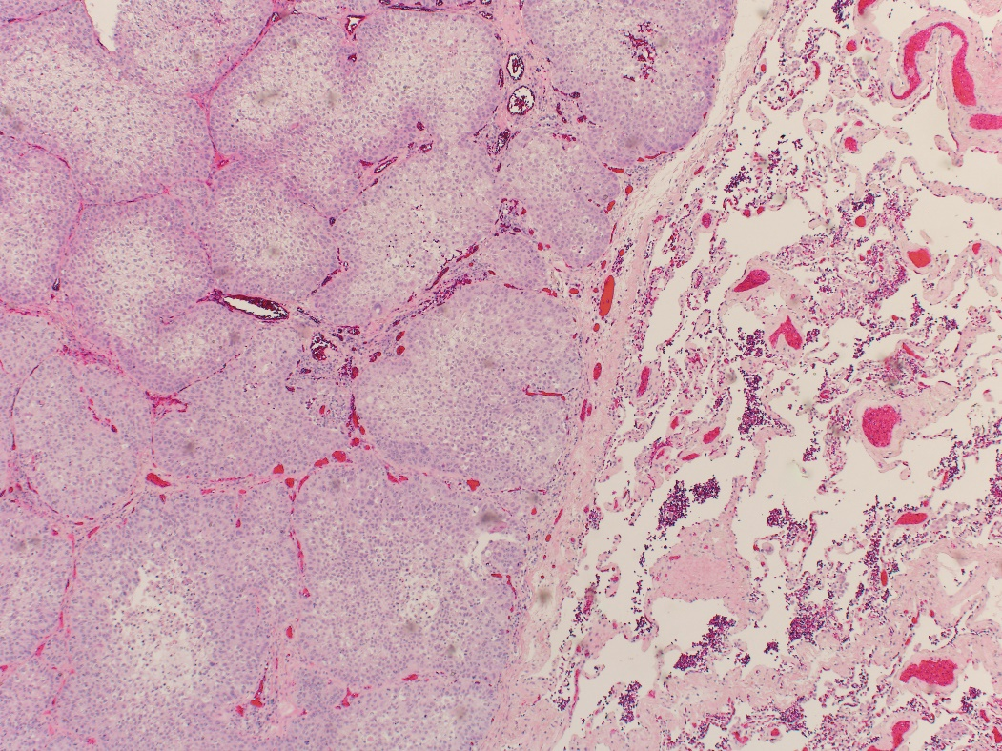
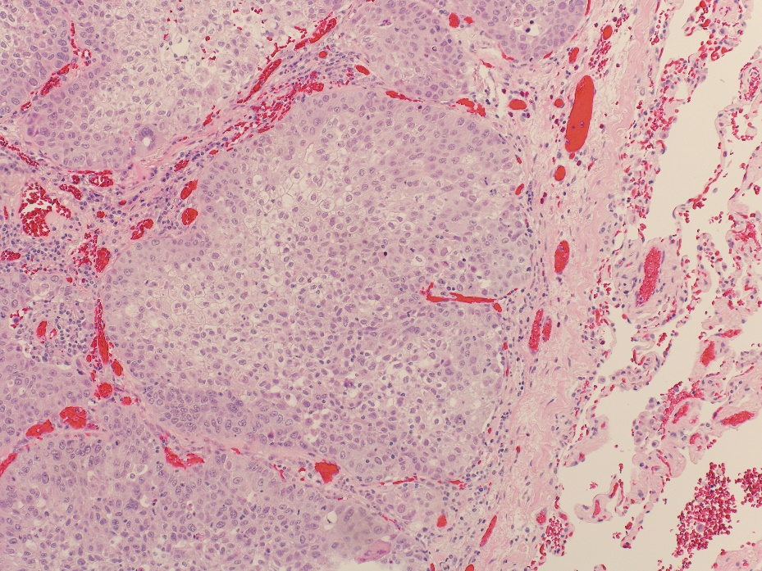
20x
100x
200x

Slide 22
Results: Metastatic renal cell carcinoma.
Radiology Images: Left lower lobe nodule with T2 hypointensity, post contrast enhancement, and diffusion restriction.
Pathology Images: Primary lung squamous cell carcinoma. Invasive squamous cell carcinoma of the lung shows large, epithelioid cells, abundant cytoplasm, minimal keratinization and distinct cell borders. The cells are arranged in nests and the nuclei are pleomorphic with prominent nucleoli.

Slide 23
Case 4
71 years old female with colorectal CA, lost to follow up. Abdominal MRI for Abdominal Pain

Slide 24
T1
Arterial Post
Venous Post
Diffusion
ADC

Slide 25
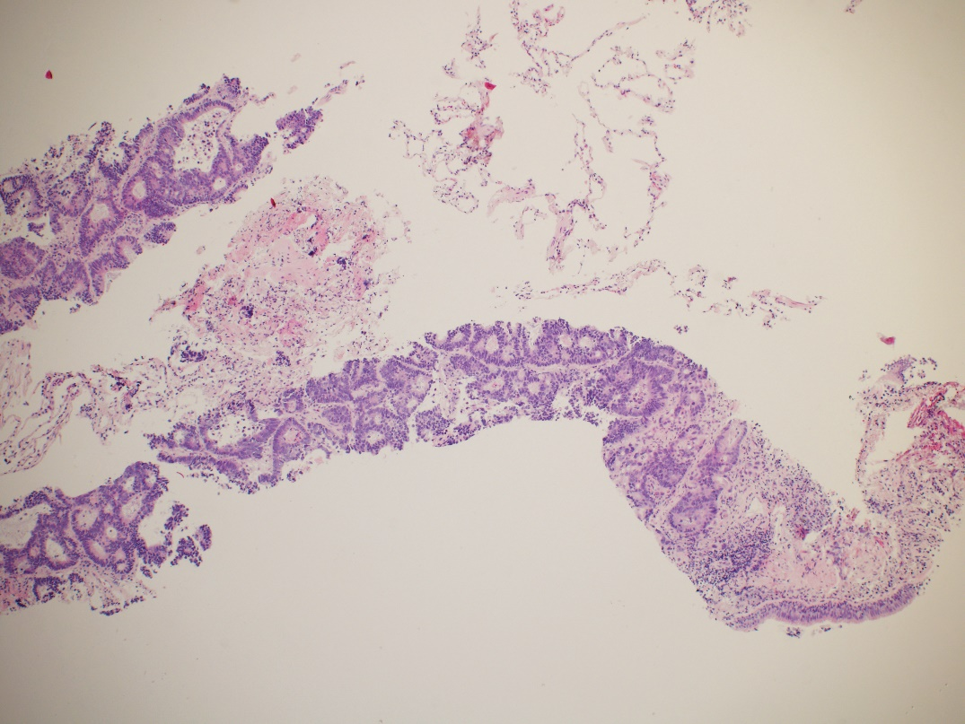
20x
200x

Slide 26
Result: Colorectal Ca Metastasis
Radiology: Right lower lobe nodule with increased T1 signal, arterial and venous post contrast enhancement, more pronounced on venous phase and diffusion restriction.
Pathology: Biopsy of a colonic adenocarcinoma metastasis within the lung. The cells form a cribriform and glandular pattern, with distinct nuclear pleomorphism.”

Slide 27
Suggested Reading
1. Kurihara Y, Matsuoka S. et al. American Journal of Roentgenology 2014 202:3, W210-W216
2. Henzler T, Schmid-Bindert G, Schoenberg SO, Fink C. Diffusion and perfusion MRI of the lung and mediastinum. Eur J Radiol 2010; 76:329–336
3. Biederer J, Hintze C, Fabel M. MRI of pulmonary nodules: technique and diagnostic value. Cancer Imaging. 2008;8(1):125–130. Published 2008 May 19. doi:10.1102/1470-7330.2008.0018

Slide 28
Presenting Author:
Gokhan Kuyumcu, M.D.
Diagnostic Radiology Resident
1501 N. Campbell Avenue
PO Box 245067
Tucson, AZ.
gokhankuyumcu@gmail.com

