Slide 1
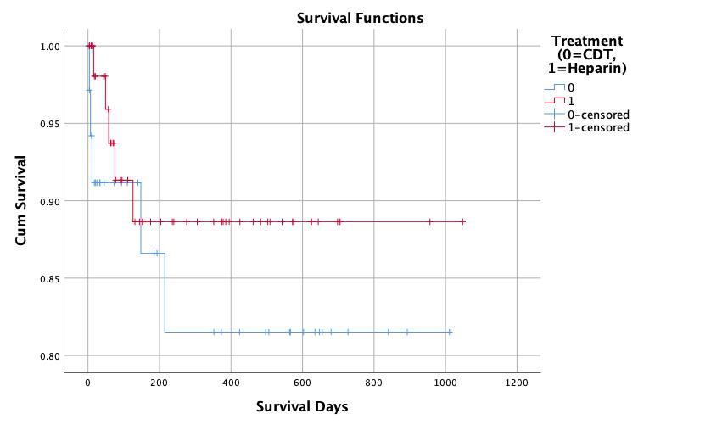
Survival Analysis Outcomes of Catheter Directed Therapy of Submassive Pulmonary Embolism
Abdul Khan, MD, Lorela Weise, BS, Gregory Woodhead, MD, PhD, Hugh McGregor, MD, Mikin Patel, MD, MBA, Charles Hennemeyer, MD
University of Arizona - Department of Medical Imaging, Department of Interventional Radiology
Purpose
Case Visuals
Conclusion
A
B
C
The implementation of catheter-directed treatment (CDT) of submassive pulmonary embolus (PE) including mechanical aspiration thrombectomy and/or ultrasound-assisted thrombolysis requires analysis of outcomes regarding mortality and survival analysis. The purpose of this study was to perform a survival analysis on submassive patients treated with CDT and compare the analysis to a matched cohort on patients treated with anticoagulation.
Previous conventional thought was that catheter intervention improves outcomes closer to treatment; however, our analysis demonstrates similar survival probabilities over three years. Further investigation is prompted given our small sample size. A more developed Kaplan Meier curve may be formed as patients are followed for 5-10 years, allowing as well for more accurate survival analysis. Given the study involved submassive patients, the impact of CDT may not be in survival analysis but may be in the changes in quality of life and prevention of right heart dysfunction.
A
B
C
Materials
Figure 1. Kaplan Meier Curve demonstrating survival analysis curve of subjects with submassive pulmonary embolism treated with anticoagulation and those treated with anticoagulation and catheter directed treatment. Log rank test was performed with p value > 0.05, suggesting no statistically significant difference.
References
A retrospective study approved by the institutional review board to investigate patient outcomes of catheter-based therapies of submassive PEs in comparison to patients treated solely with anticoagulation was performed. Data was tracked over three years and used to perform survival analysis and create Kaplan Meier curves using SPSS.
Over three years, our analysis included 93 submassive patients. There were 36 treated with CDT plus anticoagulation and 57 patients treated with anticoagulation alone. Overall, both groups demonstrated relatively high survival rates over the course of three years. The CDT group survival probability decreased to 82% over three years, while the survival probability of the anticoagulation group decreased to 88%. Both shared a >90% higher survival probability in the first 100 days, then dropping to
Jaff MR, Mcmurtry MS, Archer SL, et al. Management of massive and submassive pulmonary embolism, iliofemoral deep vein thrombosis, and chronic thromboembolic pulmonary hypertension: a scientific statement from the American Heart Association. Circulation. 2011;123(16):1788-830.
Kuo WT, Banerjee A, Kim PS, et al. Pulmonary Embolism Response to Fragmentation, Embolectomy, and Catheter Thrombolysis (PERFECT): initial results from a prospective multicenter registry. Chest. 2015;148(3):667–673.
Kuo WT, Sista AK, Faintuch S, et al. Society of Interventional Radiology Position Statement on Catheter-Directed Therapy for Acute Pulmonary Embolism. J Vasc Interv Radiol. 2018;29(3):293-297.
Results

