Slide 1
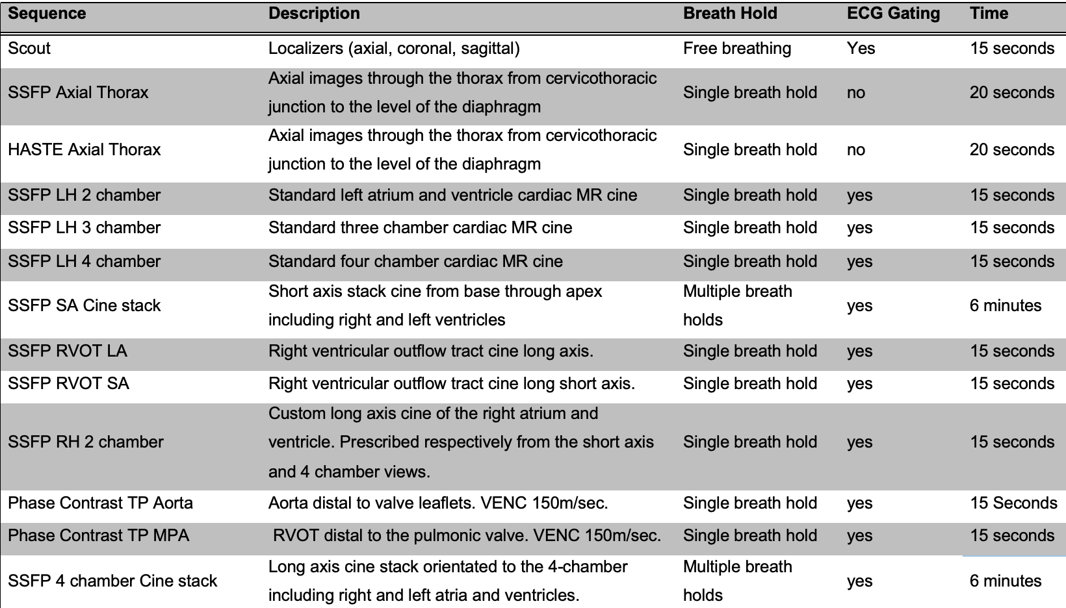
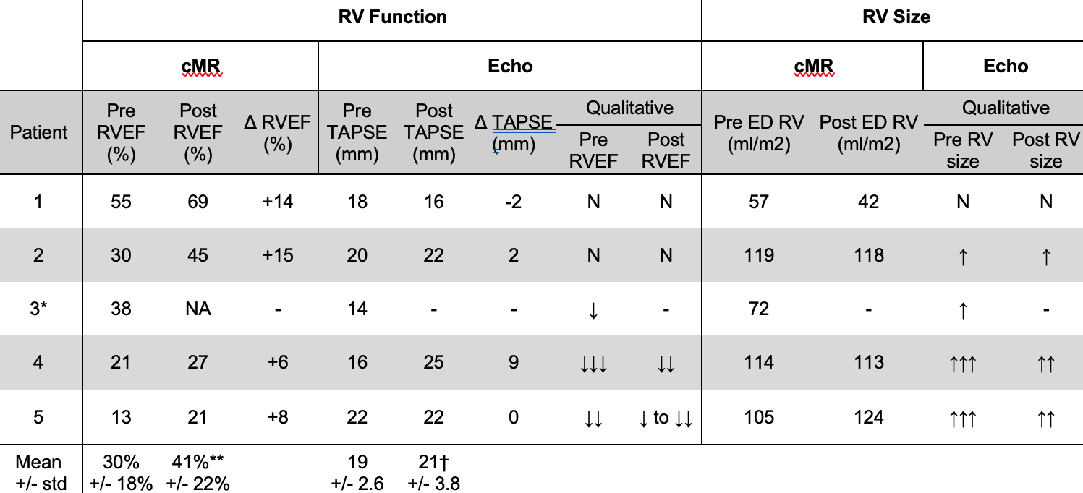
Fast Scan Cardiac MRI in Patients with Acute Pulmonary Embolism Undergoing Catheter Directed Therapy
Matt LeComte, MD, PhD, Abdul Khan, MD, Gregory Woodhead, MD, PhD, Diana Palacio, MD, Kavita Yaddanpudi, MD, Ryan Avery, MD, Hugh McGregor, MD, Mikin Patel, MD, MBA, Charles Hennemeyer, MD
University of Arizona - Department of Medical Imaging, Department of Interventional Radiology
Purpose
Results
Results
CT Pulmonary Angiography (CTPA) and transthoracic echocardiogram (TTE) are the widely accepted imaging modalities for the detection and assessment of Pulmonary Embolism (PE) severity; however, CTPA and TTE have limitations when evaluating Right Ventricular (RV) function. Catheter Directed Therapy (CDT) in the form of thrombectomy/thrombolysis is a novel therapeutic option for patients with large clot burden and right ventricular dysfunction. In order to appropriately select patients who could benefit from CDT and monitor therapeutic outcomes, accurate estimates of RV function is necessary. The purpose of this study was to create an abbreviated cardiac magnetic resonance imaging (CMR) protocol on patients suffering from submassive PE that could be safely performed to accurately assess pulmonary flow, right ventricular size and function.
There were no adverse clinical events during CMR and no aborted scans (n = 9 scans, 5 patients). The studies required no sedation or gadolinium administration. The mean scan time was 32 minutes with a standard deviation of 14 mins. The images obtained in all nine scans were of good quality and suitable for post-procedural analysis of right heart function. The patients who underwent CDT (n = 4) had CMR performed before and after the procedure. The mean time from CDT to post procedural CMR was 60 hours (n = 4 patients). Quantitative measurements of RV volume, RV function and pulmonary flow were obtained on all CMRs, in contrast to TTE where only qualitative measures of RV size and function were obtained.
"SSFP" Steady State Free Procession, "HASTE" Half-Fourier Acquisition Single-shot Turbo spin Echo, "EKG" Electrocardiogram, "LH" Left Heart, "SA" Short Axis, "RH" Right Heart, "LA" Long Axis, “TP” Through-Plane, “MPA” Main Pulmonary Artery
Table 1. Summary of Abbreviated Non-contrast enhanced Cardiac MRI.
The CMR protocol utilizes 13 EKG-gated pulse sequences. The initial three sequences are for localization of the cardiac anatomy with performance of both SSFP and HASTE sequences for bright blood and dark blood imaging, respectively. The subsequent group of EKG-gated cine SSFP images are performed for visualization of the heart in routine long and short-axis views. The short-axis cine SSFP images are acquired as a stack covering both ventricles from base to apex to allow for post-processing quantification of ventricular volume and function. Through-plane phase contrast sequences are performed perpendicular to long axis of both the aortic root and proximal main pulmonary artery for flow quantification. Axial SSFP images through the thorax are acquired to evaluate pulmonary artery clot burden.
Key notations: “*” annotates the RV and “◇” the RA.
Figure 1 . Representative images of TTE 4 chamber cine (A) and CMR four chamber SSFP cine (B). CMR has superior anatomical detail of the RV and RA compared to TTE (B vs. A). CMR short axis stack cine at end diastole from a patient with submassive PE shows a flattened interventricular septum, a result of increased RV pressure (C, white arrow). Panel D shows a CMR 2 chamber SSFP cine designed to evaluate the right heart.
Conclusion
An abbreviated CMR protocol on patients suffering from submassive PE can be safely performed to accurately assess pulmonary flow parameters, right ventricular size and function before and after CDT. In addition, the longitudinal data provided by CMR may aid in predicting clinical outcomes of CDT.
Material & Methods
We performed a study testing an abbreviated, non-contrast, CMR protocol with the objective of assessing clinical safety, technical feasibility, and quality of the protocol. The study evaluated patients with acute submassive PE both before and after CDT. Additionally, we performed a qualitative and quantitative analysis of CMR right heart function as well as analysis of pulmonary flow data with comparison of data obtained with TTE both before and after CDT.
References
Values with the units ml/m2 are indexed to body surface area. Key: "AN" = abnormal, "ED" = End Diastole, "ES" = End Systole, "EF" = Ejection Fraction, "N" = within normal limits, "Pre" = Before CDT, "Post" = following CDT, "TAPSE" = Tricuspid Annular Plane Systolic Excursion, "↓" = mildly reduced, "↓↓" = moderately reduced, "↓↓↓" = severely reduced, "↑" = mildly increased, "↑↑" = moderately increased, "↑↑↑" = severely increased. *Did not proceed to CDT: no post-CDT values. **paired Student’s T-test, p = 0.016. † paired Student’s T-test, p = 0.41.
Table 2. Targeted CMR and transthoracic echocardiogram measures of right ventricular (RV size) and function before and after catheter directed therapy (CDT)
Figure 2. Main Pulmonary Artery Flow Data.
Main pulmonary artery flow data from patients 1,2,4,5 (rows) with sub massive pulmonary embolism derived from velocity-encoded cMR sequences both pre-CDT (blue lines) and post-CDT (orange lines). Net flows (left column) and mean flow plots versus points across the R-R interval. Note the late-systolic “notch” in the pre-CDT waveform; not present on the post-CDT waveform.
Piazza G, Goldhaber SZ. Management of submassive pulmonary embolism. Circulation. 2010;122(11):1124-9.
Jeff MR, Mcmurtry MS, Archer SL, et al. Management of massive and submassive pulmonary embolism, iliofemoral deep vein thrombosis, and chronic thromboembolic pulmonary hypertension: a scientific statement from the American Heart Association. Circulation. 2011;123(16):1788-830.
Kucher N, Rossi E, De rosa M, Goldhaber SZ. Massive pulmonary embolism. Circulation. 2006;113(4):577-82.
Goldhaber SZ, Visani L, De rosa M. Acute pulmonary embolism: clinical outcomes in the International Cooperative Pulmonary Embolism Registry (ICOPER). Lancet. 1999;353(9162):1386-9.
Konstantinides SV, Torbicki A, Agnelli G, et al. 2014 ESC guidelines on the diagnosis and management of acute pulmonary embolism. Eur Heart J. 2014;35(43):3033-69, 3069a-3069k.
Kucher N, Boekstegers P, Müller OJ, et al. Randomized, controlled trial of ultrasound-assisted catheter-directed thrombolysis for acute intermediate-risk pulmonary embolism. Circulation. 2014;129(4):479-86.
Piazza G, Hohlfelder B, Jaff MR, et al. A Prospective, Single-Arm, Multicenter Trial of Ultrasound-Facilitated, Catheter-Directed, Low-Dose Fibrinolysis for Acute Massive and Submassive Pulmonary Embolism: The SEATTLE II Study. JACC Cardiovasc Interv. 2015;8(10):1382-92.
Kuo WT, Banerjee A, Kim PS, et al. Pulmonary Embolism Response to Fragmentation, Embolectomy, and Catheter Thrombolysis (PERFECT): Initial Results From a Prospective Multicenter Registry. Chest. 2015;148(3):667-73.

